Slide 1
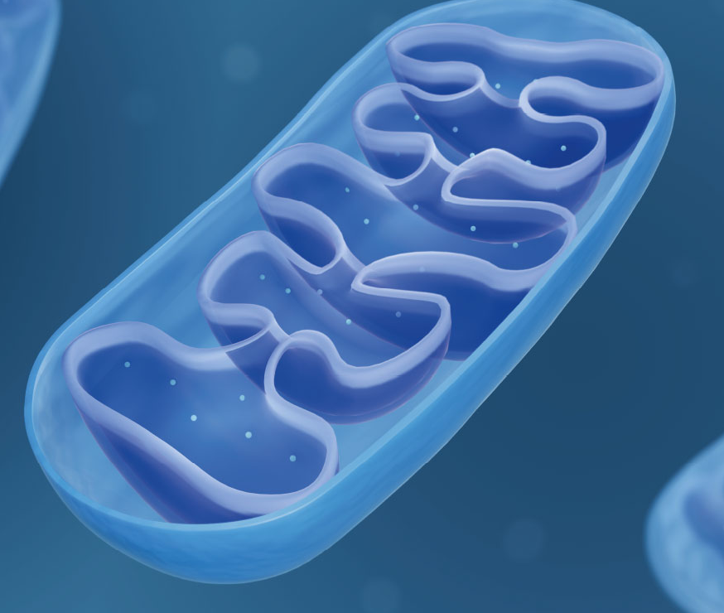

Supporting the Health of Mitochondria
Presented by Ray Griffiths
Confidential, not to be copied shared or disclosed, copyright Lamberts Healthcare Limited

Slide 2
What We’re Covering Today
The evolution of mitochondria - endosymbiosis
How mitochondria work
Mitochondria and longevity
Diet and supplements to support mitochondria
Mitochondria and health issues
The retrograde response - how mitochondria work with nuclear DNA to support longevity and mitochondrial health.

Slide 3

An event that happened only once in
4 billion years, has made all complex life, and our very existence possible

Slide 4
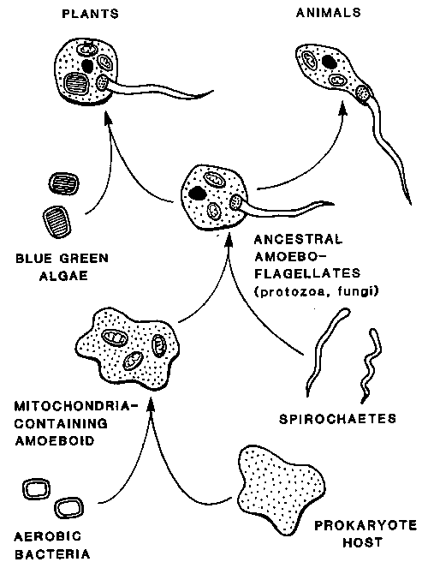
Endosymbiosis The Evolution of Alphaproteobacteria into Mitochondria
Endosymbiosis
“Becoming by living together”
CYANOBACTERIA
ALPHAPROTEOBACTERIA
ARCHAEA
Masumoto, P. A., 2022. Tablo Pty Ltd.

Slide 5
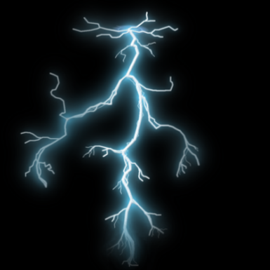
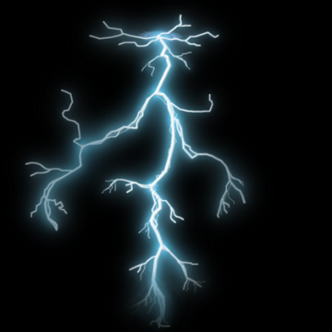
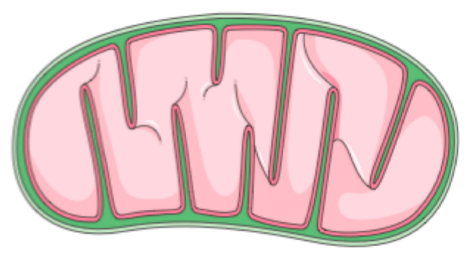
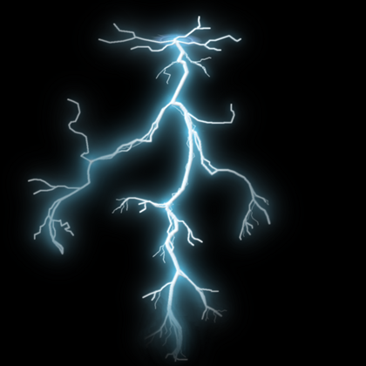
Endosymbiosis The Evolution of Alphaproteobacteria into Mitochondria
5
Endosymbiosis gave eukaryotes (animals, plants and fungi) 1000s of times more ATP per gene compared to bacteria and archaea
More energy per gene = greater ability to support the huge number of proteins required for complex life
Lane, N., 2017. Serial endosymbiosis or singular event at the origin of eukaryotes?. Journal of theoretical. biology, 434, pp.58-67.

Slide 6
Endosymbiosis The Evolution of Alphaproteobacteria into Mitochondria
We are powered by trillions of bolts of lightning – every single moment of our lives!
Charge across mitochondrial membrane = 150 millivolts over 6 nanometres
Equates to 30 million volts per metre or a bolt of lightning!
Lane, N., 2015. The vital question: energy, evolution, and the origins of complex life. WW Norton & Company.

Slide 7
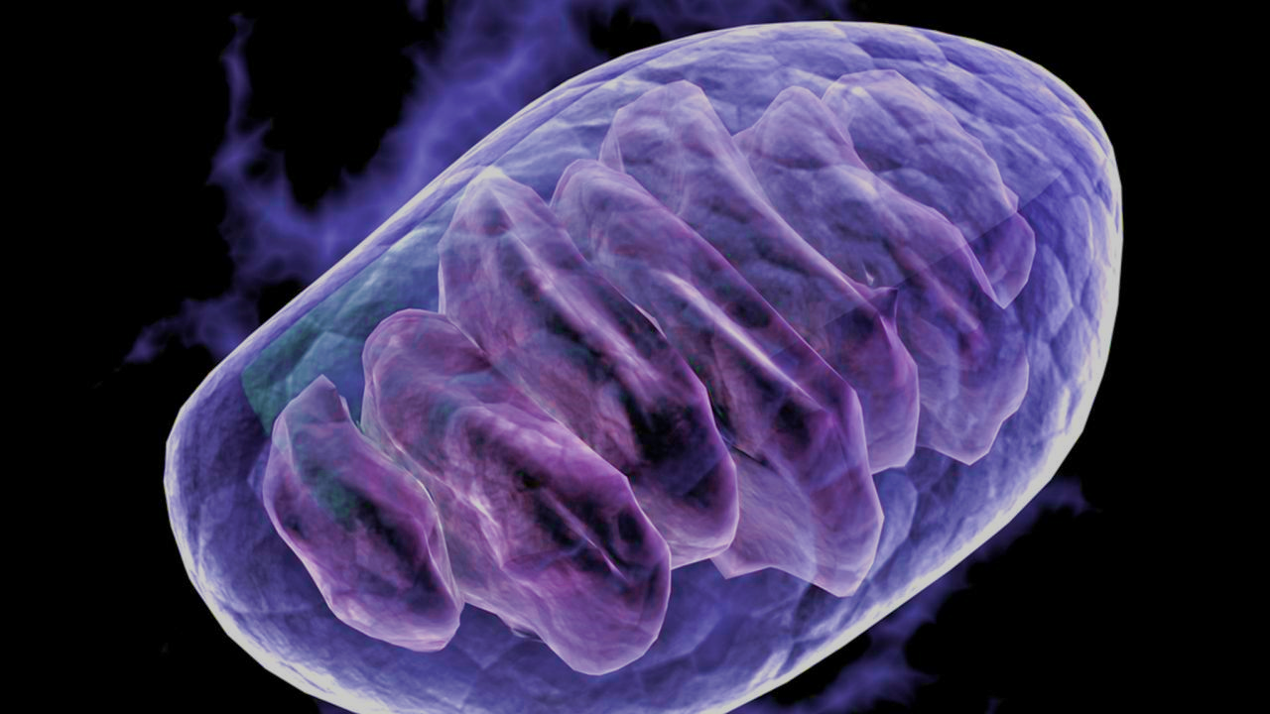
Confidential, not to be copied shared or disclosed, copyright Lamberts Healthcare Limited
The name mitochondrion was coined in 1898 by microbiologist Carl Benda (1857-1933), from the Greek mitos “thread” and knondrion “little granule”

Slide 8
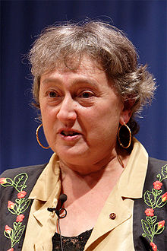
Lynn Margulis, 1938-2011
Her landmark paper “On the Origin of Mitosing Cells" was published in 1967 but was ignored for many years
Richard Dawkins on Lynn Margulis:
I greatly admire Lynn Margulis' sheer courage and stamina in sticking by the endosymbiosis theory, and carrying it through from being an unorthodoxy to an orthodoxy. I'm referring to the theory that the eukaryotic cell is a symbiotic union of primitive prokaryotic cells. This is one of the great achievements of twentieth-century evolutionary biology, and I greatly admire her for it.

Slide 9

We Have 4,000 Trillion Mitochondria!
It is estimated that there are 4,000 trillion mitochondria in the 40 trillion cells that make up the human body.
When laid flat, the combined surface area of mitochondrial membranes would cover roughly four football pitches, or 14,000 square metres.
Wembley Stadium x 4!
Lane N. The vital question : energy, evolution, and the origins of complex life. New York: W. W. Norton & Company; 2015. 360 p.

Slide 10
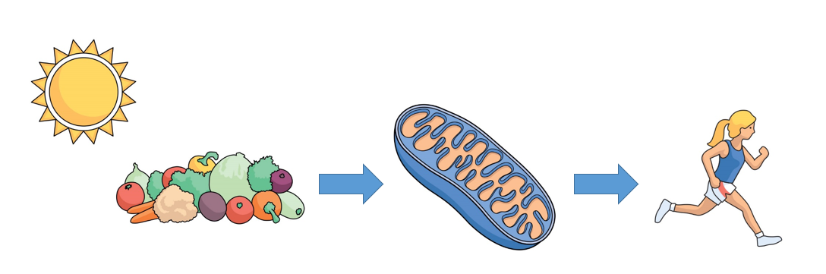
Mitochondria are Effectively Solar Powered!
Energy from photons of sunlight stored in plants through photosynthesis
Sunlight energy from food released within mitochondria
Mitochondria give us our energy
Griffiths, R. (2018) Mitochondria in Health and Disease. Singing Dragon.

Slide 11
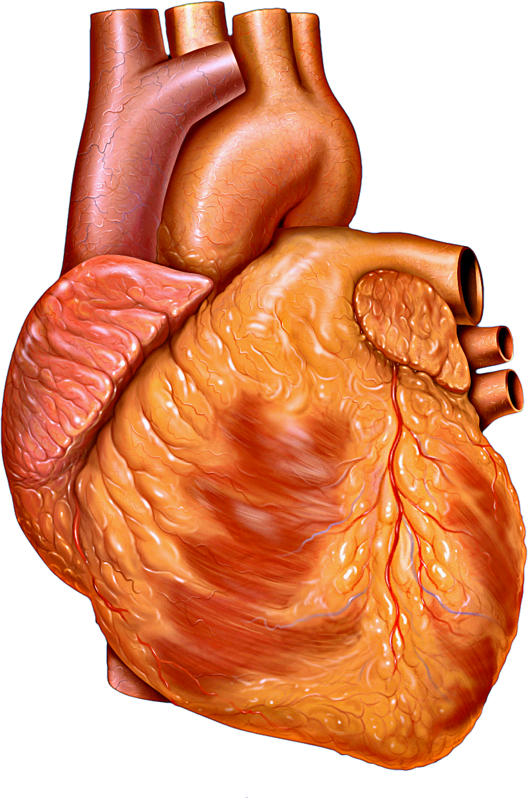
Mitochondrial Facts
The heart is the most energetically demanding organ in the human body. Heart mitochondria turn over 6 kg of ATP each day to meet the requirements of contraction - roughly 15 times the weight of the heart!
Each cardiomyocyte contains between 5,000 and 8,000 mitochondria.
Ritterhoff, J. and Tian, R., 2017. Metabolism in cardiomyopathy: every substrate matters. Cardiovascular research, 113(4), pp.411-421.
Wang X, Zhang X, Wu D, et al. Mitochondrial flashes regulate ATP homeostasis in the heart. Elife. 2017;6:e23908.

Slide 12
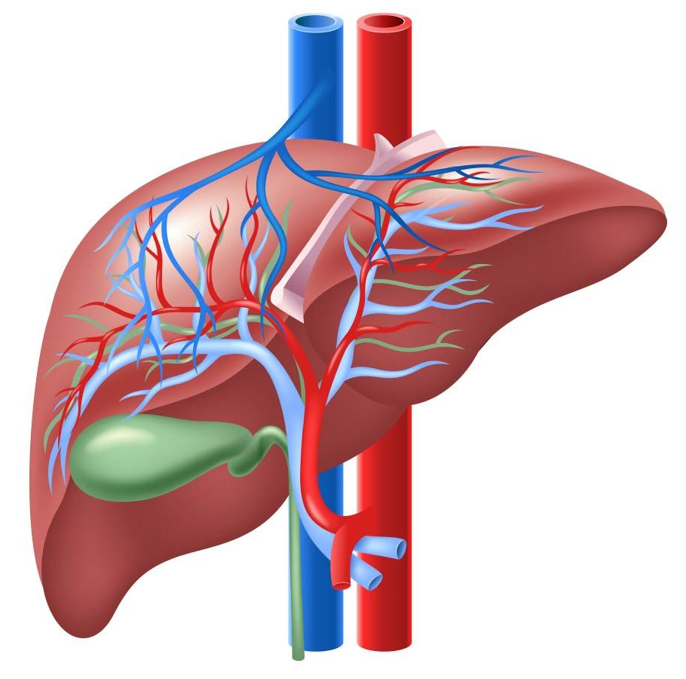
Mitochondrial Facts
In the liver, mitochondria represent almost one-fifth of the volume of hepatocytes…
…(reaching a number of 500 to 4000 per cell), being involved in several key metabolic networks and signaling pathways.
Bellanti F, Lo Buglio A, Vendemiale G. Hepatic Mitochondria-Gut Microbiota Interactions in Metabolism-Associated Fatty Liver Disease. Metabolites. 2023;13(3):322.

Slide 13
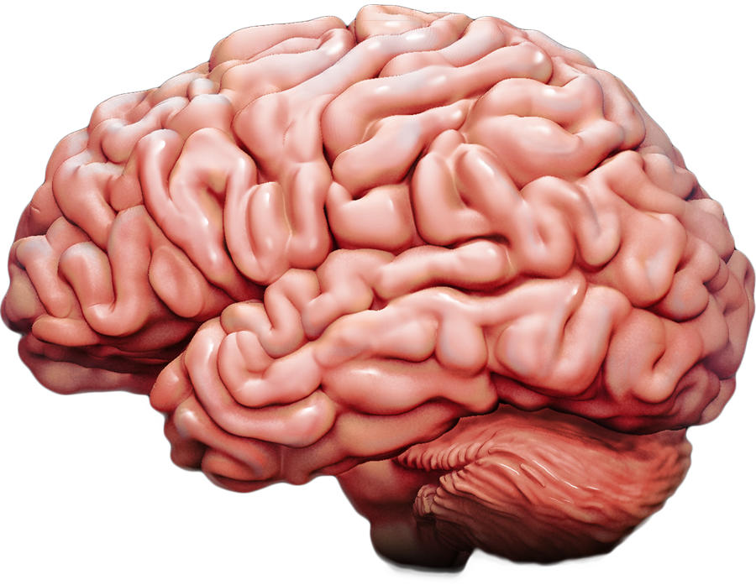
Mitochondrial Facts
In the human brain, individual neurons of the substantia nigra are calculated to give rise to 4.5 m of axon. A similar calculation for cholinergic neurons has predicted that over 100 m of axon can arise from a single cell body
In dopamine producing neurons of the substantia nigra, it is estimated that there are a population of 2 million mitochondria per neuron to fuel the 4.5 m of axon, plus synapses, dendrites and cell body
If applied to cholinergic neurons, this would mean that they would be very likely to contain as many as 40 million mitochondria per neuron!
Misgeld T, Schwarz TL. Mitostasis in Neurons: Maintaining Mitochondria in an Extended Cellular Architecture. Neuron. 2017;96(3):651-666.

Slide 14
Confidential, not to be copied shared or disclosed, copyright Lamberts Healthcare Limited
How Mitochondria Work

Slide 15
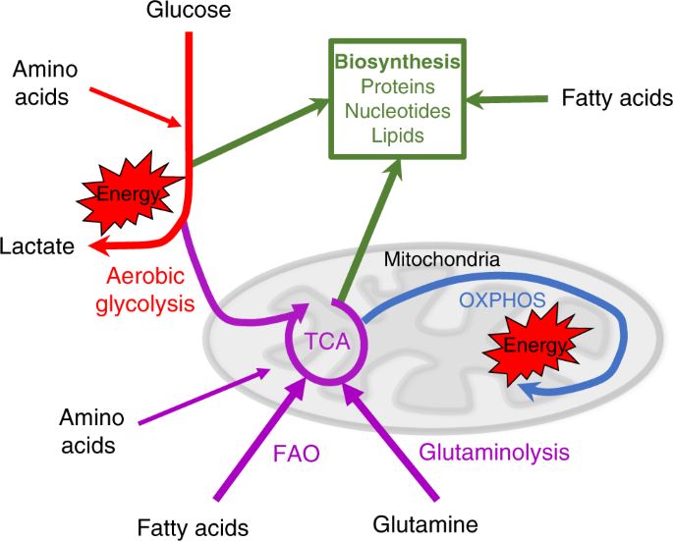
How Mitochondria
Work
Kedia-Mehta N, Finlay DK. Competition for nutrients and its role in controlling immune responses. Nat Commun. 2019;10(1):2123.

Slide 16
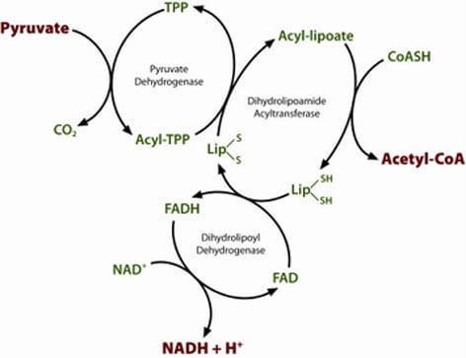
How Mitochondria Work
Transferring energy from carbohydrate into mitochondria requires:
Vitamin B1 - Thiamine - TPP
Vitamin B2 – Riboflavin - FADH
Vitamin B3 – Nicotinamide - NADH
Vitamin B5 – Pantothenic Acid - CoA
Alpha Lipoic Acid
https://www.abcam.com/pyruvate-dehydrogenase-pdh

Slide 17
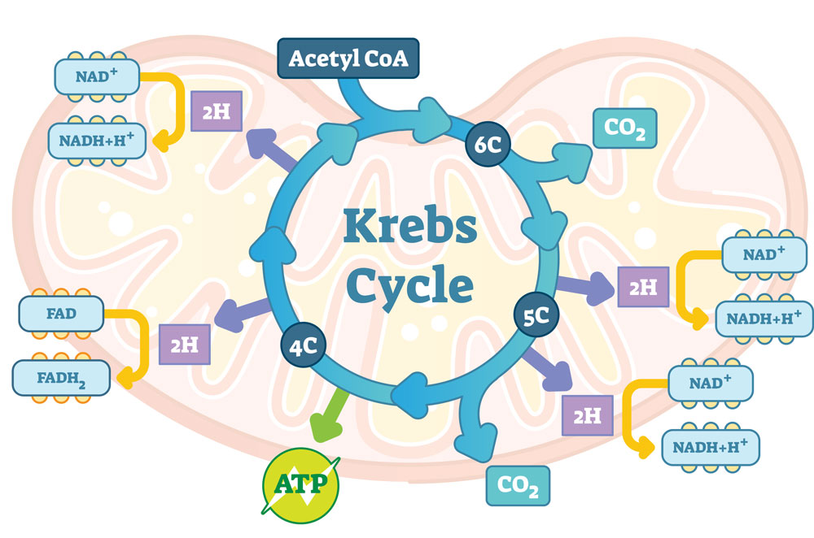
How Mitochondria Work
The first step of energy production within mitochondria involves the Krebs cycle…
aka The Citric Acid Cycle or The Tricarboxylic Acid Cycle.
https://www.teachpe.com/anatomy-physiology/aerobic-system-krebs-cycle

Slide 18
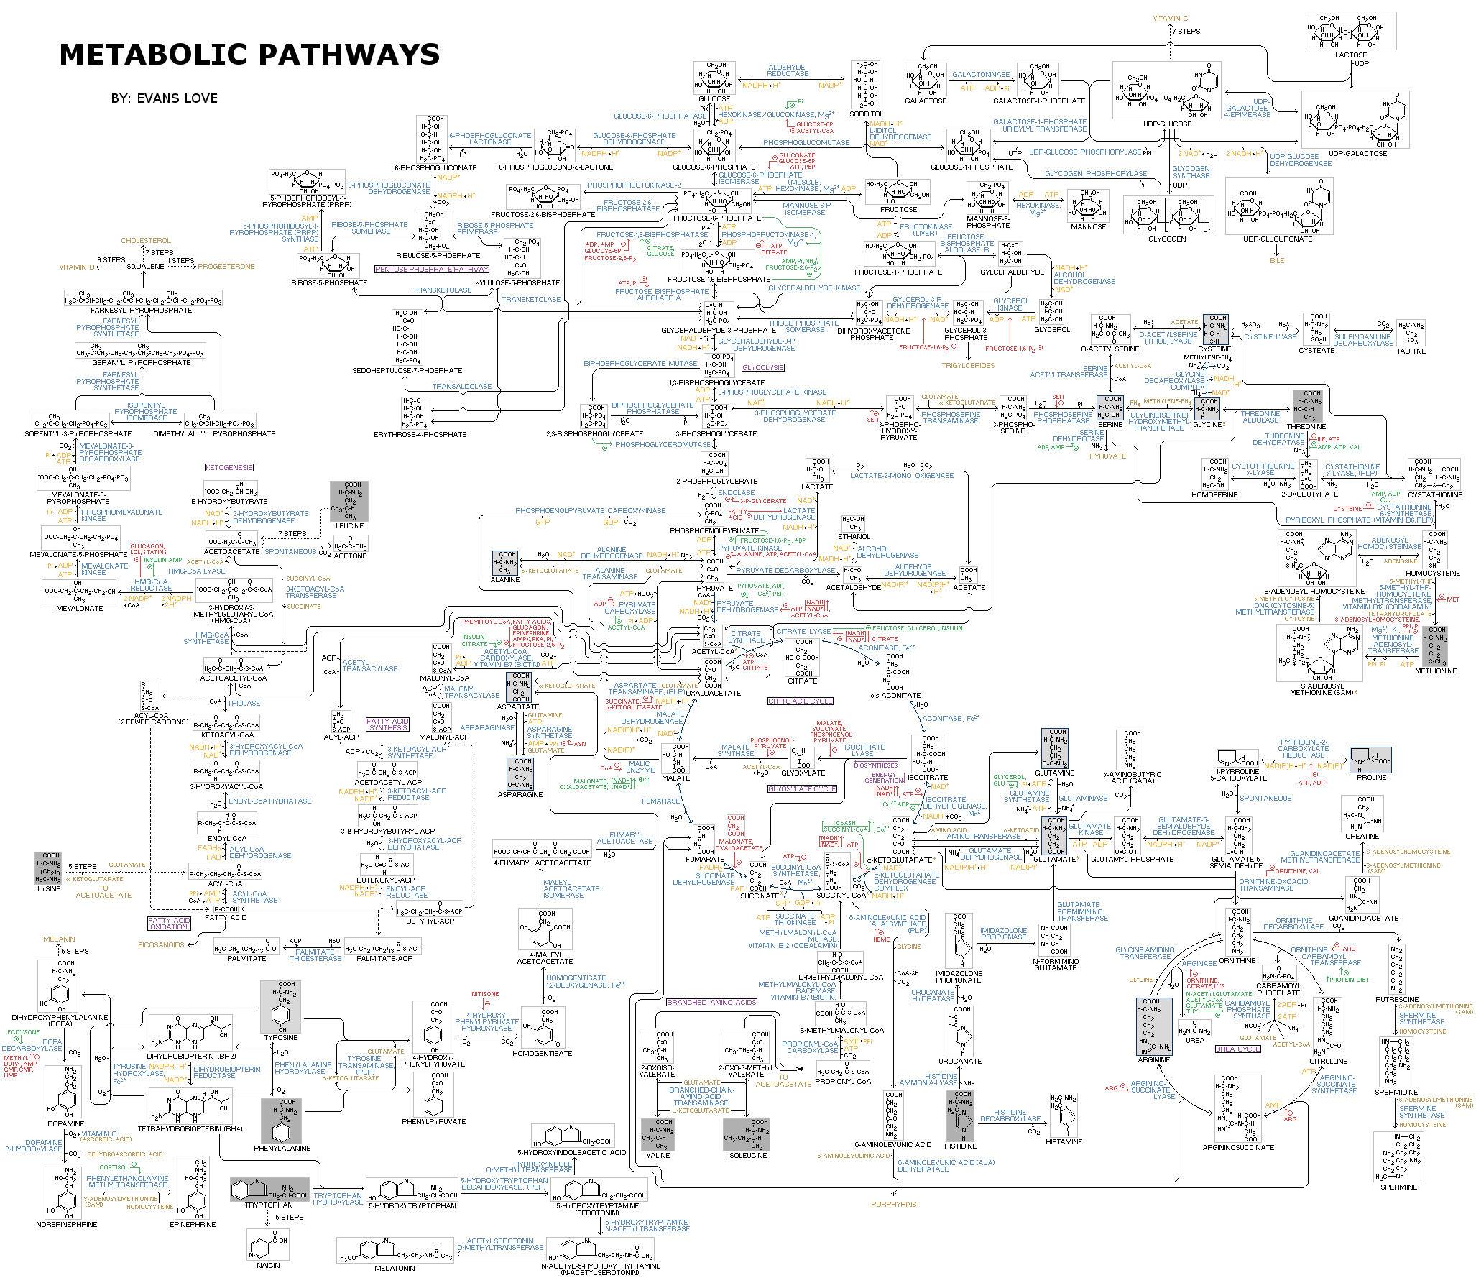
How Mitochondria Work
The Krebs Cycle is at the very heart of all metabolic pathways
https://upload.wikimedia.org/wikipedia/commons/a/a8/Human_Metabolism_-_Pathways.jpg

Slide 19
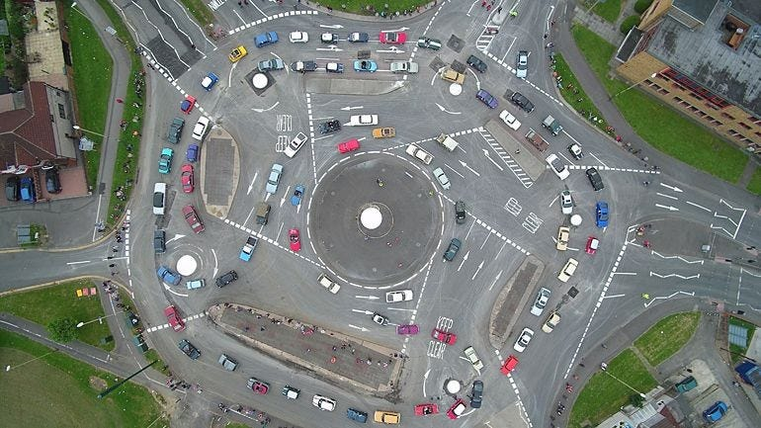
How Mitochondria Work
As an analogy, the Krebs Cycle could be viewed as a complex roundabout, with traffic entering and departing from all directions!
The Magic Roundabout in Swindon

Slide 20
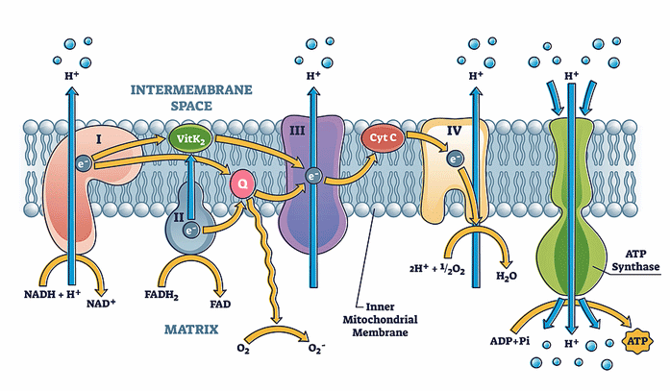
How Mitochondria Work
The Electron Transport Chain - high energy electrons (sunlight energy) from NADH and FADH, are released into complex I to IV of the electron transport chain
This energy is used to pump protons into the intermembrane space
The protons then re-enter the matrix through ATP synthase, to produce ATP.
https://www.healthrising.org/blog/2022/03/27/novel-approach-mitochondria-chronic-fatigue-syndrome/

Slide 21
Confidential, not to be copied shared or disclosed, copyright Lamberts Healthcare Limited
Mitochondria and Longevity

Slide 22
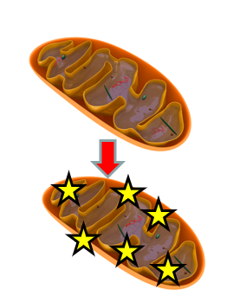
Unhealthy Mitochondria can Accelerate Ageing
Mitochondria are considered to be the main source of ROS in a cell
Oxidative stress within mitochondria leads to mtDNA mutations, reduced ATP and energy
Mitochondrial dysfunction leads to apoptosis (programmed cell death)
Mitochondrial dysfunction is linked to MS, Alzheimer’s disease as well as Parkinson’s disease, and many chronic inflammatory diseases.
Nissanka N, Moraes CT. Mitochondrial DNA damage and reactive oxygen species in neurodegenerative disease. FEBS Lett. 2018;592(5):728-742.

Slide 23
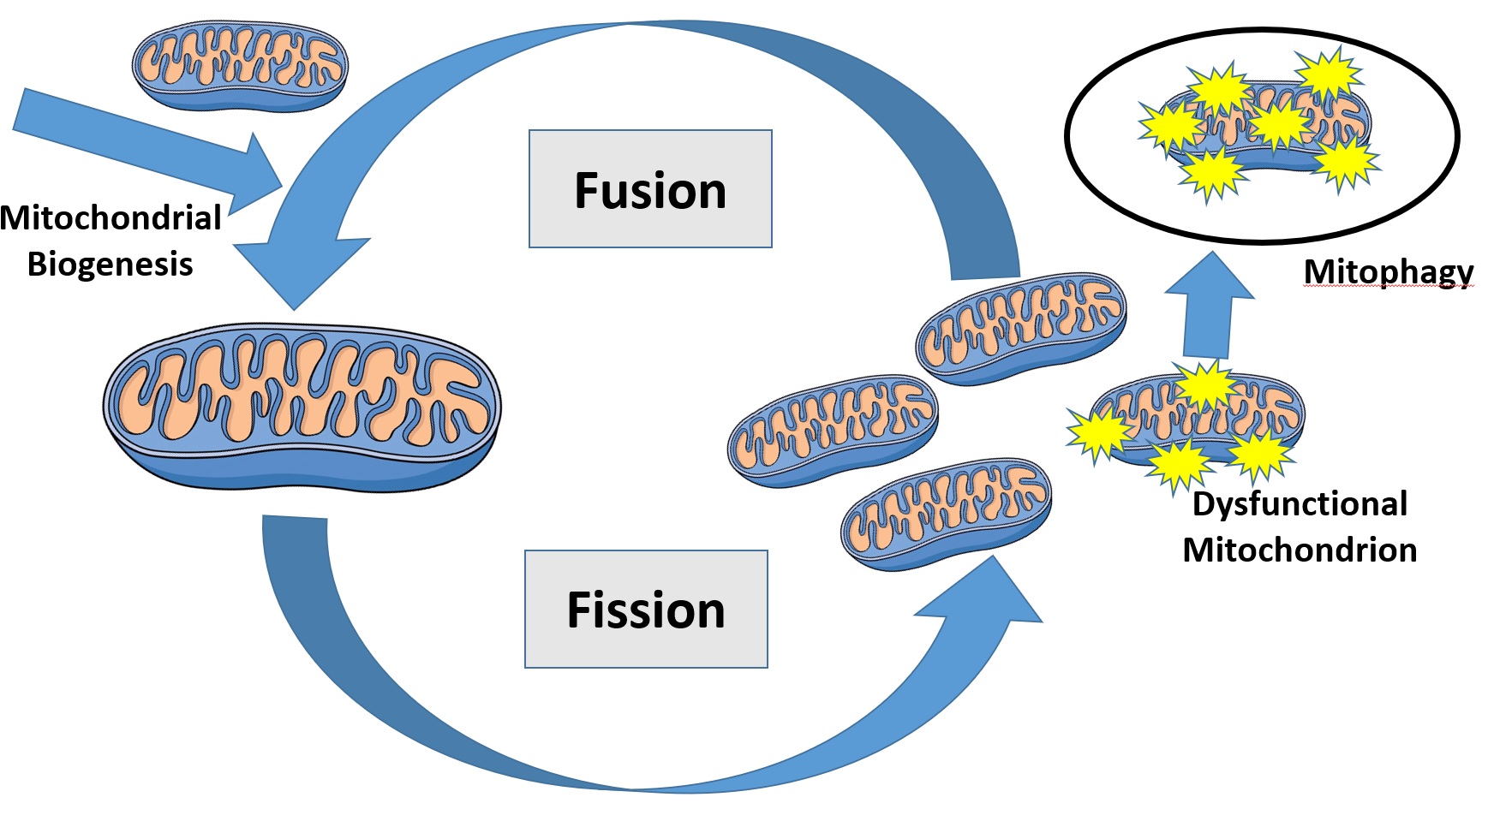
Mitochondrial Quality and Ageing Life Cycle and Quality Control Mechanisms of Mitochondria
Fission and fusion are required to maintain mitochondrial balance
Fission allows for degradation of worn mitochondrial components and for the reusing of functional mitochondria components
Fusion allows recycled mitochondria to fuse with newly synthesised mitochondria to increase mitochondrial mass.
Griffiths, R. (2018) Mitochondria in Health and Disease. Singing Dragon.

Slide 24
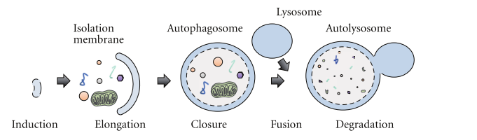
Mitochondrial Quality and Ageing
Mitophagy - mitochondrial ‘house cleaning’
The digestion or ‘self-eating’ of mitochondria
For long living species, like humans, organelle recycling is vital to maintain integrity
Kanamaru, Y. et al., 2012. The phosphorylation-dependent regulation of mitochondrial proteins in stress responses. Journal of signal transduction, 2012, p.931215.

Slide 25
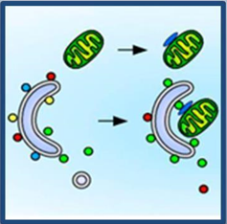
Mitochondrial Quality and Ageing
Mitochondria are digested via mitophagy every few days, to help maintain the quality of the pool
Liver: 1 to 2 days
Heart: 5 to 6 days
Brain and kidneys: 24 days
Miwa, S., Lawless, C., & Von Zglinicki, T. (2008). Mitochondrial turnover in liver is fast in vivo and is accelerated by dietary restriction: application of a simple dynamic model. Aging cell, 7(6), 920-923., Galluzzi, L., Vicencio, J. M., Kepp, O., Tasdemir, E., Maiuri, M. C., & Kroemer, G. (2008). To die or not to die: that is the autophagic question. Current molecular medicine-netherlands then uae-, 8(2), 78.

Slide 26
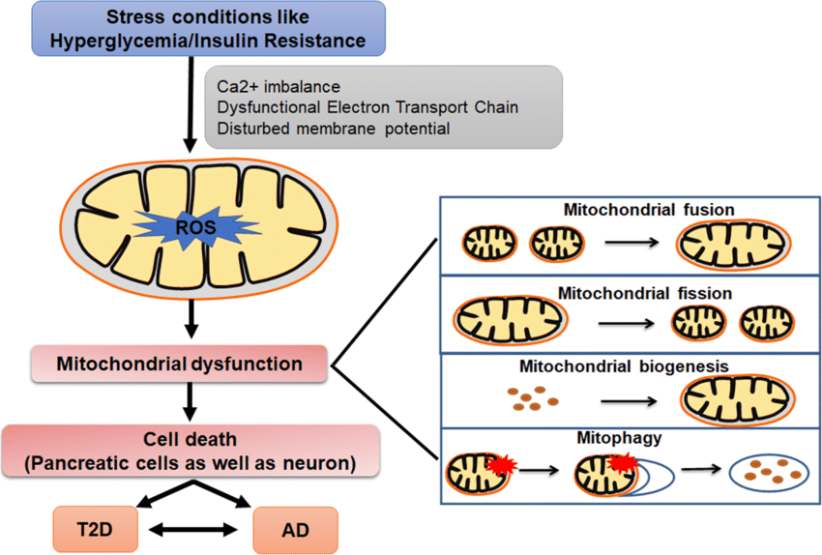
Mitochondrial Quality and Ageing
Hyperglycaemia and insulin resistance lead to slowed mitophagy and therefore mitochondrial dysfunction…
…and an increased risk of type 2 diabetes and Alzheimer’s disease.
Paul, S., Saha, D., & Bk, B. (2021). Mitochondrial dysfunction and mitophagy closely cooperate in neurological deficits associated with Alzheimer’s disease and type 2 diabetes. Molecular Neurobiology, 58(8), 3677-3691.

Slide 27
Initiators of Mitophagy
Calorie restriction
Exercise
Ketogenic diet
Coffee
Resveratrol
Anti-inflammatory diet
Small amounts of ROS
Genistein
Hops
Quercetin
Curcumin
Sulforaphane
Tocotrienols
Vitamin C
Selenium
Singletary, Keith, and John Milner. "Diet and autophagy a review." Epidemiology Biomarkers & Prevention 17.7 (2008): 1596-1610.

Slide 28
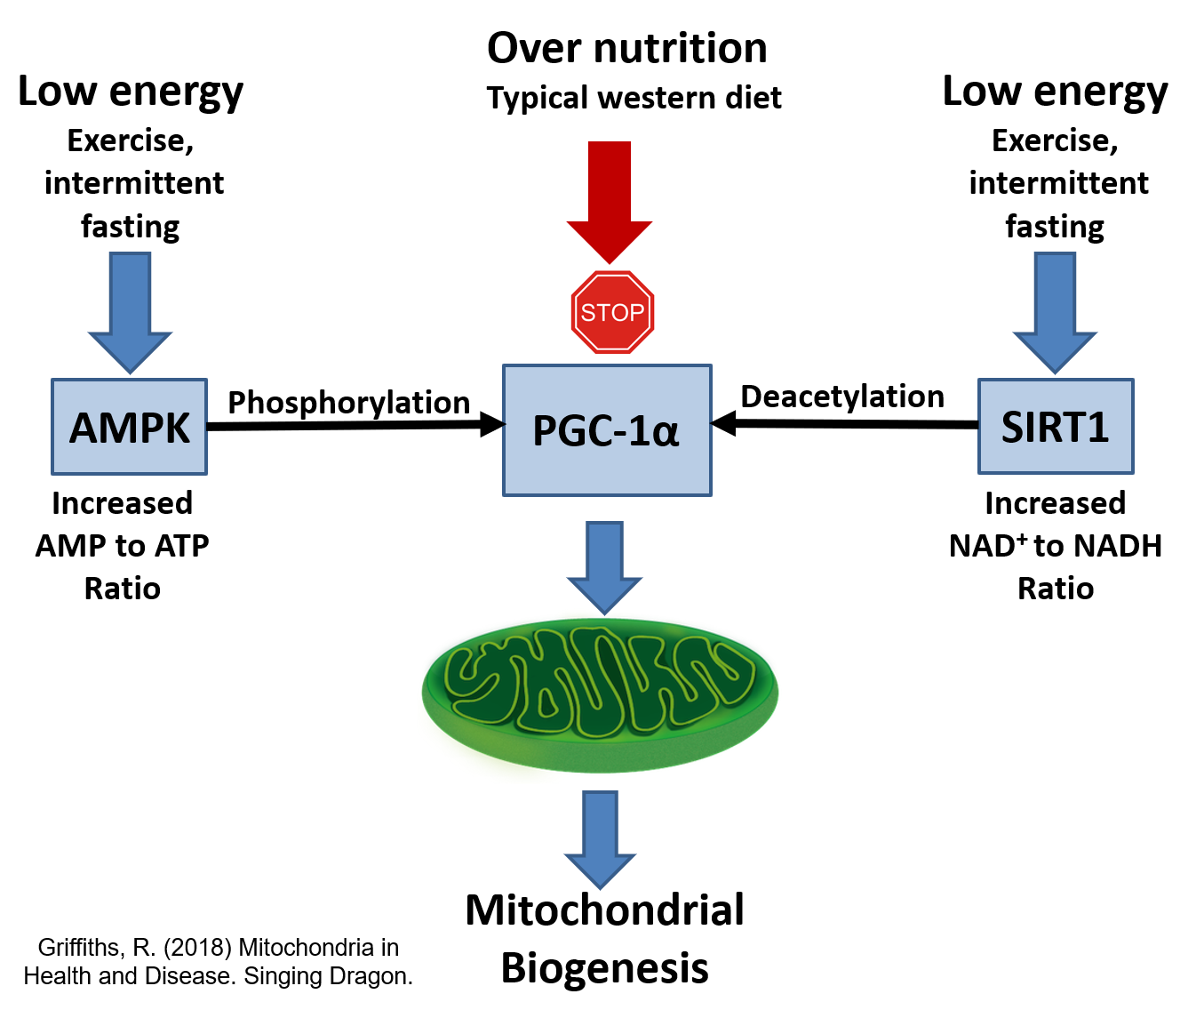
Mitochondrial Quality and Ageing

Slide 29
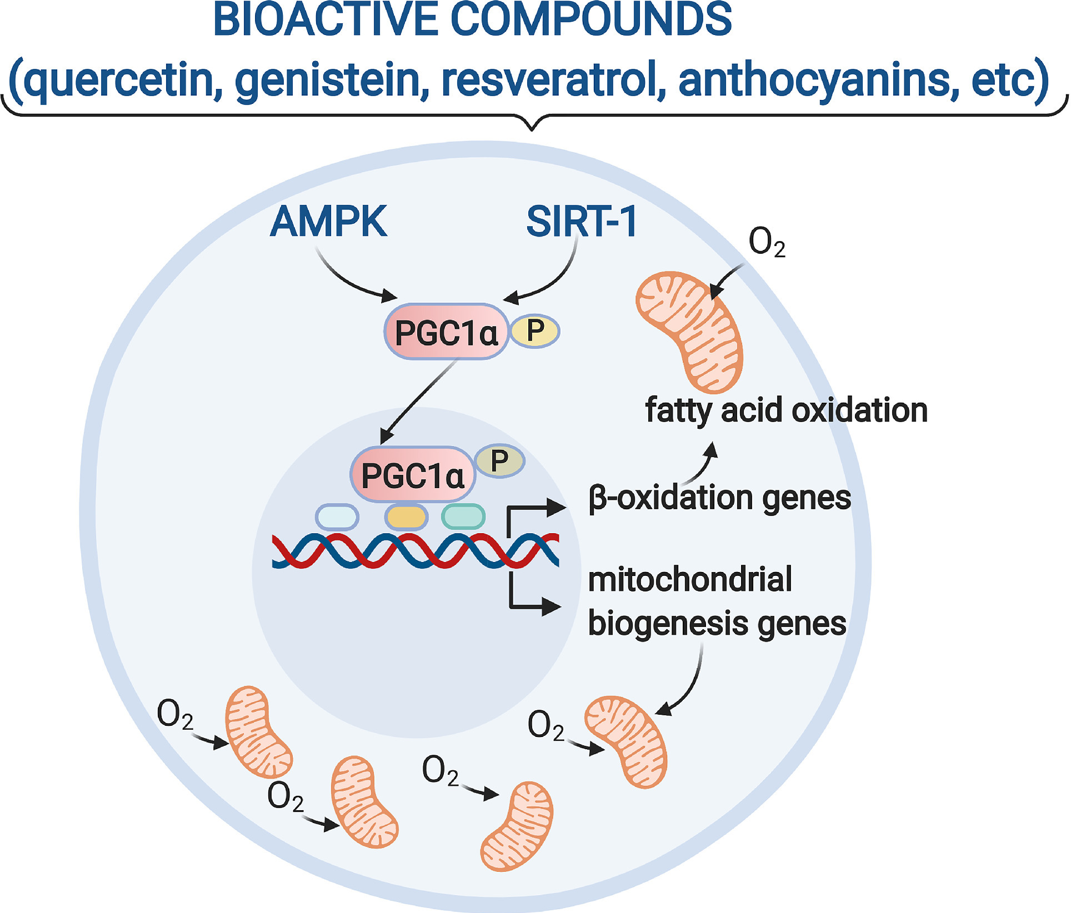
Mitochondrial Quality and Ageing
Dietary bioactive compounds activate mitochondrial biogenesis through PGC1-α via AMPK and SIRT-1 activation.
Vásquez-Reyes S, Velázquez-Villegas LA, Vargas-Castillo A, Noriega LG, Torres N, Tovar AR. Dietary bioactive compounds as modulators of mitochondrial function. J Nutr Biochem. 2021;96:108768.

Slide 30
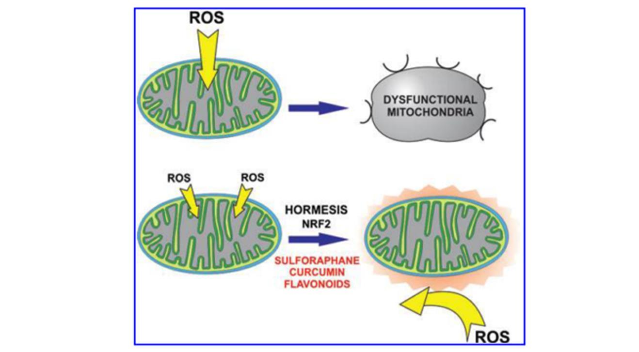
Low Levels of ROS Generated by Exercise and Plant Polyphenols Protect Mitochondria
Low levels of ROS generated by exercise and plant polyphenols protect mitochondria by inducing endogenous antioxidant synthesis.
This is known as ‘hormesis’.
Long lived species, such as humans, excel at mitochondrial hormesis, where mitochondria seek support from DNA.
Gugliandolo, A., Bramanti, P. and Mazzon, E., 2020. Activation of Nrf2 by natural bioactive compounds: a promising approach for stroke?. International Journal of Molecular Sciences, 21(14), p.4875., Biasutto, L., Szabo’, I. and Zoratti, M., 2011. Mitochondrial effects of plant-made compounds. Antioxidants & redox signaling, 15(12), pp.3039-3059.

Slide 31
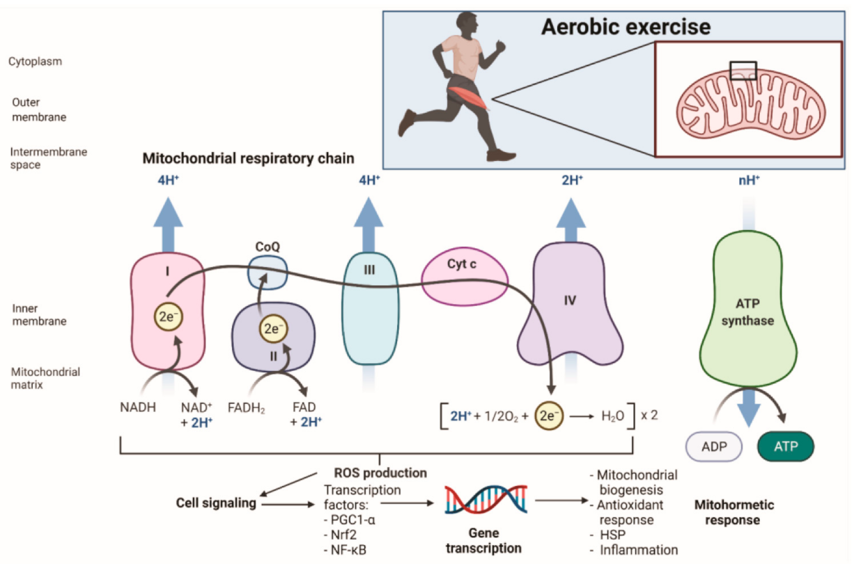
Low Levels of ROS Generated by Exercise Protect Mitochondria
Exercise-induced oxidative stress and the development of the mitohormetic response.
Mitohormesis refers to exposure to a sublethal dose of stress that, if not excessive, can enhance mitochondrial function and contribute to a protective hormetic response.
Vargas-Mendoza N, Angeles-Valencia M, Morales-González Á, et al. Oxidative Stress, Mitochondrial Function and Adaptation to Exercise: New Perspectives in Nutrition. Life (Basel). 2021;11(11):1269.

Slide 32
Supplements for Mitochondria
Confidential, not to be copied shared or disclosed, copyright Lamberts Healthcare Limited

Slide 33
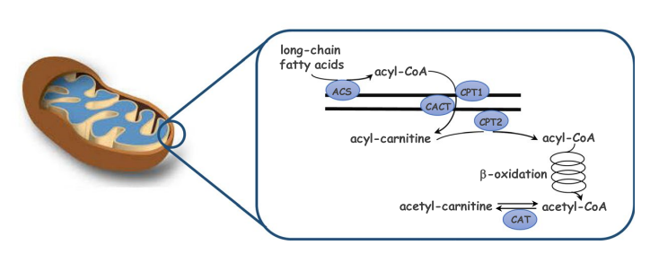
Carnitine
Dietary long-chain fatty acids require the amino acid carnitine (along with CoA/vitamin B5) to help transport these fatty acids into mitochondria.
Once inside mitochondria, fatty acids undergo beta oxidation - the first step in providing energy from fatty acids.
Bonomini, M., Zammit, V., Divino-Filho, J. C., Davies, S. J., Di Liberato, L., Arduini, A., & Lambie, M. (2021). The osmo-metabolic approach: A novel and tantalizing glucose-sparing strategy in peritoneal dialysis. Journal of Nephrology, 34, 503-519.

Slide 34
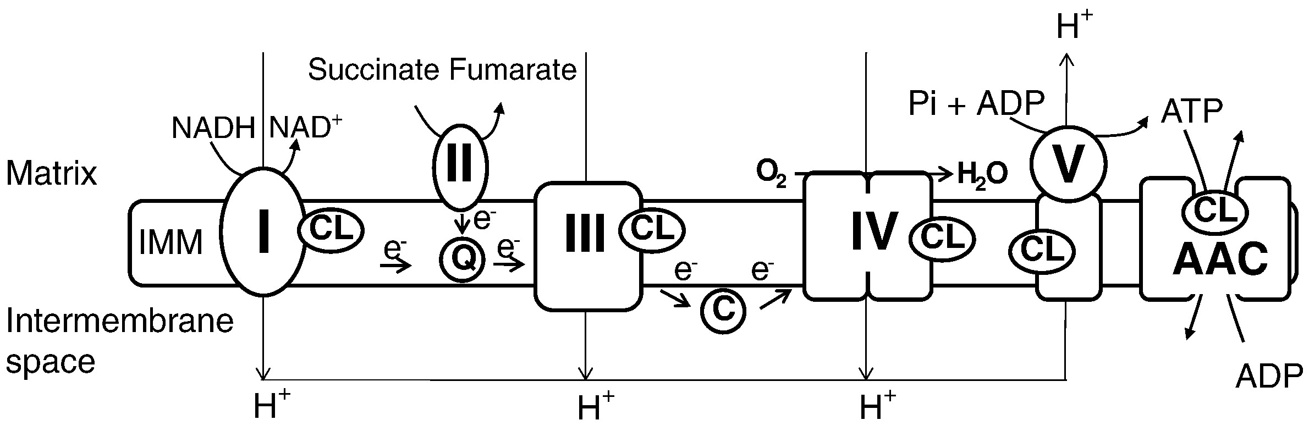
Acetyl-L-Carnitine
Cardiolipin is a mitochondrial phospholipid, vital for the integrity of the inner mitochondrial membrane and functioning of the electron transport chain to make energy.
Acetyl-L-Carnitine reverses the age-associated decline in cardiolipin levels, indicating that Acetyl-L-Carnitine cannot only improve fatty acid transport into mitochondria, but also has a remarkable ability to maintain the structure and function of the mitochondrial inner membrane.
Paradies, G., Paradies, V., De Benedictis, V., Ruggiero, F.M. and Petrosillo, G., 2014. Functional role of cardiolipin in mitochondrial bioenergetics. Biochimica et Biophysica Acta (BBA)-Bioenergetics, 1837(4), pp.408-417.
Hagen TM, Ingersoll RT, Wehr CM, et al. Acetyl-L-carnitine fed to old rats partially restores mitochondrial function and ambulatory activity. Proc Natl Acad Sci U S A. 1998;95(16):9562-9566.

Slide 35
Vitamin B Complex and Alpha Lipoic Acid
Transferring energy from carbohydrate into mitochondria requires:
Vitamin B1 - Thiamine - TPP
Vitamin B2 - Riboflavin - FADH
Vitamin B3 - Nicotinamide - NADH
Vitamin B5 - Pantothenic Acid - CoA
Alpha Lipoic Acid
https://www.abcam.com/pyruvate-dehydrogenase-pdh

Slide 36
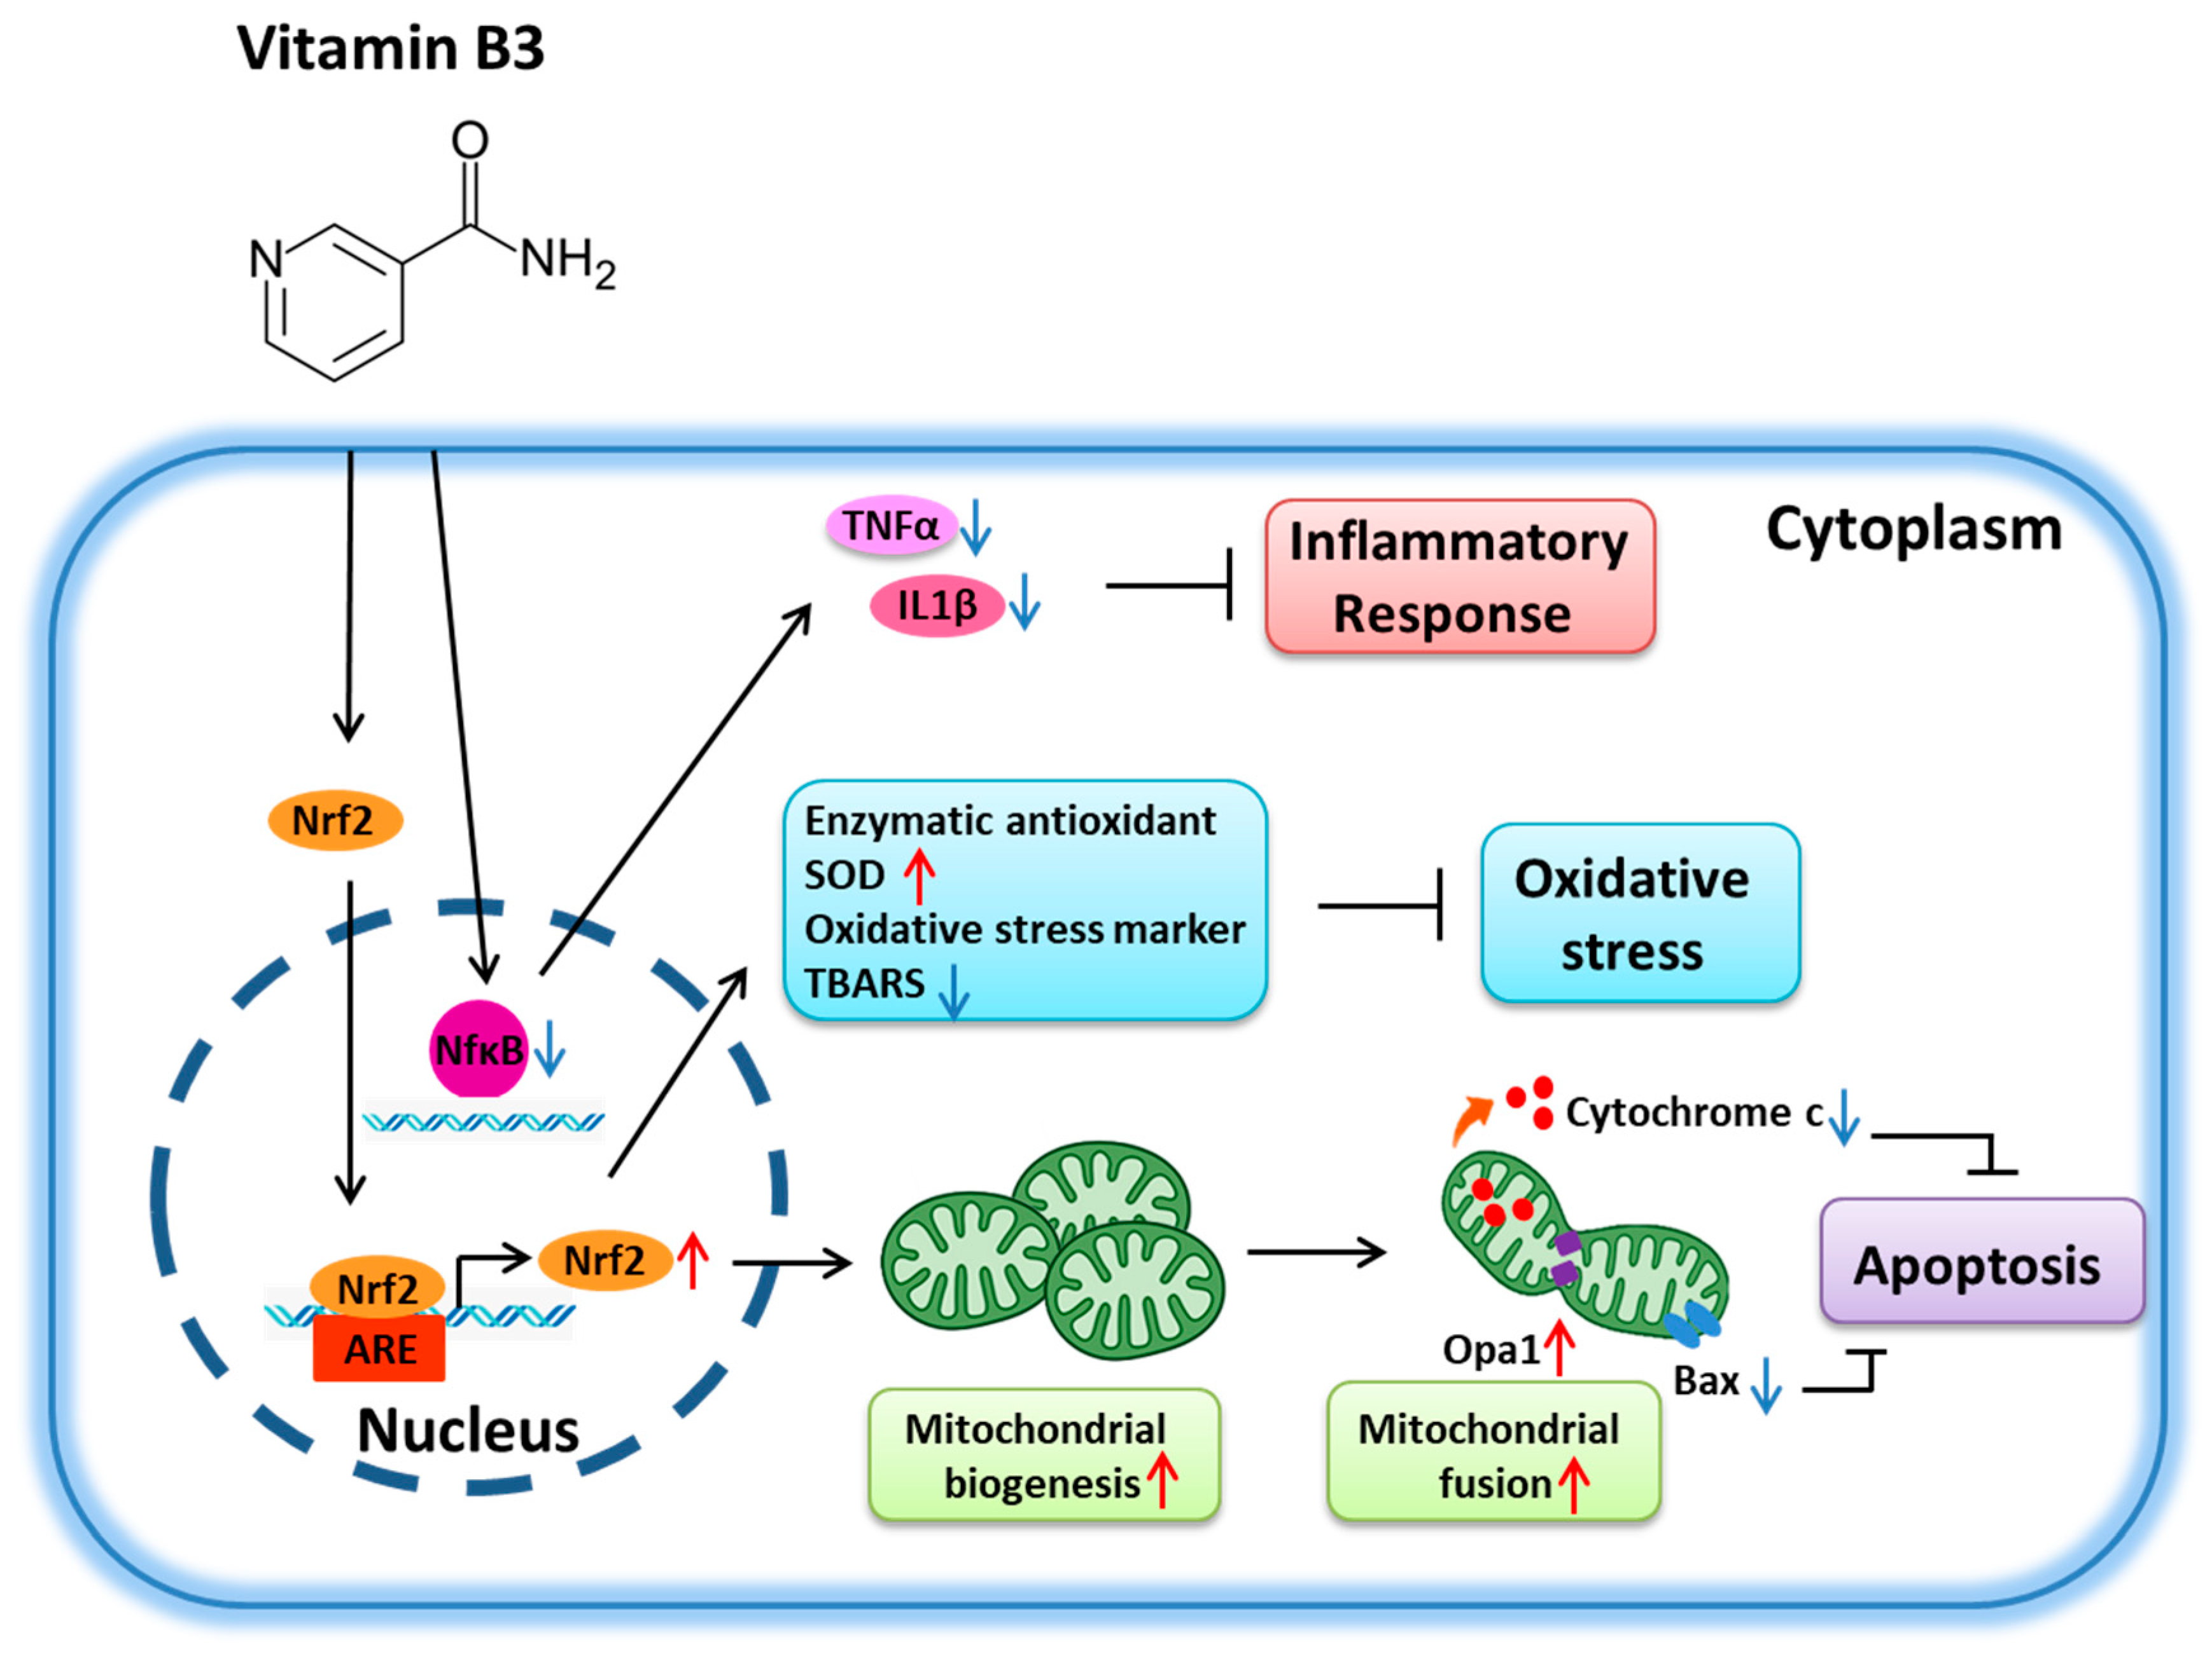
Vitamin B3
Vitamin B3, is a precursor to the coenzymes nicotinamide adenine dinucleotide (NAD+) and nicotinamide adenine dinucleotide phosphate (NADP+), which are needed to enhance mitochondrial activities for the synthesis of ATP.
Chen TW, Wu PY, Wen YT, et al. Vitamin B3 Provides Neuroprotection via Antioxidative Stress in a Rat Model of Anterior Ischemic Optic Neuropathy. Antioxidants (Basel). 2022;11(12):2422.

Slide 37
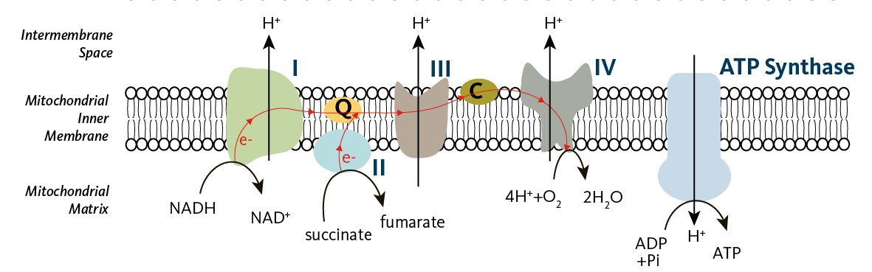
Coenzyme Q10
The conversion of energy from carbohydrate and fat into ATP requires the presence of coenzyme Q10 in the inner mitochondrial membrane.
https://lpi.oregonstate.edu/mic/dietary-factors/coenzyme-Q10

Slide 38
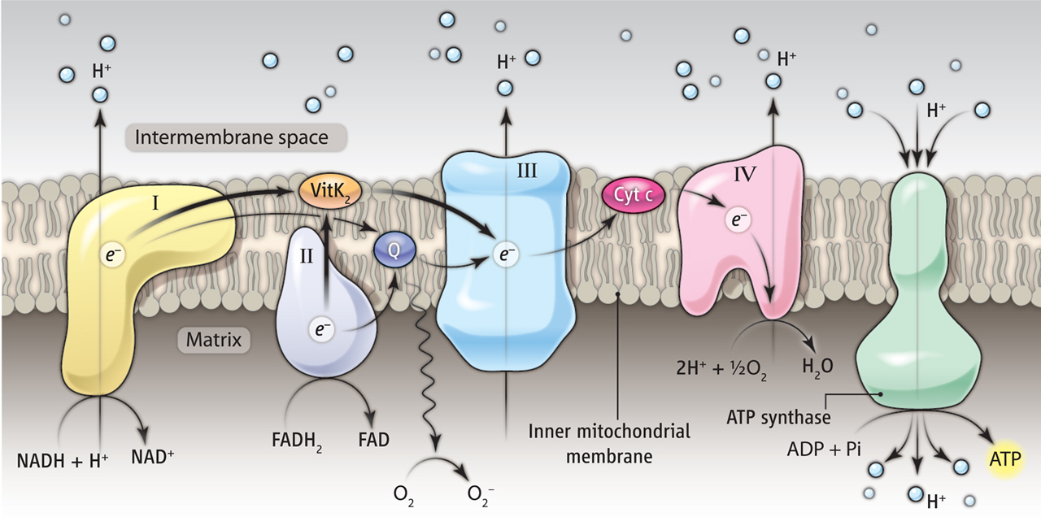
Vitamin K2 and Vitamin C can Stand in for Coenzyme Q10
Bhalerao, S. and Clandinin, T.R., 2012. Vitamin K2 takes charge. Science, 336(6086), pp.1241-1242.
Ivanova, D., Zhelev, Z., Getsov, P., Nikolova, B., Aoki, I., Higashi, T. and Bakalova, R., 2018. Vitamin K: Redox-modulation, prevention of mitochondrial dysfunction. Redox biology, 16, pp.352-358.

Slide 39
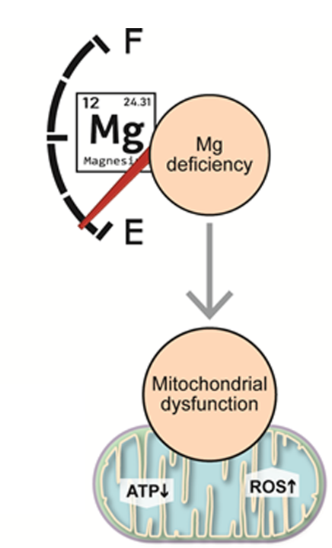
Magnesium
Magnesium deficiency leads to reduced mitochondrial energy (ATP) and increased oxidative stress (ROS)…
…both low ATP and high ROS are significant factors in mitochondrial dysfunction.
Liu, M., Liu, H., Feng, F., Xie, A., Kang, G. J., Zhao, Y., ... & Dudley Jr, S. C. (2021). Magnesium deficiency causes a reversible, metabolic, diastolic cardiomyopathy. Journal of the American Heart Association, 10(12), e020205.

Slide 40

Taurine
The amino acid taurine was originally isolated from bull semen - hence its name - after taurus the bull!
Within mitochondria, taurine can:
Increase energy by supporting ATP synthesis
Decrease oxidative stress
Decrease inflammation
Protect against calcium overload
Protect against apoptosis (programmed cell death).
Jong, C. J., Sandal, P., & Schaffer, S. W. (2021). The role of taurine in mitochondria health: more than just an antioxidant. Molecules, 26(16), 4913.

Slide 41
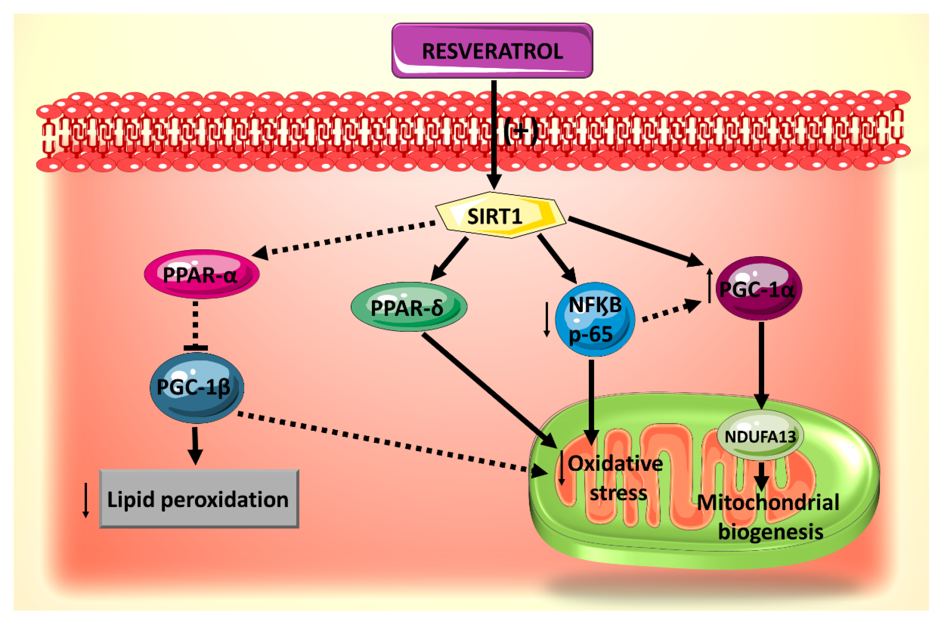
Resveratrol
Resveratrol activates anti-ageing genes which switch on the proteins needed to make new mitochondria (mitochondrial biogenesis).
Bhagani, H., Nasser, S. A., Dakroub, A., El-Yazbi, A. F., Eid, A. A., Kobeissy, F., ... & Eid, A. H. (2020). The mitochondria: a target of polyphenols in the treatment of diabetic cardiomyopathy. International Journal of Molecular Sciences, 21(14), 4962.

Slide 42
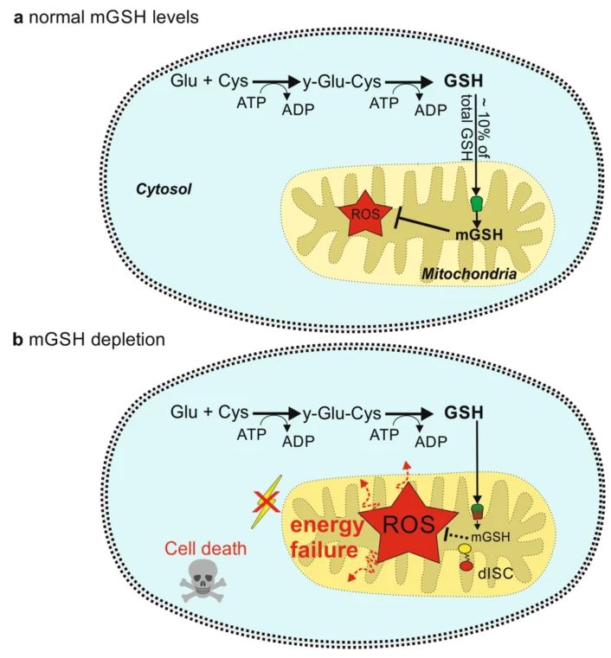
Glutathione
Glutathione (GSH) is an antioxidant which is vital for the correct functioning of mitochondria.
10% of cellular glutathione is imported into mitochondria - any less than this will lead to oxidative stress and energy failure.
von Bohlen Und Halbach, O. (2022). Controlling glutathione entry into mitochondria: potential roles for SLC25A39 in health and (treatment of) disease. Signal Transduction and Targeted Therapy, 7(1), 75.

Slide 43
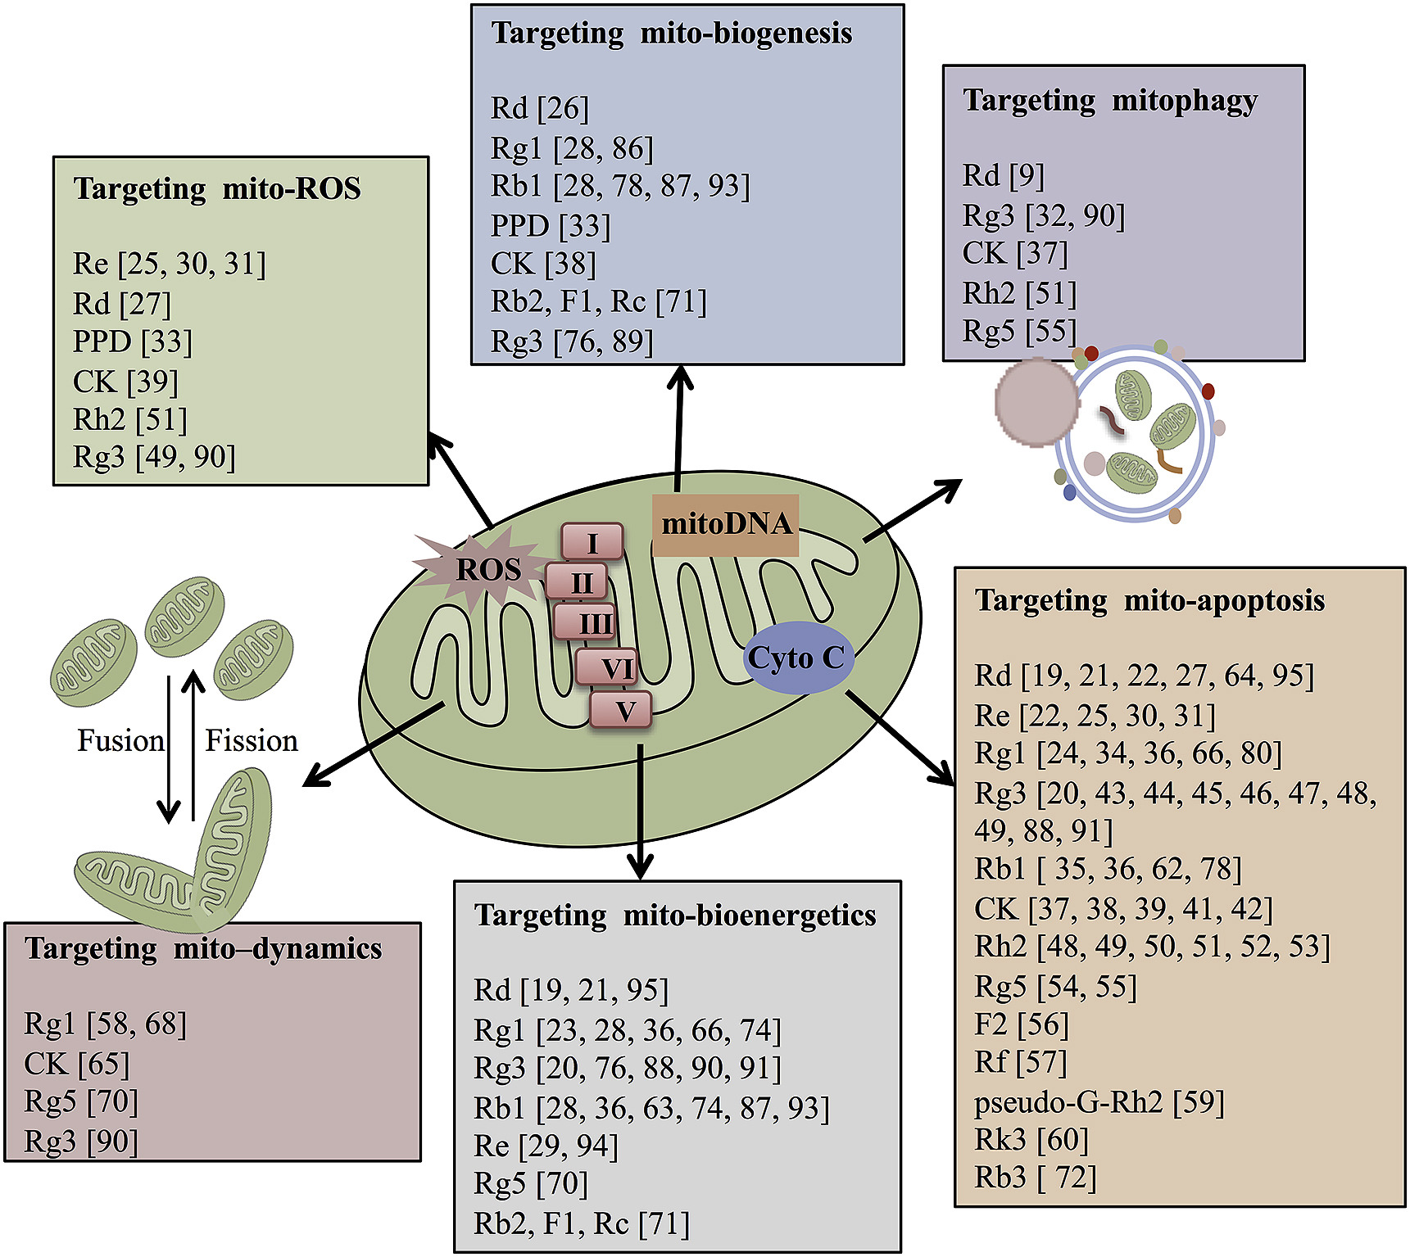
Korean Ginseng
Korean ginseng compounds target mitochondrial ROS, apoptosis, bioenergetics, biogenesis, dynamics, and mitophagy.
Huang Q, Gao S, Zhao D, Li X. Review of ginsenosides targeting mitochondrial function to treat multiple disorders: Current status and perspectives. J Ginseng Res. 2021;45(3):371-379.

Slide 44
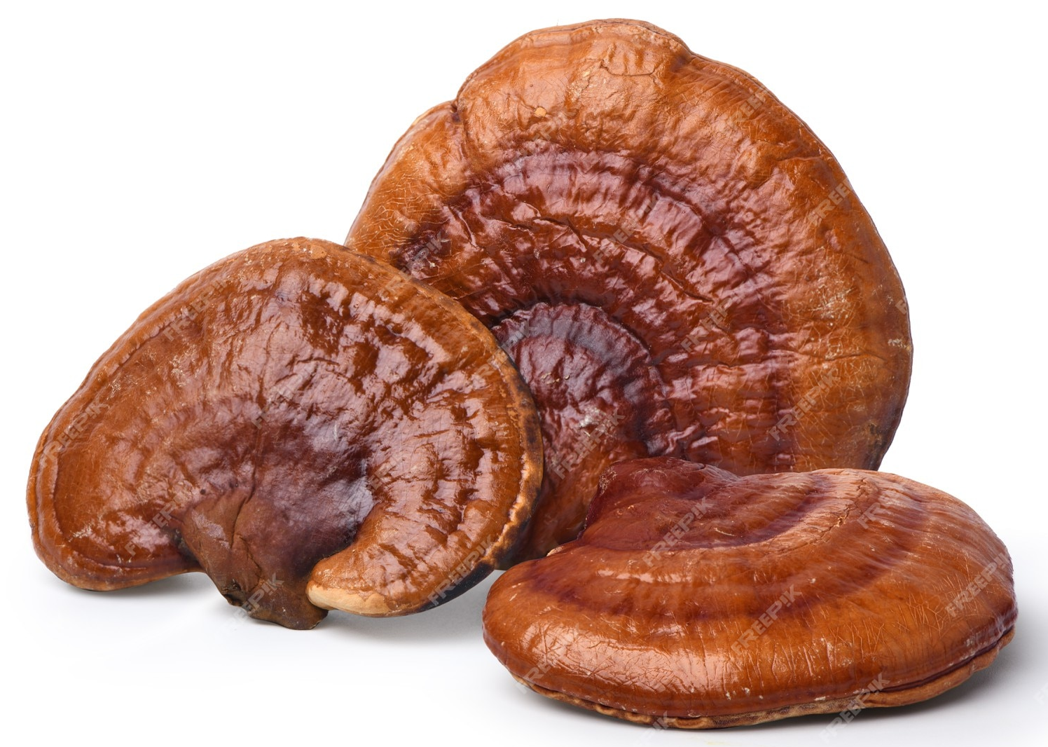
Reishi Mushroom
Results of an animal study revealed that reishi mushroom significantly enhanced the activities of mitochondrial Krebs cycle and electron transport chain complexes.
Reishi mushroom upregulates heart glutathione peroxidase, glutathione-S-transferase, catalase, superoxide dismutase (SOD) and reduced glutathione (GSH)…
…and decreases the highly toxic hydroxyl radical and the membrane destructive lipid peroxide malondialdehyde.
Sudheesh NP, Ajith TA, Janardhanan KK. Ganoderma lucidum (Fr.) P. Karst enhances activities of heart mitochondrial enzymes and respiratory chain complexes in the aged rat. Biogerontology. 2009;10(5):627-636.

Slide 45
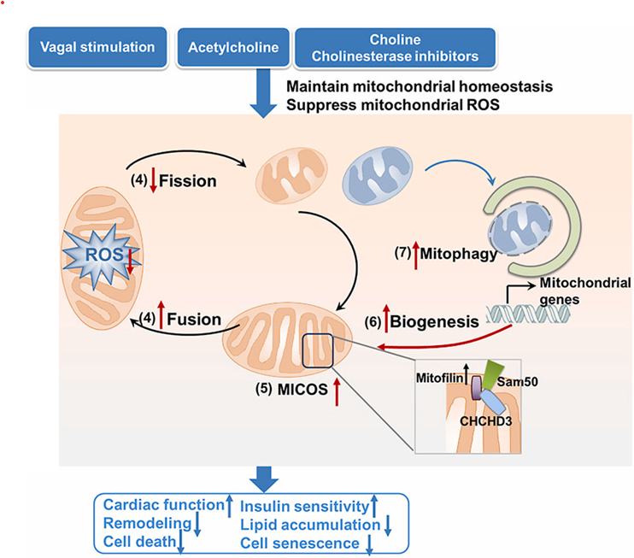
Vagal Stimulation
The vagal system plays an important role in maintaining mitochondrial homeostasis and suppressing mitochondrial oxidative stress.
Mitochondrial contact site and cristae organising system (MICOS) in the inner mitochondrial membrane is crucial for the formation and maintenance of cristae structure.
He X, Liu J, Zang WJ. Mitochondrial homeostasis and redox status in cardiovascular diseases: Protective role of the vagal system. Free Radic Biol Med. 2022;178:369-379.

Slide 46
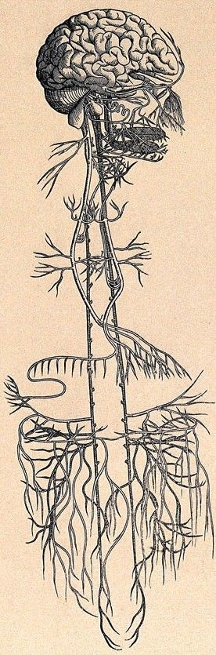
Vagal Tone can be Stimulated by a Variety of Activities
Breathing
Bullmore, E., 2018. The inflamed mind: a radical new approach to depression. Picador.
Outdoor/Green Country Space
van den Berg, Magdalena, et al. "Autonomic nervous system responses to viewing green and built settings: differentiating between sympathetic and parasympathetic activity." International journal of environmental research and public health 12.12 (2015): 15860-15874.
Social Connection
Colonnello, Valentina, et al. "Positive social interactions in a lifespan perspective with a focus on opioidergic and oxytocinergic systems: Implications for neuroprotection." Current neuropharmacology 15.4 (2017): 543-561.
Singing and Music
Ellis, Robert J., and Julian F. Thayer. "Music and autonomic nervous system (dys) function." Music Perception: An Interdisciplinary Journal 27.4 (2010): 317-326.
Laughter and Crying
Dolgoff-Kaspar, Rima, et al. "Effect of laughter yoga on mood and heart rate variability in patients awaiting organ transplantation: a pilot study." Altern Ther Health Med 18.5 (2012): 61-6.
Rottenberg, Jonathan, et al. "Vagal rebound during resolution of tearful crying among depressed and nondepressed individuals." Psychophysiology 40.1 (2003): 1-6.
Exercise
Guiraud, Thibaut, et al. "High-intensity interval exercise improves vagal tone and decreases arrhythmias in chronic heart failure." Medicine and science in sports and exercise45.10 (2013): 1861-1867.
Yoga and Meditation
Cahn, B.R., Goodman, M.S., Peterson, C.T., Maturi, R. and Mills, P.J., 2017. Yoga, meditation and mind-body health: increased BDNF, cortisol awakening response, and altered inflammatory marker expression after a 3-month yoga and meditation retreat. Frontiers in human neuroscience, 11, p.315.

Slide 47
Confidential, not to be copied shared or disclosed, copyright Lamberts Healthcare Limited
Mitochondria
and Health Issues

Slide 48
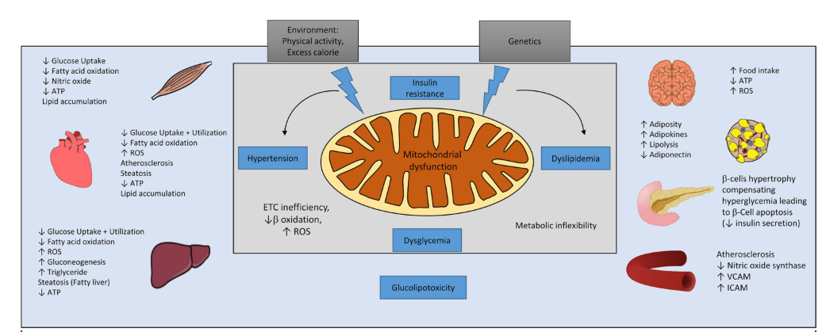
Mitochondria and Health Issues
Mitochondrial dysfunction plays a central role in metabolic dysfunction in different organ systems… including skeletal muscle, heart, liver, brain, adipose tissue, pancreas, and blood vessels.
Dutt C, Nunes Salles JE, Joshi S, et al. Risk Factors Analysis and Management of Cardiometabolic-Based Chronic Disease in Low- and Middle-Income Countries. Diabetes Metab Syndr Obes. 2022;15:451-465

Slide 49
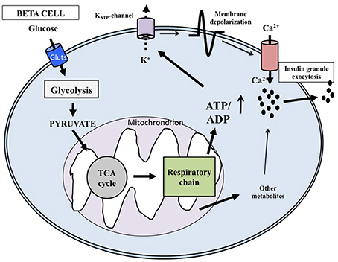
Insulin Secretion is Mitochondria Dependent
Excess glucose consumption can lead to mitochondrial dysfunction in the pancreatic beta cell - undermining insulin metabolism.
Marchetti, P., Bugliani, M., De Tata, V., Suleiman, M. and Marselli, L., 2017. Pancreatic beta cell identity in humans and the role of type 2 diabetes. Frontiers in cell and developmental biology, 5, p.55.

Slide 50
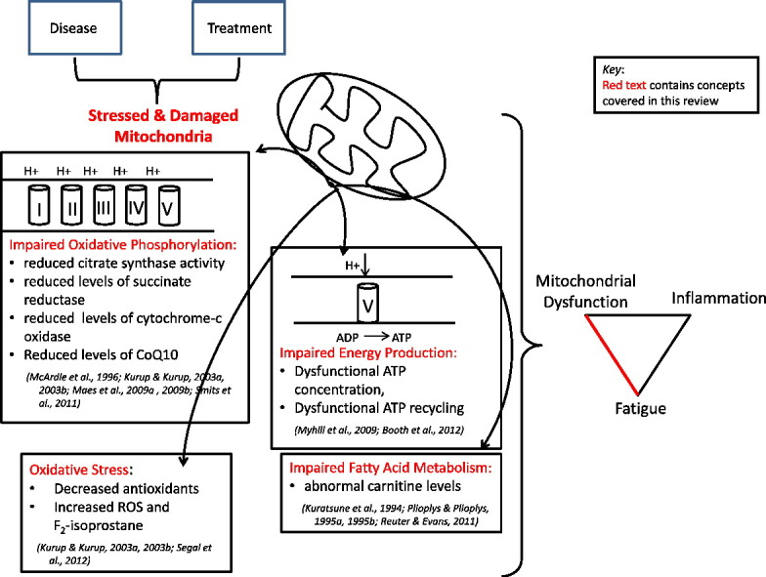
Fatigue
Fatigue is a hallmark symptom of mitochondrial dysfunction.
Fatigue is often described by patients as a lack of energy, mental or physical tiredness, diminished endurance, and the need for a prolonged recovery after physical activity.
Fatigue is reported by patients to be unrelieved by rest.
Filler K, Lyon D, Bennett J, et al. Association of Mitochondrial Dysfunction and Fatigue: A Review of the Literature. BBA Clin. 2014;1:12-23.

Slide 51
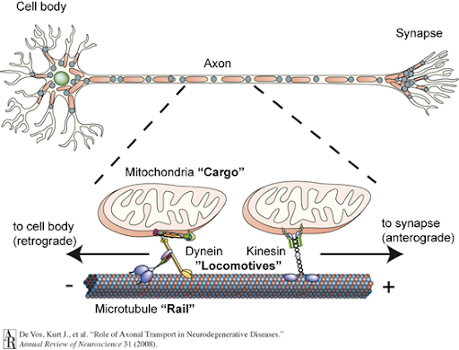
Neurodegeneration
Alzheimer’s and Parkinson’s Disease
High concentrations of mitochondria are needed at synapses - and have to be transported or ‘chauffeured’ along axons via microtubules.
De Vos, K.J., Grierson, A.J., Ackerley, S. and Miller, C.C., 2008. Role of axonal transport in neurodegenerative diseases. Annu. Rev. Neurosci., 31, pp.151-173.

Slide 52
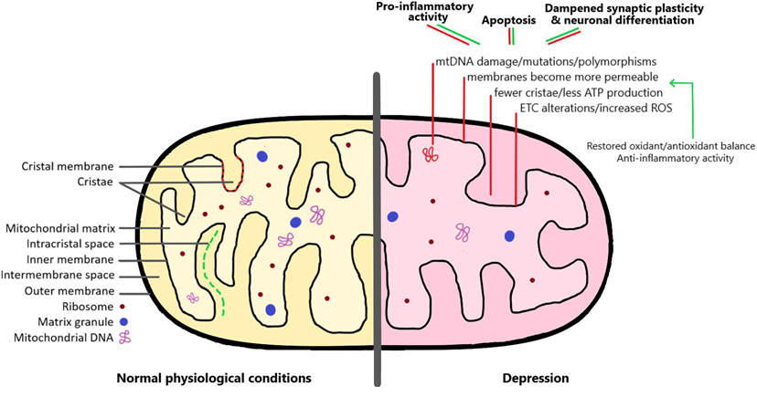
Depression
Allen, J., Romay-Tallon, R., Brymer, K. J., Caruncho, H. J., & Kalynchuk, L. E. (2018). Mitochondria and mood: mitochondrial dysfunction as a key player in the manifestation of depression. Frontiers in neuroscience, 12, 386.

Slide 53
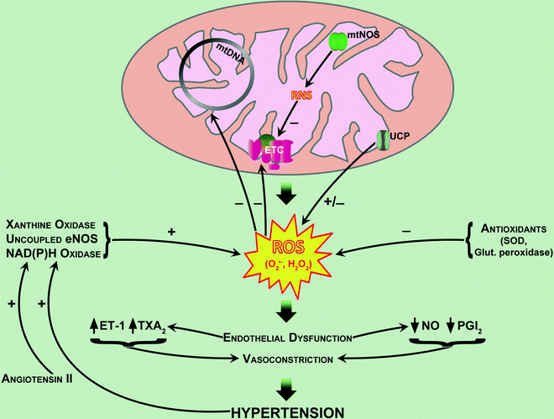
Hypertension
Mitochondrial dysfunction in the vascular endothelium leads to reduced vasodilation and increased vasoconstriction.
Marín-García J. (2013) The Role of Mitochondria in Hypertension. In: Mitochondria and Their Role in Cardiovascular Disease. Springer, Boston, MA. https://doi.org/10.1007/978-1-4614-4599-9_15

Slide 54
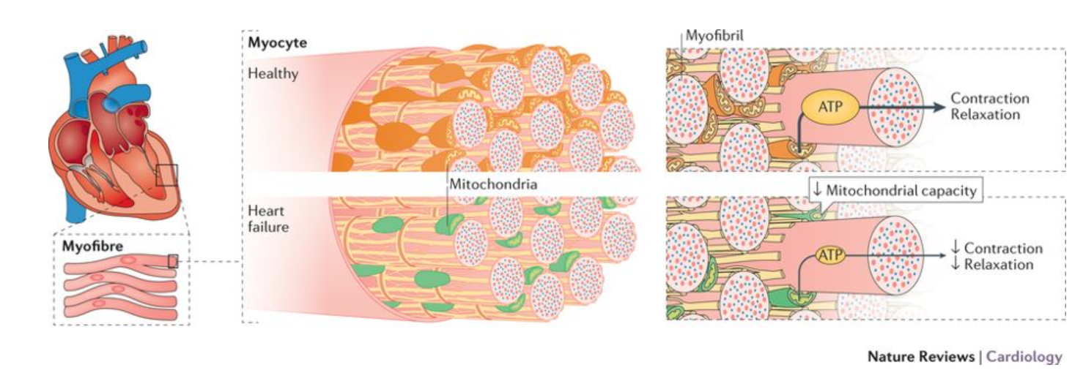
Healthy Mitochondria are Needed for Heart Contraction and Relaxation
Brown, D.A., Perry, J.B., Allen, M.E., Sabbah, H.N., Stauffer, B.L., Shaikh, S.R., Cleland, J.G., Colucci, W.S., Butler, J., Voors, A.A. and Anker, S.D., 2017. Expert consensus document: mitochondrial function as a therapeutic target in heart failure. Nature Reviews Cardiology, 14(4), p.238.

Slide 55
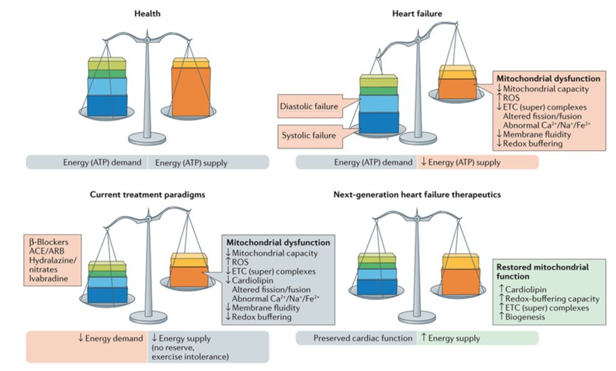
Heart Disease
Brown, D.A., Perry, J.B., Allen, M.E., Sabbah, H.N., Stauffer, B.L., Shaikh, S.R., Cleland, J.G., Colucci, W.S., Butler, J., Voors, A.A. and Anker, S.D., 2017. Expert consensus document: mitochondrial function as a therapeutic target in heart failure. Nature Reviews Cardiology, 14(4), p.238.

Slide 56
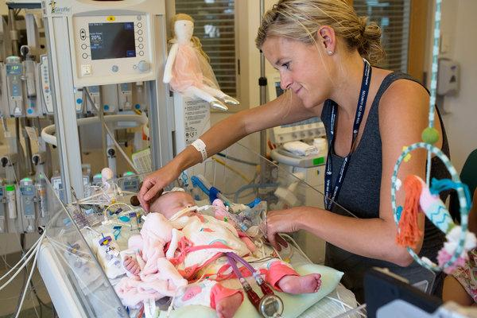
Georgia Bowen had a Heart Attack Within the Womb and was Struggling to Survive
https://www.nytimes.com/2018/07/10/health/mitochondria-transplant-heart-attack.html

Slide 57
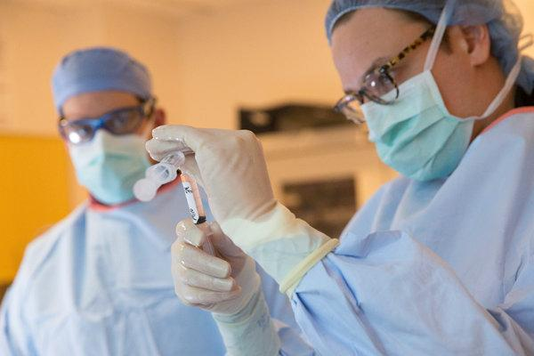
Georgia Bowen had a Heart Attack Within the Womb and was Struggling to Survive
Doctors from Boston Children’s Hospital decided to try an experimental procedure that had never before been attempted in a human being following a heart attack.
They took a billion mitochondria from a small plug of Georgia’s healthy muscle and infused them into the injured muscle of her heart.
https://www.nytimes.com/2018/07/10/health/mitochondria-transplant-heart-attack.html

Slide 58
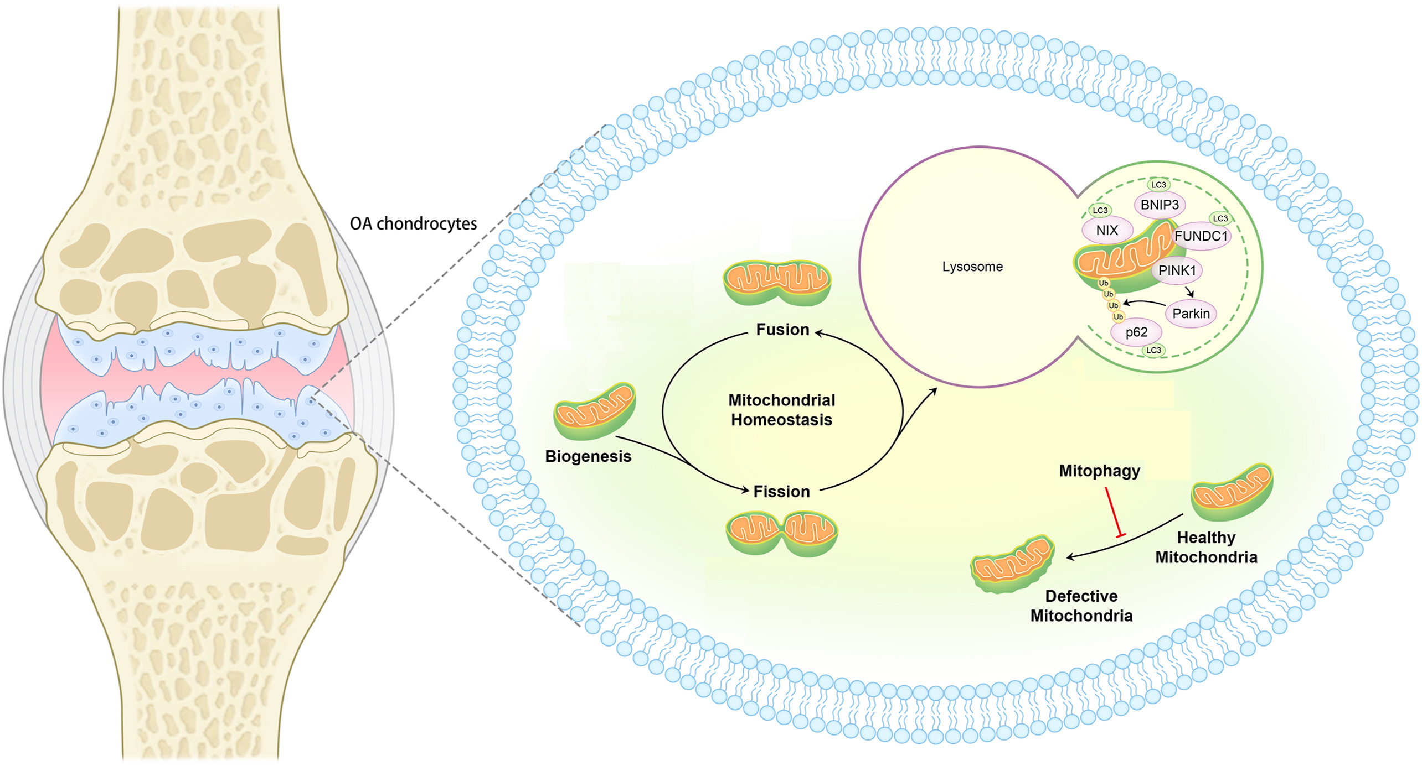
Mitochondria and Osteoarthritis
Chondrocytes require mitochondrial energy to maintain their integrity…
…to protect against osteoarthritis.
Liu, D., Cai, Z. J., Yang, Y. T., Lu, W. H., Pan, L. Y., Xiao, W. F., & Li, Y. S. (2022). Mitochondrial quality control in cartilage damage and osteoarthritis: new insights and potential therapeutic targets. Osteoarthritis and Cartilage, 30(3), 395-405.

Slide 59

Bone Needs Functional Mitochondria
Mitochondria regulate the balance between osteogenesis and osteoclast activity and maintain bone homeostasis.
Under pathological conditions, mitochondrial dysfunction alters this balance; this disruption is important in the pathogenesis of osteoporosis.
Zheng CX, Sui BD, Qiu XY, Hu CH, Jin Y. Mitochondrial Regulation of Stem Cells in Bone Homeostasis. Trends Mol Med. 2020;26(1):89-104.

Slide 60

Mitochondria in Ovarian Ageing and Reproductive Longevity
There is increasing evidence that mitochondrial dysfunction drives ovarian ageing.
Chiang JL, Shukla P, Pagidas K, et al. Mitochondria in Ovarian Aging and Reproductive Longevity. Ageing Res Rev. 2020;63:101168.

Slide 61

Mitochondria and Male Infertility
Sperm mitochondrial dysfunction is associated with oxidative stress within semen - a primary underlying cause of male infertility.
Durairajanayagam D, Singh D, Agarwal A, Henkel R. Causes and consequences of sperm mitochondrial dysfunction. Andrologia. 2021;53(1):e13666.

Slide 62
Confidential, not to be copied shared or disclosed, copyright Lamberts Healthcare Limited
The Retrograde Response
When Mitochondria ask Nuclear DNA for Help

Slide 63

The Retrograde Response -
Increased Longevity
Long-lived species, such as humans, have excellent communication between mitochondria and nuclear DNA - to request for assistance when under stress.
This is known as the retrograde response and is a kind of mitochondrial hormesis or mitohormesis.
Amigo, I., da Cunha, F.M., Forni, M.F., Garcia-Neto, W., Kakimoto, P.A., Luévano-Martínez, L.A., Macedo, F., Menezes-Filho, S.L., Peloggia, J. and Kowaltowski, A.J., 2016. Mitochondrial form, function and signalling in aging. Biochemical Journal, 473(20), pp.3421-3449.
Walker BR, Moraes CT. Nuclear-Mitochondrial Interactions. Biomolecules. 2022;12(3):427. Published 2022 Mar 10.

Slide 64

The Salvage Pathway or De Novo Synthesis?
Nucleotides and Nucleosides are Needed for Mitochondria to ‘talk’ to DNA

Slide 65

The Salvage Pathway or De Novo Synthesis? Nucleotides and Nucleosides are Needed for Mitochondria to ‘talk’ to DNA
Adenosine is required for ATP, ADP and AMP.
Adenine is required for NAD⁺ and NADH.
Nucleotides required for mitochondrial DNA synthesis.
http://www.novocib.com/Nucleotide_Analysis_Services.html

Slide 66
The Retrograde Response -
Increased Longevity
The degradation products of RNA and DNA can be ‘salvaged’ to make the nucleotides and nucleosides which allow retrograde communication between mitochondria and nuclear DNA.
Supplementary nucleotides and nucleosides may also support this communication.
De novo nucleotide synthesis requires folic acid.
Tufi, R., Gandhi, S., De Castro, I.P., Lehmann, S., Angelova, P.R., Dinsdale, D., Deas, E., Plun-Favreau, H., Nicotera, P., Abramov, A.Y. and Willis, A.E., 2014. Enhancing nucleotide metabolism protects against mitochondrial dysfunction and neurodegeneration in a PINK1 model of Parkinson’s disease. Nature cell biology, 16(2), p.157.

Slide 67
The Retrograde Response -
Increased Longevity
“Defective mitochondria in Parkinson's models send SOS signals to the cell nucleus. This involves a demand to increasing the synthesis of their own genetic material. They use a major pathway the so-called ‘salvage pathway for mitochondrial DNA synthesis’ to do this.”
“Our data support the therapeutic potential of folic acid to enhance nucleotide pools, promoting mitochondrial biogenesis and improving mitochondrial function in neurons in neurodegenerative disease…”
https://www2.le.ac.uk/offices/press/press-releases/2014/january/folic-acid-could-suppress-parkinson2019s-2013-new-study

Slide 68

Mitochondria are Needed for Synthesis of Nucleotides
Ill Health may Require Supplementation From a Dietary Source
Folate cycle
Ahn, C.S. and Metallo, C.M., 2015. Mitochondria as biosynthetic factories

Slide 69
Confidential, not to be copied shared or disclosed, copyright Lamberts Healthcare Limited
Diet and Mitochondria

Slide 70

The Mediterranean Diet
The Mediterranean diet is associated with lower oxidative stress levels and a lower incidence of chronic disease.
Compounds within foods contained in the Mediterranean diet can improve mitochondrial function…
…and also reduce cardiovascular and metabolic risk - promoting health and longevity.
Pollicino F, Veronese N, Dominguez LJ, Barbagallo M. Mediterranean diet and mitochondria: New findings. Exp Gerontol. 2023;176:112165.
Polyphenols

Slide 71

Bioactive Compounds
Dietary bioactive compounds improve oxygen consumption and upregulate mitochondrial activity and ATP synthesis.
Vásquez-Reyes S, Velázquez-Villegas LA, Vargas-Castillo A, Noriega LG, Torres N, Tovar AR. Dietary bioactive compounds as modulators of mitochondrial function. J Nutr Biochem. 2021;96:108768.

Slide 72

Whole Grains
Natural bioactive components in whole grains can help protect against metabolic disorders by modulating mitochondrial biogenesis and energy metabolism.
Wang Z, Yang Z, Liu J, Hao Y, Sun B, Wang J. Potential Health Benefits of Whole Grains: Modulation of Mitochondrial Biogenesis and Energy Metabolism. J Agric Food Chem. 2021;69(47):14065-14074.

Slide 73

The Ketogenic Diet
β
Ketone bodies such as acetoacetate (AA) and β-hydroxybutyrate (β-OHB) lead to decreases in oxidative stress and improvements in mitochondrial biogenesis and mitochondrial function.
Branco AF, Ferreira A, Simões RF, et al. Ketogenic diets: from cancer to mitochondrial diseases and beyond. Eur J Clin Invest. 2016;46(3):285-298

Slide 74
Confidential, not to be copied shared or disclosed, copyright Lamberts Healthcare Limited
Tests

Slide 75

Organic Acid Test
Electron transport chain markers – Organic acid test, Mosaic Dx
CoQ10 is capable of supporting the function of the mitochondrial electron transport chain.
He, R., Yan, X., Tang, B. and Sun, Q., 2018. Recent advances in Biomarkers for Parkinson’s disease. Frontiers in aging neuroscience, 10, p.305.

Slide 76

Mitochondrial Profile From AONM
For more information, contact AONM at: info@aonm.org

Slide 77

Genetic Profile
Lifecode Gx Metabolic Profile
Testing for polymorphisms affecting mitochondrial function.

Slide 78
Confidential, not to be copied shared or disclosed, copyright Lamberts Healthcare Limited
“If we wish to live longer and to rid ourselves of the diseases of old age, we will need more mitochondria”
Healthy mitochondria of course!
Lane, N. (2005). Power, Sex, Suicide: Mitochondria and the Meaning of Life.

Slide 79
What We’ve Done Today
Mitochondria have provided the energy to allow the evolution and existence of all complex life
The charge across a mitochondrial membrane is equivalent to a bolt of lightning!
Mitochondria are effectively solar powered
Mitochondria digest themselves every few days to maintain their quality and integrity
Hyperglycaemia and insulin resistance lead to mitochondrial dysfunction.

Slide 80
What We’ve Done Today
Insulin secretion is dependent on beta cell mitochondria
Fatigue is a hallmark symptom of mitochondrial dysfunction
Bone and cartilage depend on mitochondrial energy for their integrity
The heart is the most energetically demanding organ of the human body and requires over 6kg of mitochondrial ATP per day!

Slide 81
Supporting the Health of Mitochondria
Thank you!
This confidential presentation is intended for educational purposes only and is not to be copied, modified or redistributed (in whole or in part) shared or disclosed, copyright Lamberts Healthcare Limited

