Slide 1
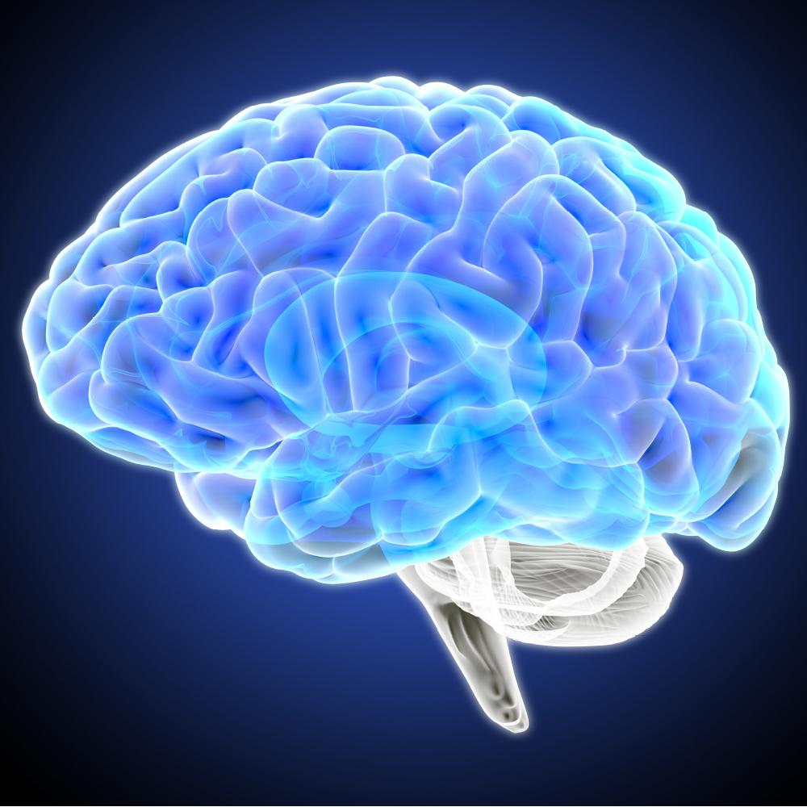

Cognitive Health - What a Healthy Brain Requires,
What Goes Wrong, and Strategies to Maintain Function
Presented by Ray Griffiths

Slide 2
What We’re Covering Today
Brain energy, neurotrophins and mitochondria
Insulin and cognitive health
High-fat diet and cognitive health
Brain inflammation
Vascular health and cognition
Gut-brain axis
Acetylcholine
Diets for the mind.

Slide 3
Brain Energy
The human brain is at the limit of its energy production…
…and it’s taken 1.5 billion years of evolution to get to where it is today!
First life on earth = 4 billion years ago
Age of our planet = 4.5 billion years
Big bang = 13.7 billion years ago

Slide 4

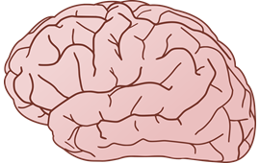
Brain Energy
To power a cortical neuron in the human brain, mitochondria have to supply 4.7 billion ATP molecules per second…
…and that’s when
it’s at rest!
Zhu, X.H., Qiao, H., Du, F., Xiong, Q., Liu, X., Zhang, X., Ugurbil, K. and Chen, W., 2012. Quantitative imaging of energy expenditure in human brain. Neuroimage, 60(4), pp.2107-2117.

Slide 5
Brain Energy
The brain has the highest mitochondrial energy demand of any organ and cannot work fully anaerobically.
Pei, L. and Wallace, D.C., 2018. Mitochondrial etiology of neuropsychiatric disorders. Biological psychiatry, 83(9), pp.722-730.

Slide 6
Brain Energy
The brain represents 2% of our body’s weight, yet consumes up to 20% of our oxygen and 25% of our glucose.
No wonder we struggle to think clearly without enough oxygen or good food to help power our brain!
Pei L, Wallace DC. Mitochondrial Etiology of Neuropsychiatric Disorders. Biol Psychiatry. 2018;83(9):722-730. doi:10.1016/j.biopsych.2017.11.018

Slide 7
Brain Blood Supply
In normal situations, cerebral blood flow is maintained at 50mL per 100g of brain tissue per minute.
This equates to roughly 700mL of cerebral blood flow per minute for the average person.
Cipolla MJ. The Cerebral Circulation. San Rafael (CA): Morgan & Claypool Life Sciences; 2009. Chapter 5, Control of Cerebral Blood Flow. Available from: https://www.ncbi.nlm.nih.gov/books/NBK53082/

Slide 8
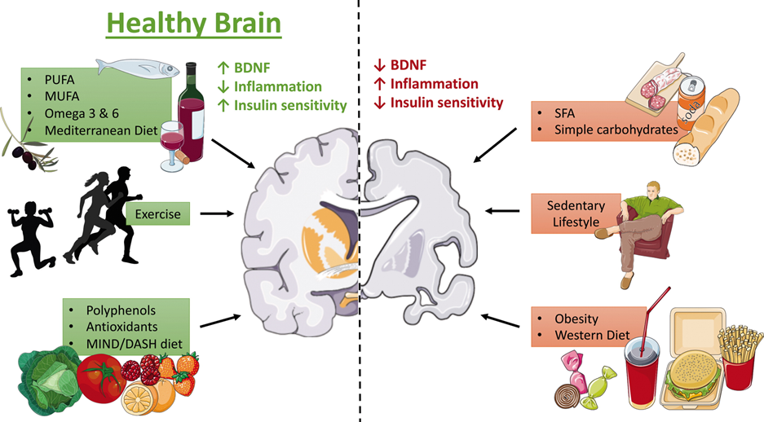
Diet and Lifestyle for Brain Health
Unhealthy Brain
Baranowski BJ, Marko DM, Fenech RK, Yang AJT, MacPherson REK. Healthy brain, healthy life: a review of diet and exercise interventions to promote brain health and reduce Alzheimer's disease risk. Appl Physiol Nutr Metab. 2020;45(10):1055-1065. doi:10.1139/apnm-2019-0910

Slide 9
Neurotrophins
Neurotrophins (such as BDNF and NGF) help direct the flow of food, nourishment and energy to the brain.

Slide 10
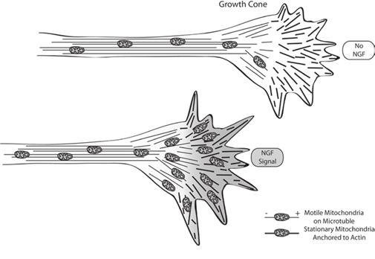

Neurotrophins
Neurotrophins act like ‘magnets’ to mitochondria, to provide the energy to help build and maintain synapses.
Zinsmaier, K.E., Babic, M. and Russo, G.J., 2009. Mitochondrial transport dynamics in axons and dendrites. In Cell Biology of the Axon (pp. 361-381). Springer, Berlin, Heidelberg.

Slide 11
BDNF can be Induced By:
Dietary compounds
Environmental enrichment
Social enrichment
Yoga and meditation
Dance
Music
Cultural excursions
Singing
Gut-brain axis.
Depression: The Mind-Body diet and lifestyle connection Ray Griffiths 2019

Slide 12
Mitochondria Provide the Energy Needed to Maintain Cognitive Health

Slide 13
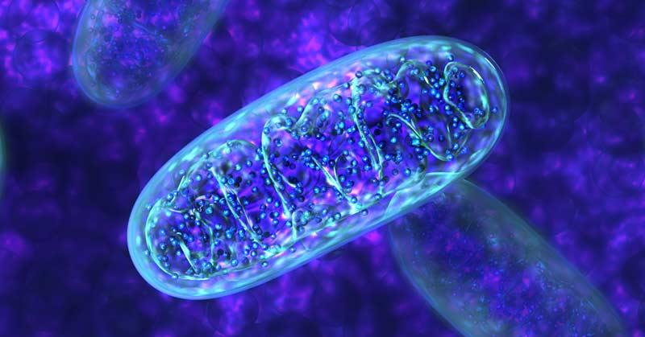
Mitochondria
It is estimated that each neuron in our brain can have up to 2 million mitochondria…
…compared to several thousand in most peripheral cells.
Healthy brain mitochondria can help maintain our cognitive health into old age - however dysfunctional brain mitochondria are associated with all neurological and neurodegenerative disorders.
Kwon, D. (2021). Could mitochondria be the key to a healthy brain. Scientific American. Neurology. Knowable Magazine on June, 18.

Slide 14
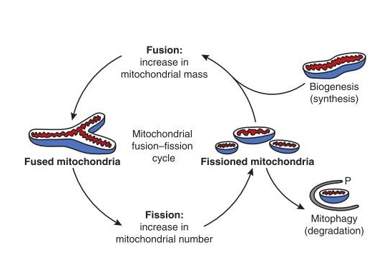
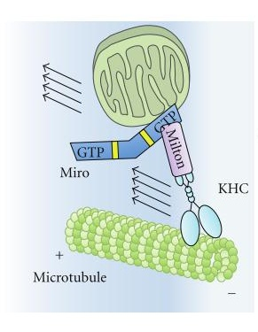
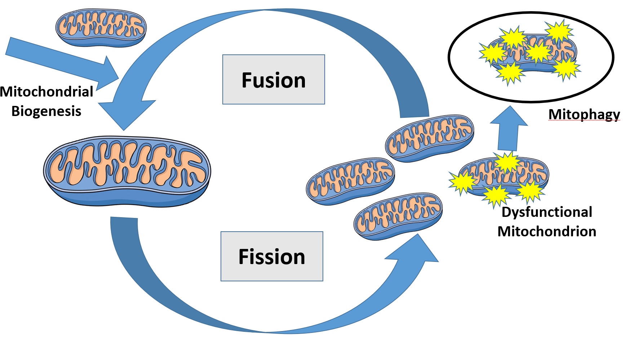
Mitochondrial Dynamics –
Life Cycle and Quality Control Mechanisms of Mitochondria
Griffiths, R., 2018. Mitochondria in Health and Disease. Singing Dragon.

Slide 15
Mitochondrial Dynamics
Mitochondria undergo coordinated cycles of fission and fusion… the balance of fission/fusion events is referred to as mitochondrial dynamics.
Energy for neurons is provided by mitochondria, who generate adenosine triphosphate (ATP) via oxidative phosphorylation.
Excessive damage to mitochondria may have a detrimental impact on the ATP synthesis… which can be disastrous for the viability and survival of neurons.
Yang D, Ying J, Wang X, et al. Mitochondrial Dynamics: A Key Role in Neurodegeneration and a Potential Target for Neurodegenerative Disease. Front Neurosci. 2021;15:654785. Published 2021 Apr 12. doi:10.3389/fnins.2021.654785

Slide 16
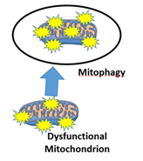
Mitophagy
Mitophagy is the ‘self-digestion’ of mitochondria for quality control, so that mitochondria can maintain peak efficiency for our brain energy.
Deficits of mitophagy are seen in ageing and neurodegenerative disorders, and targeting impaired mitochondrial pathways can protect cognitive health as our brains age.
Nutrition to enhance optimal mitochondrial integrity and turnover holds great potential.
Jayatunga DPW, Hone E, Khaira H, et al. Therapeutic Potential of Mitophagy-Inducing Microflora Metabolite, Urolithin A for Alzheimer's Disease. Nutrients. 2021;13(11):3744. Published 2021 Oct 23. doi:10.3390/nu13113744

Slide 17
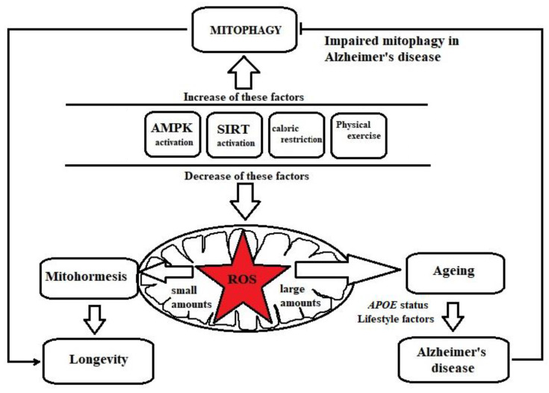
Mitophagy
Jayatunga DPW, Hone E, Khaira H, et al. Therapeutic Potential of Mitophagy-Inducing Microflora Metabolite, Urolithin A for Alzheimer's Disease. Nutrients. 2021;13(11):3744. Published 2021 Oct 23. doi:10.3390/nu13113744

Slide 18

Urolithin A
Urolithin A is an intestinal microbe-derived metabolite of polyphenols called ellagitannins.
Urolithin A exerts anti-ageing/brain supportive properties and increases mitochondrial efficiency, thought to be due to its mitophagy-inducing and antioxidant effects.
Ellagitannins are found in pomegranates, raspberries, strawberries, walnuts and almonds.
Jayatunga DPW, Hone E, Khaira H, et al. Therapeutic Potential of Mitophagy-Inducing Microflora Metabolite, Urolithin A for Alzheimer's Disease. Nutrients. 2021;13(11):3744. Published 2021 Oct 23. doi:10.3390/nu13113744

Slide 19
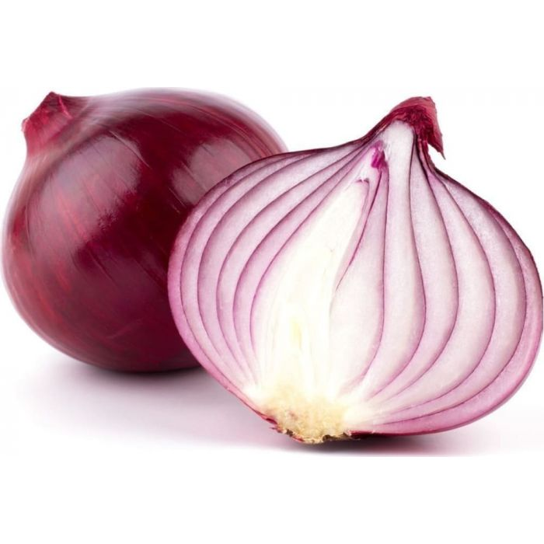
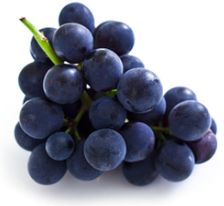
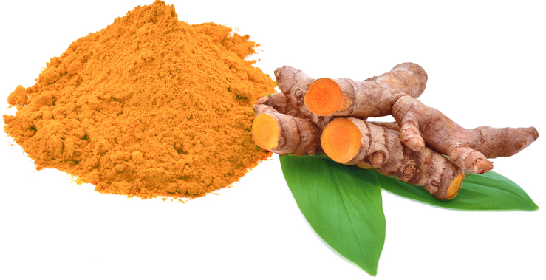
Polyphenols Support Mitochondria
Quercetin, resveratrol and curcumin all support mitophagy to help improve mitochondrial integrity.
Tan, S. and Wong, E., 2017. Mitophagy transcriptome: mechanistic insights into polyphenol-mediated mitophagy. Oxidative medicine and cellular longevity, 2017.

Slide 20
Insulin and
Cognitive Health

Slide 21
Insulin and Cognitive Health
Imbalanced mitochondrial dynamics and impaired mitophagy are found in type 2 diabetes, and result in cognitive impairment - no wonder Alzheimer’s disease is often called ‘type 3 diabetes’.
In type 2 diabetes, insulin resistance may exert a negative influence on memory and other cognitive functions.
Luo JS, Ning JQ, Chen ZY, et al. The Role of Mitochondrial Quality Control in Cognitive Dysfunction in Diabetes. Neurochem Res. 2022;47(8):2158-2172. doi:10.1007/s11064-022-03631-y, Cholerton B, Baker LD, Craft S. Insulin resistance and pathological brain ageing. Diabet Med. 2011;28(12):1463-1475. doi:10.1111/j.1464-5491.2011.03464.x

Slide 22
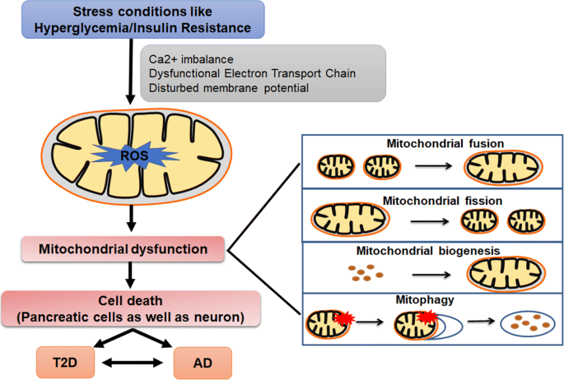
Insulin and Cognitive Health
Hyperglycaemia/insulin resistance undermine mitochondrial dynamics
(quality control)…
…a dysfunction common to both type 2 diabetes and neurodegeneration.
Paul, S., Saha, D. and Binukumar, B.K., 2021. Mitochondrial Dysfunction and Mitophagy Closely Cooperate in Neurological Deficits Associated with Alzheimer’s Disease and Type 2 Diabetes. Molecular Neurobiology, pp.1-15.

Slide 23
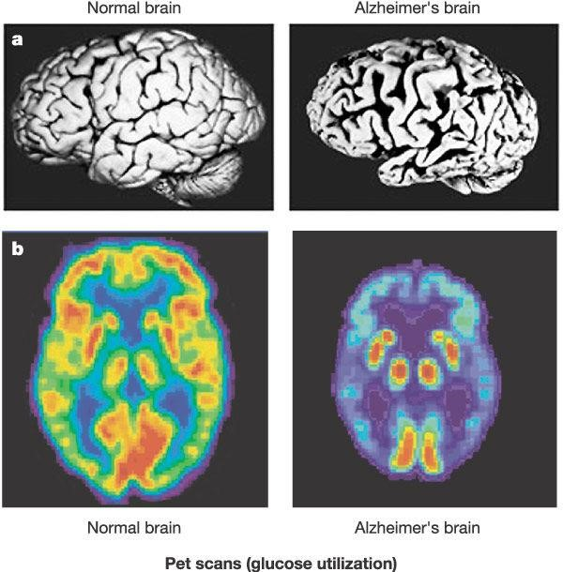
Insulin and Cognitive Health
The brain is loaded with insulin receptors to support healthy brain function…
…insulin resistance is therefore catastrophic for the brain.
https://thenoakesfoundation.org/news/blog/is-alzheimers-type-3-diabetes

Slide 24
Insulin and Cognitive Health
Healthy insulin signaling is
neuroprotective and regenerative…
…this is beyond insulin’s role
in glucose metabolism.

Slide 25
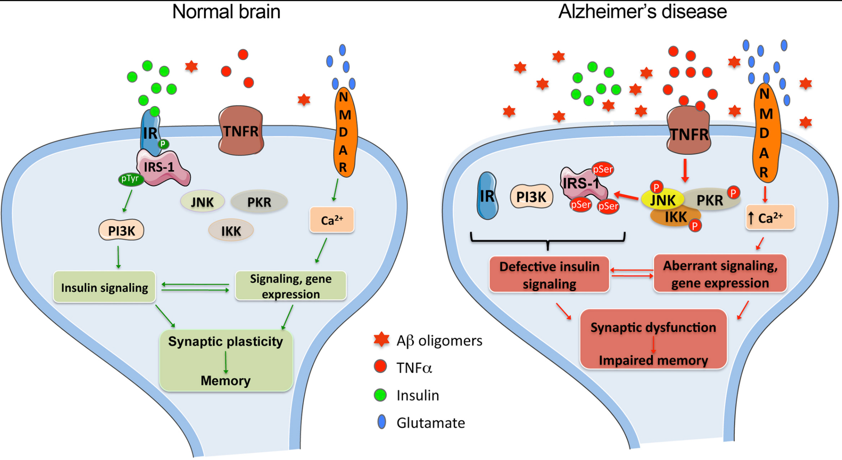
Insulin is Needed for Brain Health and Memory
Insulin plays a major neuroprotective and trophic function for cerebral cell populations…
…countering apoptosis, amyloid beta toxicity, and oxidative stress…
...favouring neuronal survival and enhancing memory and learning processes.
De Felice, F.G., Lourenco, M.V. and Ferreira, S.T., 2014. How does brain insulin resistance develop in Alzheimer's disease?. Alzheimer's & Dementia, 10(1), pp.S26-S32., Berlanga-Acosta, J., Guillén-Nieto, G., Rodríguez-Rodríguez, N., Bringas-Vega, M.L., García-del-Barco-Herrera, D., Berlanga-Saez, J.O., García-Ojalvo, A., Valdés-Sosa, M.J. and Valdés-Sosa, P.A., 2020. Insulin Resistance at the Crossroad of Alzheimer Disease Pathology: A Review. Frontiers in Endocrinology, 11.

Slide 26
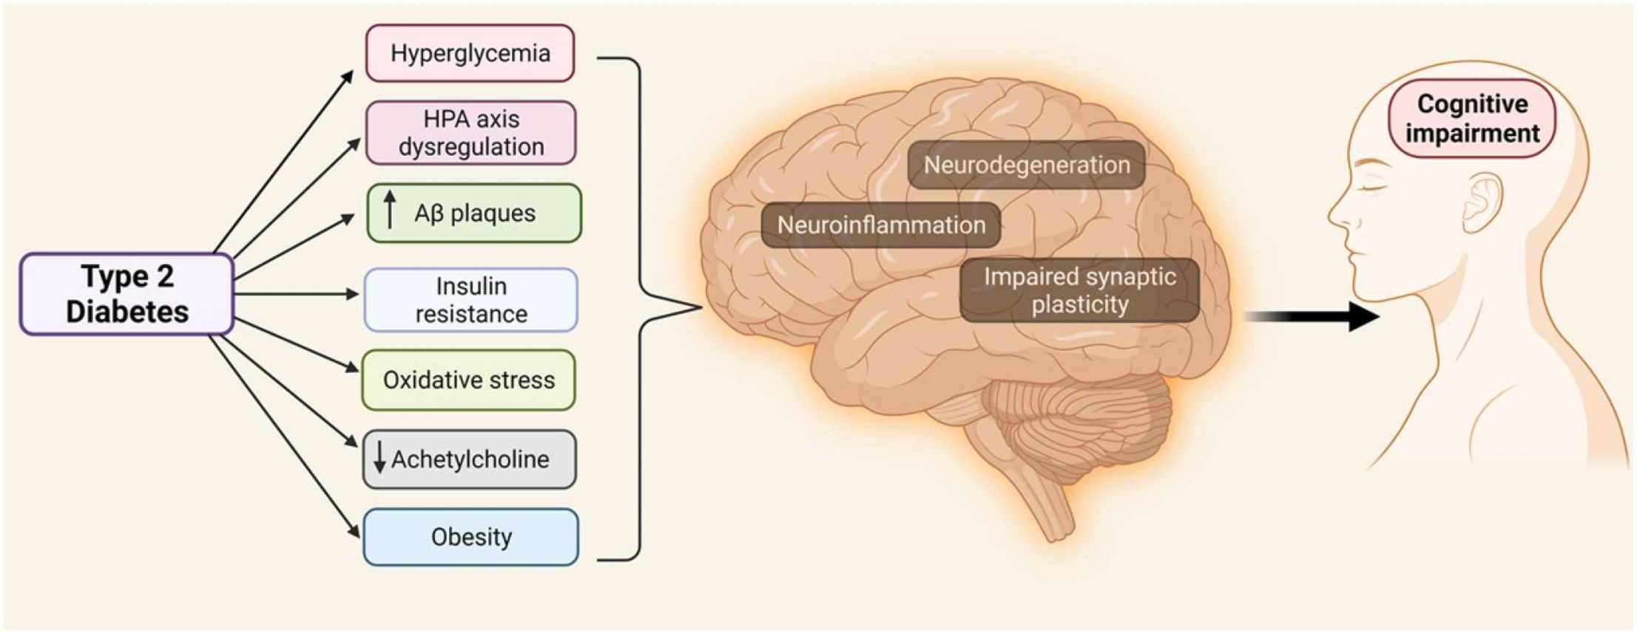
Many Aspects of Type 2 Diabetes are Associated with Cognitive Impairment
Dutta BJ, Singh S, Seksaria S, Das Gupta G, Singh A. Inside the diabetic brain: Insulin resistance and molecular mechanism associated with cognitive impairment and its possible therapeutic strategies. Pharmacol Res. 2022;182:106358. doi:10.1016/j.phrs.2022.106358

Slide 27
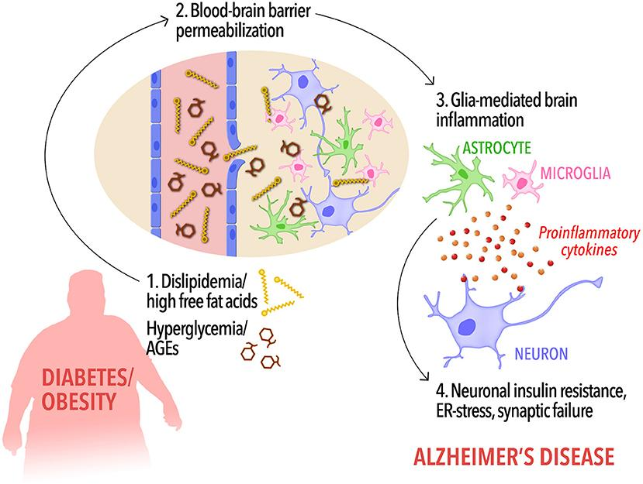
Type 2 Diabetes/Obesity Dysregulation Links to Alzheimer’s Disease
Ferreira, L.S., Fernandes, C.S., Vieira, M.N. and De Felice, F.G., 2018. Insulin resistance in Alzheimer's disease. Frontiers in neuroscience, 12, p.830.

Slide 28
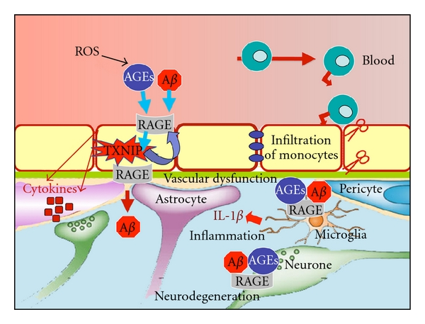
Advanced Glycation End-Products (AGEs)
AGEs increase during hyperglycaemia
AGEs bind to their receptors (RAGEs)
The damage to the blood-brain barrier from AGEs can result in low levels of glucose reaching neurons
Strangely, high blood glucose, can lead to low brain glucose.
Perrone, L., Sbai, O., Nawroth, P.P. and Bierhaus, A., 2012. The complexity of sporadic Alzheimer’s disease pathogenesis: the role of RAGE as therapeutic target to promote neuroprotection by inhibiting neurovascular dysfunction. International journal of Alzheimer’s disease, 2012., Salahuddin, P., Rabbani, G. and Khan, R., 2014. The role of advanced glycation end products in various types of neurodegenerative disease: a therapeutic approach. Cellular and Molecular Biology Letters, 19(3), pp.407-437.

Slide 29
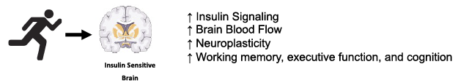
Exercise, Insulin and the Brain
Malin SK, Stewart NR, Ude AA, Alderman BL. Brain insulin resistance and cognitive function: influence of exercise. J Appl Physiol (1985). 2022;133(6):1368-1380. doi:10.1152/japplphysiol.00375.2022

Slide 30
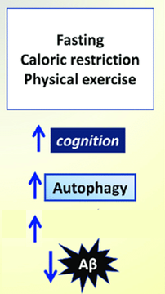
Fasting, CR and Exercise
Fasting, calorie restriction and exercise can help improve insulin sensitivity, mitophagy and improve cognition...
…and the risk of the formation of damaging amyloid beta aggregates is also decreased.
Mitophagy
Insulin sensitivity
de Mello NP, Orellana AM, Mazucanti CH, de Morais Lima G, Scavone C, Kawamoto EM. Insulin and Autophagy in Neurodegeneration. Front Neurosci. 2019;13:491. Published 2019 May 22. doi:10.3389/fnins.2019.00491

Slide 31
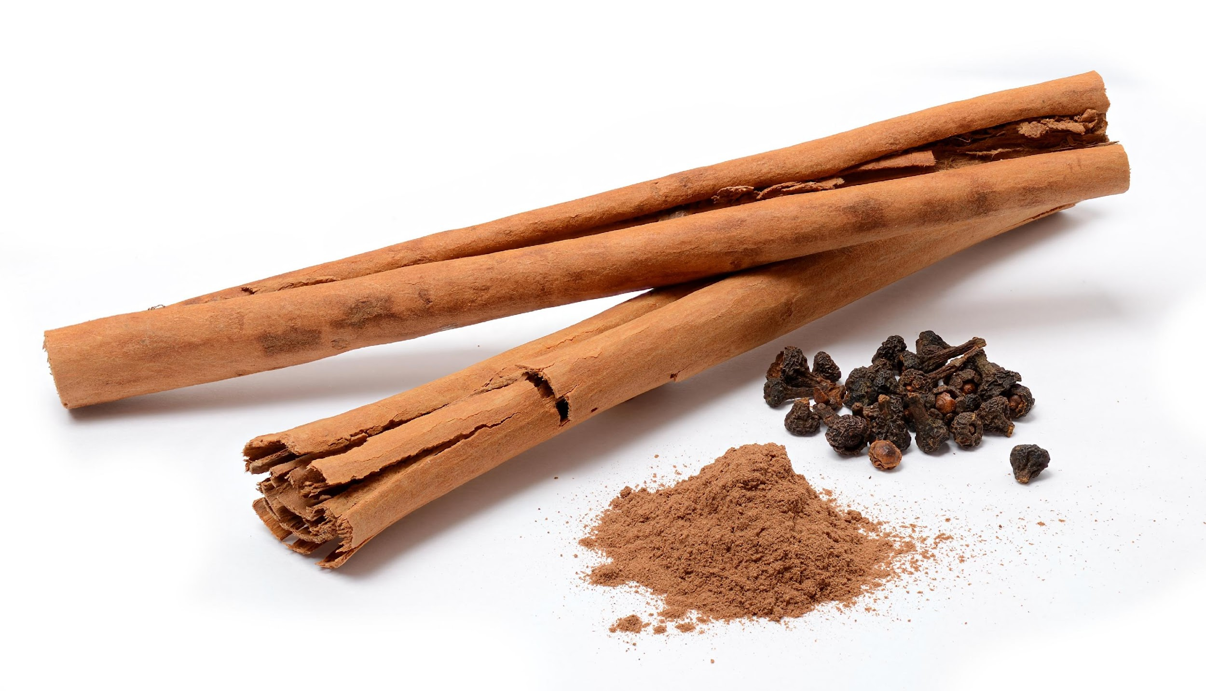
Cinnamon
There is evidence for cinnamon helping to prevent insulin resistance, metabolic syndrome, type 2 diabetes and alleviating factors associated with Alzheimer’s disease and memory loss.
Anderson RA, Qin B, Canini F, Poulet L, Roussel AM. Cinnamon counteracts the negative effects of a high fat/high fructose diet on behavior, brain insulin signaling and Alzheimer-associated changes. PLoS One. 2013;8(12):e83243. Published 2013 Dec 13. doi:10.1371/journal.pone.0083243

Slide 32
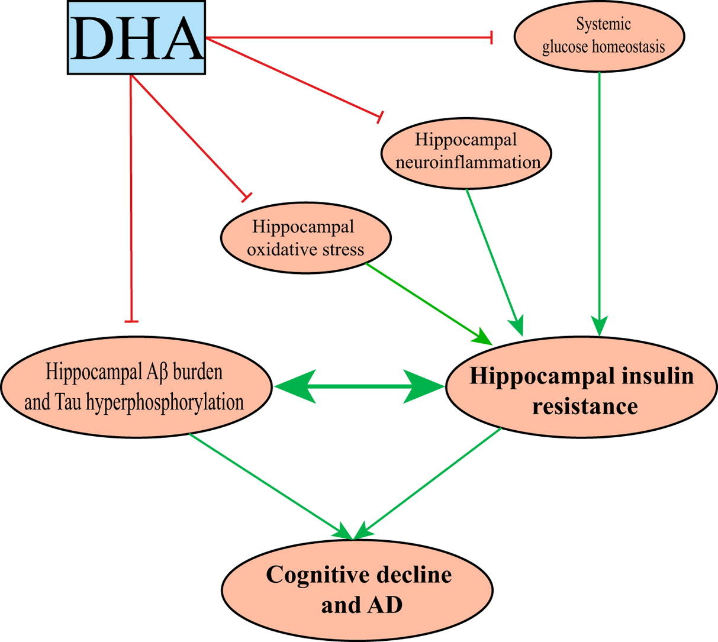
DHA
Improves systemic glucose metabolism disorders
Prevents hippocampal neuroinflammation
Attenuates hippocampal oxidative stress
Inhibits hippocampal amyloid formation and Tau phosphorylation
Reduces hippocampal insulin resistance
Improves cognitive function.
Xu J, Ni B, Ma C, et al. Docosahexaenoic acid enhances hippocampal insulin sensitivity to promote cognitive function of aged rats on a high-fat diet. J Adv Res. 2023;45:31-42. doi:10.1016/j.jare.2022.04.015

Slide 33
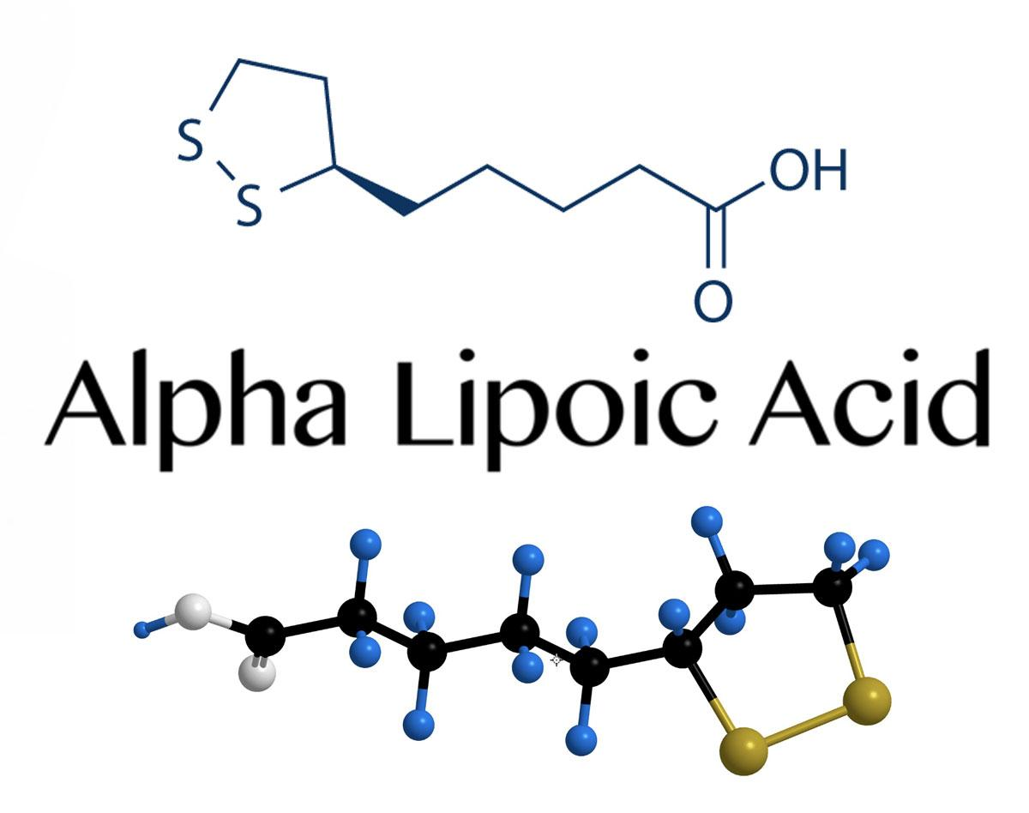
Alpha Lipoic Acid
Alpha lipoic acid has anti-inflammatory effects, and there is evidence for it helping prevent vascular diseases, reducing cognitive impairment, and alleviating brain insulin resistance.
Ko CY, Xu JH, Lo YM, et al. Alleviative Effect of Alpha-Lipoic Acid on Cognitive Impairment in High-Fat Diet and Streptozotocin-Induced Type 2 Diabetic Rats. Front Aging Neurosci. 2021;13:774477. Published 2021 Nov 12. doi:10.3389/fnagi.2021.774477

Slide 34
High-Fat Diet and Cognitive Health

Slide 35
Ceramide, a Toxic Lipid for the Brain
High levels of saturated fat from the diet or endogenous synthesis are often metabolised to a toxic lipid metabolite called ceramide
Ceramide is ‘lipotoxic’
Ceramide triggers insulin resistance
Excessively high levels of ceramide are synthesised in type 2 diabetes, obesity, inflammation and neurodegeneration
The most toxic saturated fat for ceramide synthesis is palmitic acid (16C).
Field BC, Gordillo R, Scherer PE. The Role of Ceramides in Diabetes and Cardiovascular Disease Regulation of Ceramides by Adipokines. Front Endocrinol (Lausanne). 2020;11:569250. Published 2020 Oct 2. doi:10.3389/fendo.2020.569250

Slide 36
Ceramide, a Toxic Lipid for the Brain
Ceramide levels in the cell and blood lead to pathological changes in Alzheimer’s disease…
…including Aβ plaques, mitochondrial dysfunction, mitophagy dysfunction, platelet activation and endothelial dysfunction.
Chowdhury MR, Jin HK, Bae JS. Diverse Roles of Ceramide in the Progression and Pathogenesis of Alzheimer's Disease. Biomedicines. 2022;10(8):1956. Published 2022 Aug 12. doi:10.3390/biomedicines10081956

Slide 37
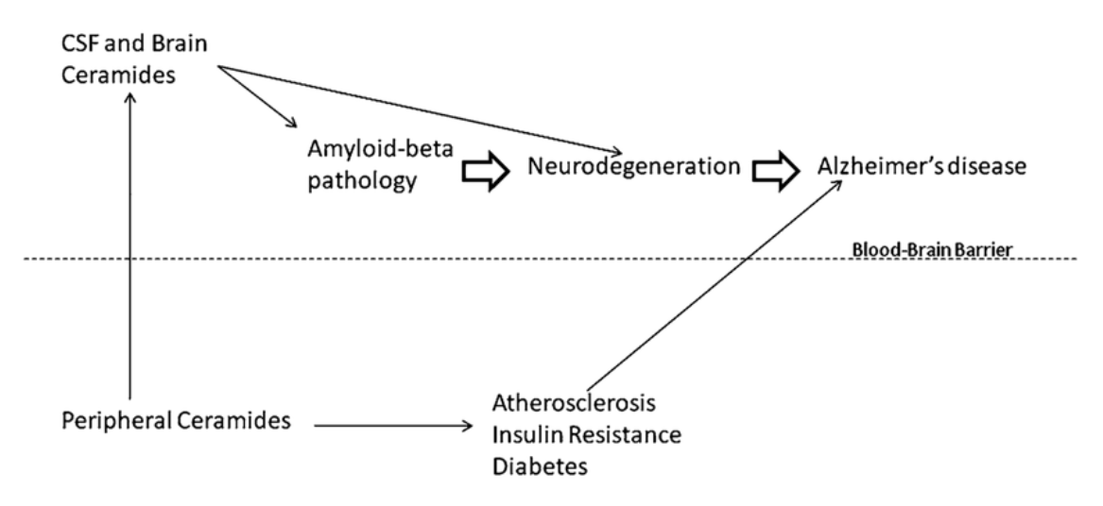
Ceramide, a Toxic Lipid for the Brain
Mielke MM, Lyketsos CG. Alterations of the sphingolipid pathway in Alzheimer's disease: new biomarkers and treatment targets?. Neuromolecular Med. 2010;12(4):331-340. doi:10.1007/s12017-010-8121-y

Slide 38
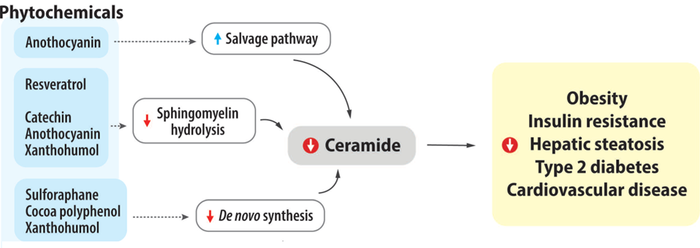
Phytochemicals Protect Against Ceramide Toxicity
Chamiloflan
Kim, E. and Jeon, S., 2023. The Impact of Phytochemicals in Obesity-Related Metabolic Diseases: Focus on Ceramide Metabolism. Nutrients, 15(3), p.703.

Slide 39
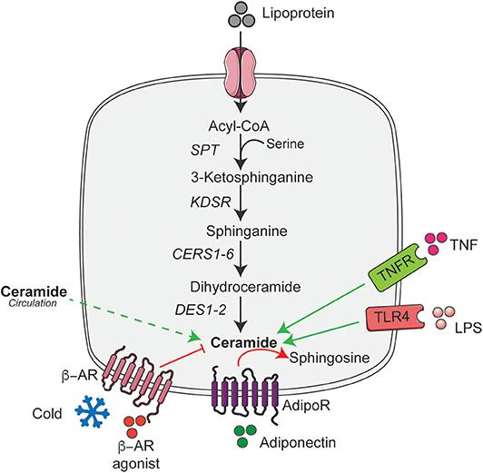
Adiponectin Enhances Ceramide Degradation
High saturated fat
The adipokine, adiponectin, increases the activity of ceramidase and enhances ceramide catabolism to sphingosine
Increased degradation of ceramide to sphingosine helps to improve insulin sensitivity
Cold exposure or noradrenaline activate thermogenic genes which inhibit ceramide synthesis.
Sokolowska, E. and Blachnio-Zabielska, A., 2019. The role of ceramides in insulin resistance. Frontiers in Endocrinology, 10, p.577., Li, Y., Talbot, C.L. and Chaurasia, B., 2020. Ceramides in adipose tissue. Frontiers in Endocrinology, 11, p.407.

Slide 40
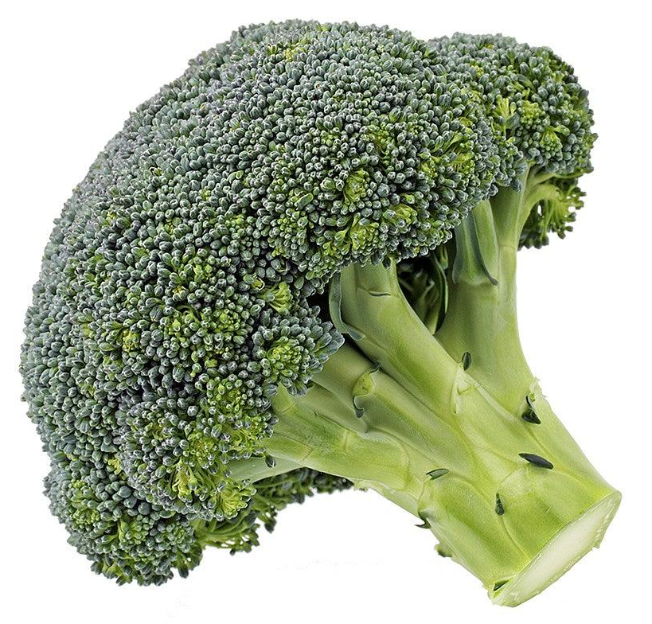
Sulforaphane from Broccoli Inhibits Ceramide Synthesis
Broccoli florets added to a high fat diet significantly reduce serum insulin levels, and upregulate the expression of the adiponectin receptor…
…and as mentioned, adiponectin drives ceramide degradation through ceramidase activation.
Omega-3 fatty acids also increase adiponectin.
Zandani, G., Anavi-Cohen, S., Tsybina-Shimshilashvili, N., Sela, N., Nyska, A. and Madar, Z., 2021. Broccoli florets supplementation improves insulin sensitivity and alters gut microbiome population—a steatosis mice model induced by high-fat diet. Frontiers in Nutrition, 8, p.680241., Sokolowska, E. and Blachnio-Zabielska, A., 2019. The role of ceramides in insulin resistance. Frontiers in Endocrinology, 10, p.577., Li, Y., Talbot, C.L. and Chaurasia, B., 2020. Ceramides in adipose tissue. Frontiers in Endocrinology, 11, p.407., Rausch JA, Gillespie S, Orchard T, Tan A, McDaniel JC. Secondary data analysis investigating effects of marine omega-3 fatty acids on circulating levels of leptin and adiponectin in older adults. Prostaglandins Leukot Essent Fatty Acids. 2021;170:102302. doi:10.1016/j.plefa.2021.102302

Slide 41
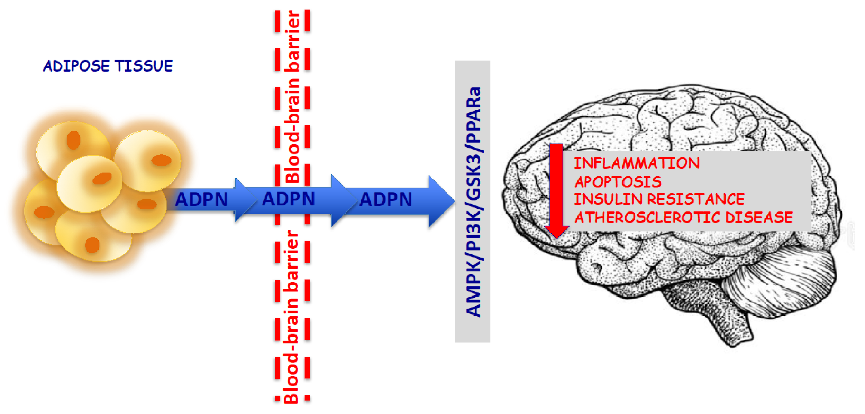
Adiponectin Supports Cognitive Health
Adiponectin displays anti-inflammatory effects within the central nervous system, making it an important tool in protecting against cognitive decline.
Rizzo MR, Fasano R, Paolisso G. Adiponectin and Cognitive Decline. Int J Mol Sci. 2020;21(6):2010. Published 2020 Mar 16. doi:10.3390/ijms21062010

Slide 42
Brain Inflammation

Slide 43
The Brain has its own Immune System
Microglia are resident immune cells of the brain
15% of all brain cells are microglia, and they act as the first line of defence in the brain - dealing with infection or the clearance of damaged neurons
However they do far more than just fight infection
If ‘side-tracked’ with infection/inflammation for too long, microglia will not be able to deal with important brain ‘housekeeping’ and building.

Slide 44
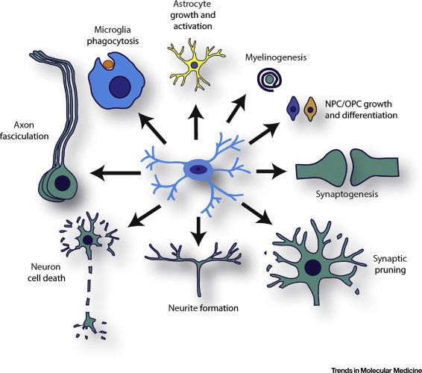
Microglia as Dynamic Cellular Mediators of Brain Function
Microglia are critical for proper neuronal function in the brain, including regulating axon development, programmed cell death, neurite formation, synaptic “pruning”, and synaptogenesis.
In addition, microglia specify neural progenitor cell (NPC) and oligodendrocyte progenitor cell (OPC) expansion and differentiation…
…promote myelinogenesis, and increase astrocyte activation and proliferation.
Lastly, microglia engulf cellular debris (phagocytosis).
Wright-Jin EC, Gutmann DH. Microglia as Dynamic Cellular Mediators of Brain Function. Trends Mol Med. 2019;25(11):967-979. doi:10.1016/j.molmed.2019.08.013

Slide 45
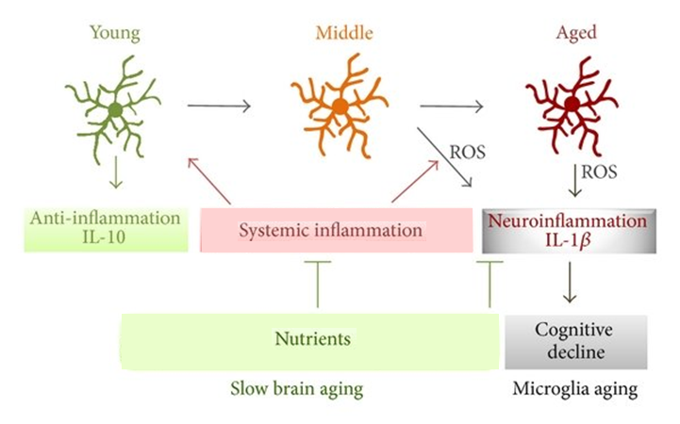
Inflammation Diverts Microglia from their Protective Activities
Inflammation and the inflammatory transcription factor NF-kappa B ‘push’ microglia to a pro-inflammatory phenotype…
…meaning that they are diverted from brain protective activities.
The transcription factor Nrf2 keeps microglia in a healthy phenotype.
Wu Z, Yu J, Zhu A, Nakanishi H. Nutrients, Microglia Aging, and Brain Aging. Oxid Med Cell Longev. 2016;2016:7498528. doi:10.1155/2016/7498528, Rojo AI, McBean G, Cindric M, et al. Redox control of microglial function: molecular mechanisms and functional significance. Antioxid Redox Signal. 2014;21(12):1766-1801. doi:10.1089/ars.2013.5745

Slide 46
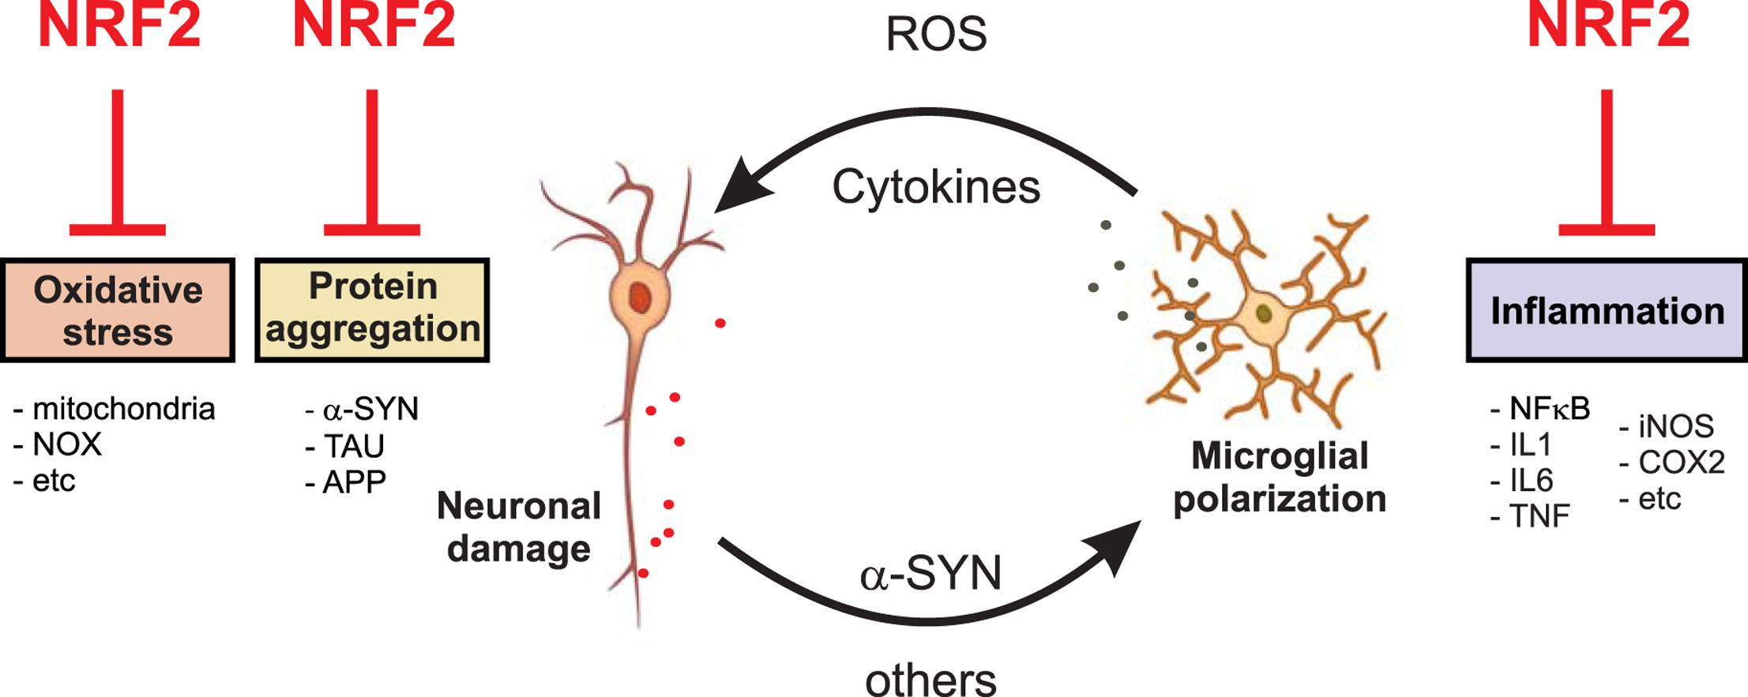
How Nrf2 Protects Against Neuroinflammation
The transcription factor Nrf2 provides protection against the main hallmarks of neuroinflammatory disorders including:
Misfolded proteins and oxidative, inflammatory and metabolic stress.
Cuadrado, A. (2016). NRF2 in neurodegenerative diseases. Current Opinion in Toxicology, 1, 46-53.

Slide 47
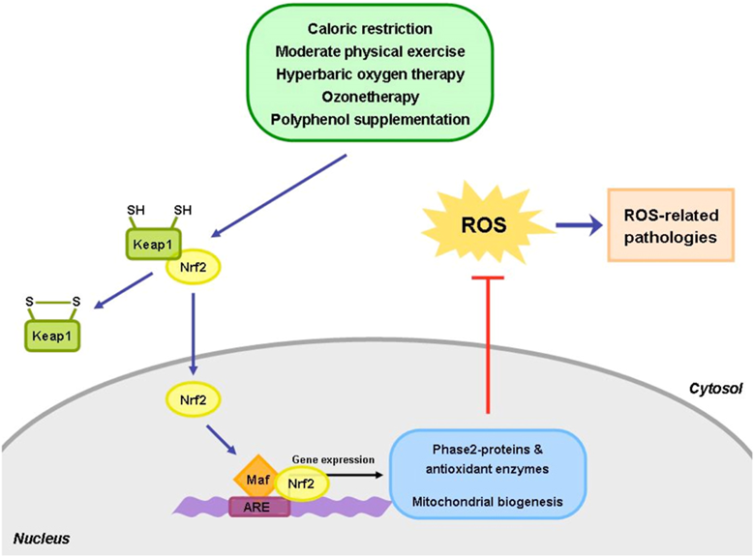
Nrf2 Tells DNA to Make Antioxidant Enzymes
Mild oxidative stress activates Nrf2/ARE* to trigger the gene expression of antioxidant enzymes, support neurological health and promote mitochondrial biogenesis.
*ARE: Antioxidant Response Element
Bocci, V. and Valacchi, G., 2015. Nrf2 activation as target to implement therapeutic treatments. Frontiers in chemistry, 3, p.4.

Slide 48
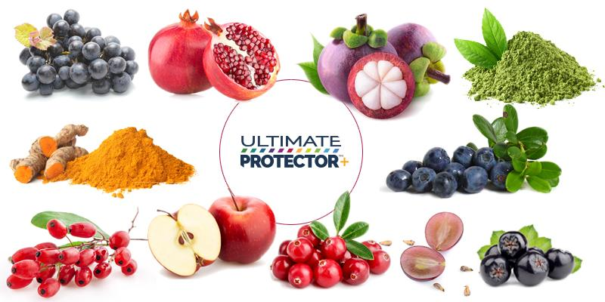
Nrf2 Activators
Nrf2 Activators
THE AMAZING HEALING POTENTIAL OF NATURAL NRF2 ACTIVATORS http://www.integratedhealthblog.com/category/enzymes/

Slide 49
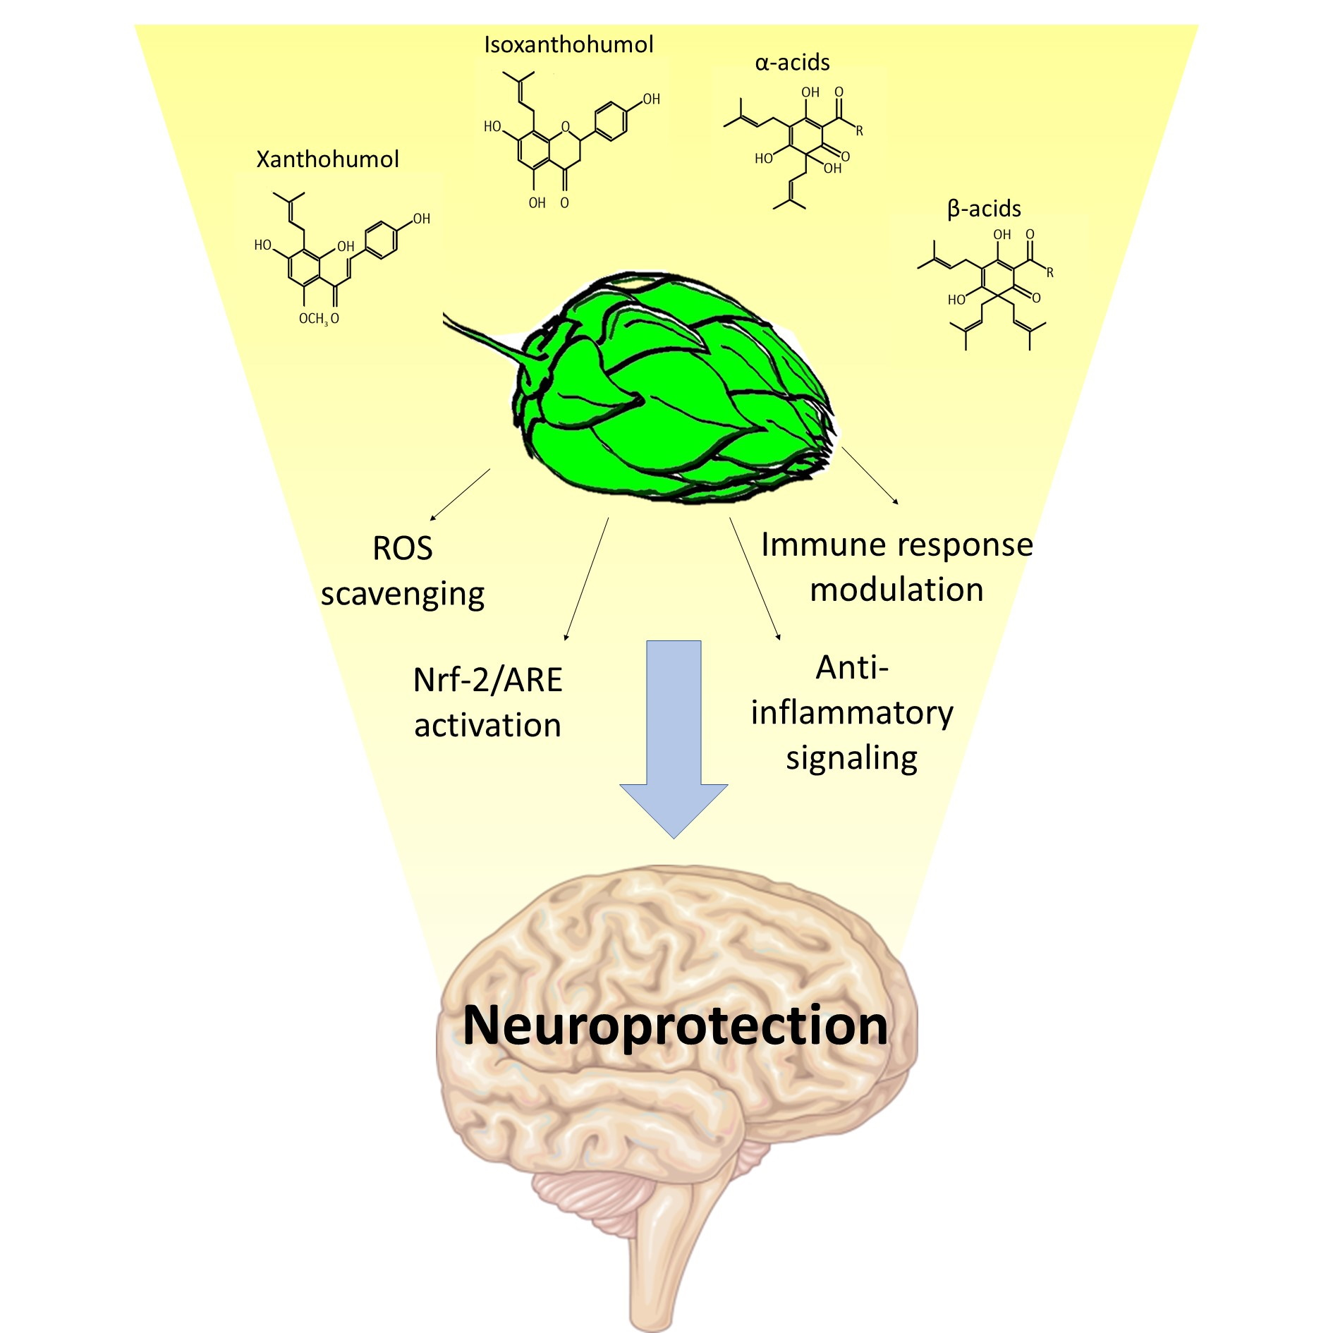
The Neuroprotective Power of Hops
Vazquez-Cervantes GI, Ortega DR, Blanco Ayala T, et al. Redox and Anti-Inflammatory Properties from Hop Components in Beer-Related to Neuroprotection. Nutrients. 2021;13(6):2000. Published 2021 Jun 10. doi:10.3390/nu13062000

Slide 50
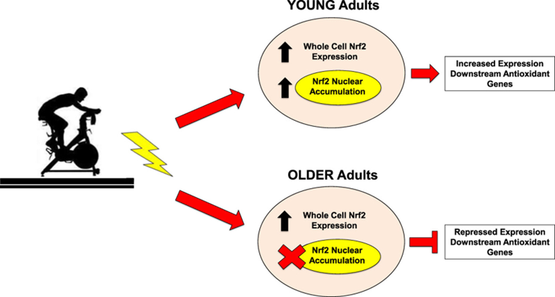
Nrf2 Becomes Less Effective as we Age
Exercise induced Nrf2 is repressed as we get older.
Therefore it is more difficult to suppress inflammation as we age.
Done, A.J., Gage, M.J., Nieto, N.C. and Traustadóttir, T., 2016. Exercise-induced Nrf2-signaling is impaired in aging. Free Radical Biology and Medicine, 96, pp.130-138.

Slide 51
Preserving Nrf2 Actions in Ageing
Calorie restriction prevents
the age-related decline in Nrf2 activity.
Vitamin D plays a role in delaying ageing
by upregulating Nrf2, inhibiting oxidative stress
and DNA damage.
Bruns, D.R., Drake, J.C., Biela, L.M., Peelor, F.F., Miller, B.F. and Hamilton, K.L., 2015. Nrf2 signaling and the slowed aging phenotype: evidence from long-lived models. Oxidative medicine and cellular longevity, 2015., Chen, L., Yang, R., Qiao, W., Zhang, W., Chen, J., Mao, L., Goltzman, D. and Miao, D., 2019. 1, 25‐Dihydroxyvitamin D exerts an antiaging role by activation of Nrf2‐antioxidant signaling and inactivation of p16/p53‐senescence signaling. Aging Cell, 18(3), p.e12951.

Slide 52
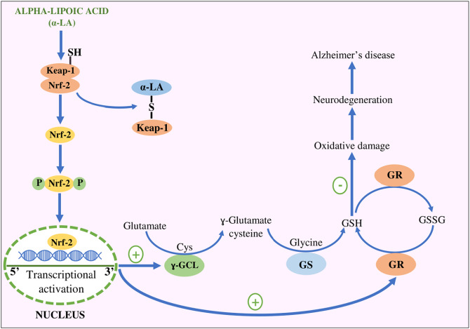
Alpha Lipoic Acid Supports Nrf2 During Ageing
The decline in transcriptional activity of Nrf2 causes age-related loss of glutathione synthesis, which is reversible with alpha lipoic acid.
Suh, J.H., Shenvi, S.V., Dixon, B.M., Liu, H., Jaiswal, A.K., Liu, R.M. and Hagen, T.M., 2004. Decline in transcriptional activity of Nrf2 causes age-related loss of glutathione synthesis, which is reversible with lipoic acid. Proceedings of the National Academy of Sciences, 101(10), pp.3381-3386, Kaur D, Behl T, Sehgal A, et al. Decrypting the potential role of α-lipoic acid in Alzheimer's disease. Life Sci. 2021;284:119899. doi:10.1016/j.lfs.2021.119899

Slide 53

Vitamin D
A recent study assessed effects of Vitamin D on dementia incidence in 12,388 trial participants
Vitamin D supplementation was associated with 40% lower incidence of dementia cases
Insulin resistance and obesity lead to slowing of the liver enzyme CYP2R1 - needed for the conversion of vitamin D₃ to 25-hydroxy vitamin D
Insulin resistant and obese individuals are therefore very likely to be vitamin D deficient
Serum 25-hydroxy vitamin D should be monitored regularly.
Ghahremani M, Smith EE, Chen HY, Creese B, Goodarzi Z, Ismail Z. Vitamin D supplementation and incident dementia: Effects of sex, APOE, and baseline cognitive status. Alzheimers Dement (Amst). 2023;15(1):e12404. Published 2023 Mar 1. doi:10.1002/dad2.12404, Tobias DK, Luttmann-Gibson H, Mora S, et al. Association of Body Weight With Response to Vitamin D Supplementation and Metabolism. JAMA Netw Open. 2023;6(1):e2250681. Published 2023 Jan 3. doi:10.1001/jamanetworkopen.2022.50681

Slide 54
Vascular Health and the Brain

Slide 55
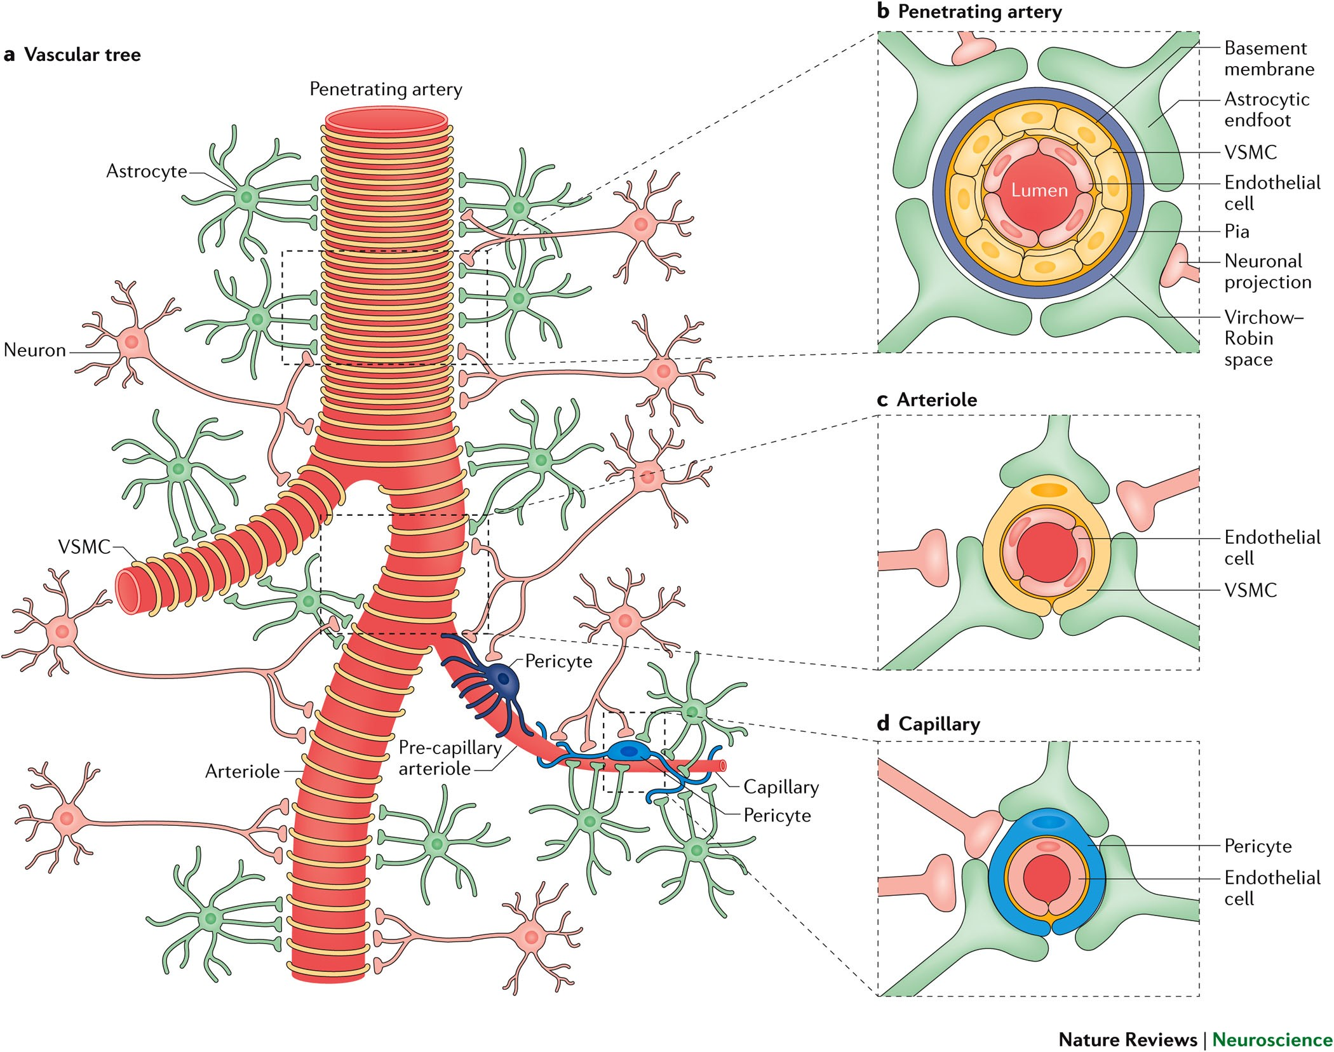
Neurons Closely Associate with Cerebral Blood Supply
The cerebral blood supply is fed by interconnected blood vessels, forming a 400 mile long vascular network.
Within this network, cerebral arteries, arterioles and capillaries supply the brain with oxygen, energy metabolites and nutrients.
Kisler, K., Nelson, A.R., Montagne, A. and Zlokovic, B.V., 2017. Cerebral blood flow regulation and neurovascular dysfunction in Alzheimer disease. Nature Reviews Neuroscience, 18(7), pp.419-434.

Slide 56
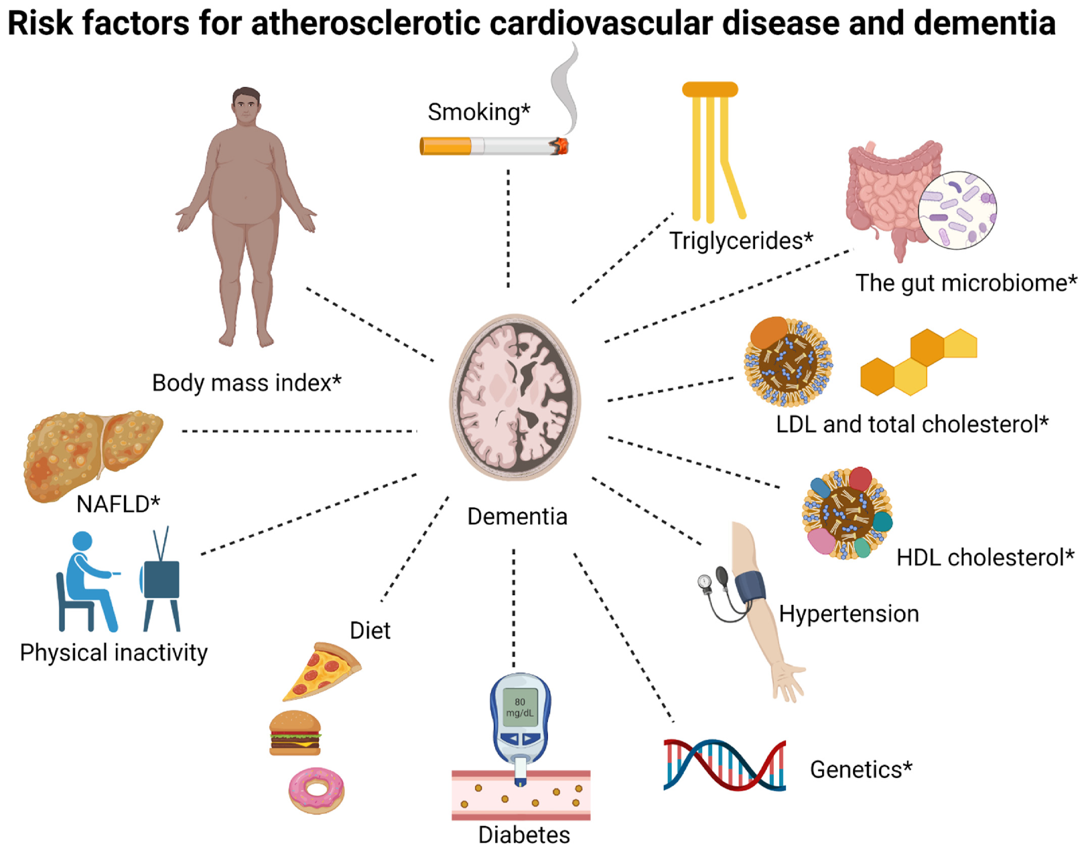
Risk Factors for Dementia and Cardiovascular Disease
Nordestgaard LT, Christoffersen M, Frikke-Schmidt R. Shared Risk Factors between Dementia and Atherosclerotic Cardiovascular Disease. Int J Mol Sci. 2022;23(17):9777. Published 2022 Aug 29. doi:10.3390/ijms23179777

Slide 57
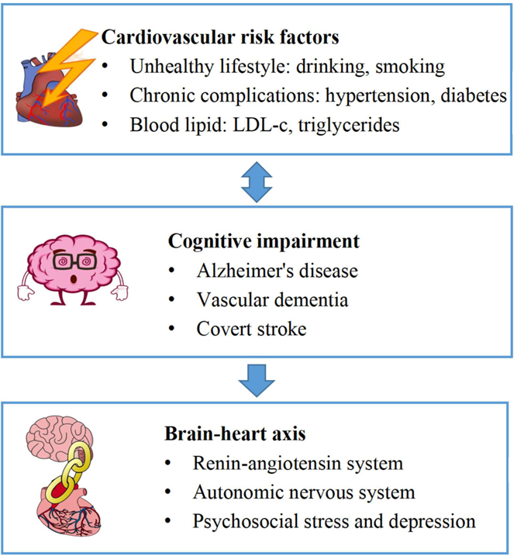
The Brain-Heart Axis
According to the theory of the brain-heart axis, cognitive impairment is related to:
Activation of the renin-angiotensin system
Dysfunction of the autonomic nervous system
Increased psychosocial stress.
Li, D., Jia, Y., Yu, J., Liu, Y., Li, F., Zhang, W., ... & Zeng, R. (2022). Cognition impairment and risk of subclinical cardiovascular disease in older adults: The atherosclerosis risk in communities study. Frontiers in Aging Neuroscience, 14.

Slide 58
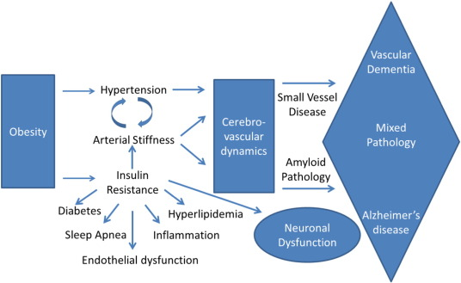
The Brain-Heart Axis
Metabolic and vascular health affect the risk of Alzheimer's disease and vascular related cognitive impairment.
Hughes TM, Craft S. The role of insulin in the vascular contributions to age-related dementia. Biochim Biophys Acta. 2016;1862(5):983-991. doi:10.1016/j.bbadis.2015.11.013

Slide 59
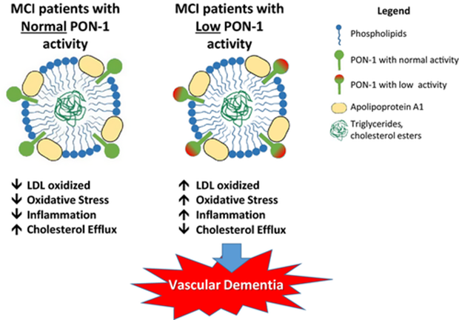
Protective Effects of Paraoxonase and Vascular Dementia
In patients with mild cognitive impairment (MCI) low serum levels of paraoxonase-1 (PON-1) are associated with a higher likelihood of developing vascular dementia.
Paraoxonase-1 helps to reduce levels of low-density lipoprotein (LDL) oxidation, decrease oxidative stress, attenuate inflammation, and increase cholesterol efflux.
Cervellati C, Trentini A, Romani A, et al. Serum paraoxonase and arylesterase activities of paraoxonase-1 (PON-1), mild cognitive impairment, and 2-year conversion to dementia: A pilot study. J Neurochem. 2015;135(2):395-401. doi:10.1111/jnc.13240

Slide 60
Pomegranate Juice Supports Paraoxonase
Pomegranate juice consumption increases the binding of high-density lipoproteins (HDL) to paraoxonase.
Decreased levels of paraoxonase are associated with higher levels of total cholesterol.
After four weeks of pomegranate juice consumption, subjects of a study showed a significant improvement in memory and increased verbal and visual tasks.
Estrada-Luna D, Martínez-Hinojosa E, Cancino-Diaz JC, Belefant-Miller H, López-Rodríguez G, Betanzos-Cabrera G. Daily supplementation with fresh pomegranate juice increases paraoxonase 1 expression and activity in mice fed a high-fat diet. Eur J Nutr. 2018;57(1):383-389. doi:10.1007/s00394-017-1394-2,
Bookheimer SY, Renner BA, Ekstrom A, Li Z, Henning SM, Brown JA, Jones M, Moody T, Small GW. Pomegranate juice augments memory and FMRI activity in middle-aged and older adults with mild memory complaints. Evid Based Complement Alternat Med. 2013;2013:946298.

Slide 61
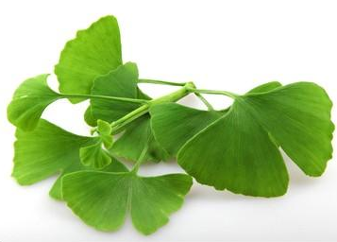
Ginkgo Biloba
Ginkgo biloba extracts are supportive in patients with mild cognitive impairment, vascular dementia and Alzheimer’s disease.
Zhang HF, Huang LB, Zhong YB, et al. An Overview of Systematic Reviews of Ginkgo biloba Extracts for Mild Cognitive Impairment and Dementia. Front Aging Neurosci. 2016;8:276. Published 2016 Dec 6. doi:10.3389/fnagi.2016.00276

Slide 62
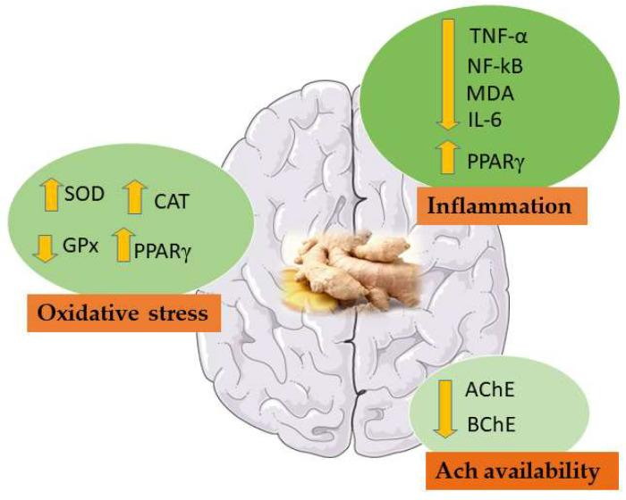
Protective Effects of Ginger in Vascular Dementia
NF-κB: Nuclear factor kappa-B; MDA: Malondialdehyde; TNF-α: Tumour necrosis factor-α; IL-6: Interleukin 6; SOD: Superoxide dismutase; CAT: Catalase; AChE: Acetylcholinesterase; BChE: Butyrylcholinesterase; GPx: glutathione peroxidase; PPARγ: peroxisome proliferation activator receptor γ.
Schepici G, Contestabile V, Valeri A, Mazzon E. Ginger, a Possible Candidate for the Treatment of Dementias?. Molecules. 2021;26(18):5700. Published 2021 Sep 21. doi:10.3390/molecules26185700

Slide 63
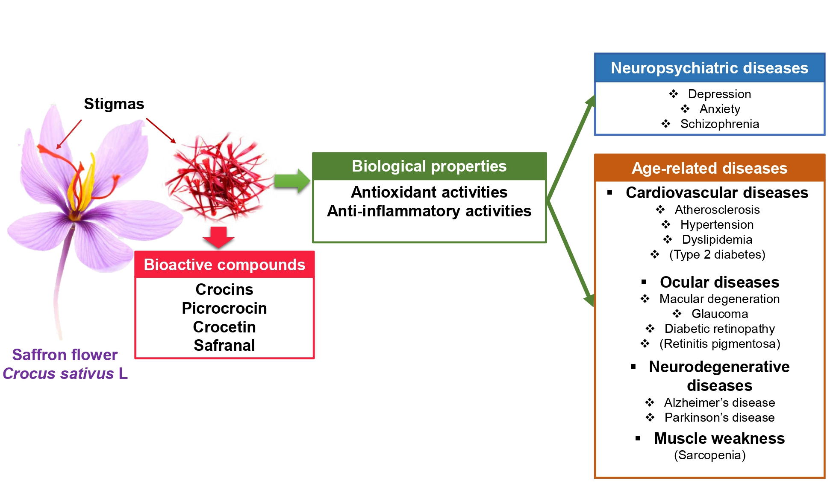
Saffron for the Mind and Body
Saffron’s rich phytochemical profile provides a promising approach in the prevention and treatment of age-related diseases.
Saffron’s main constituent molecules are crocins, crocetin, picrocrocin and safranal.
They exert positive effects on age-related and neurological diseases.
El Midaoui A, Ghzaiel I, Vervandier-Fasseur D, et al. Saffron (Crocus sativus L.): A Source of Nutrients for Health and for the Treatment of Neuropsychiatric and Age-Related Diseases. Nutrients. 2022;14(3):597. Published 2022 Jan 29. doi:10.3390/nu14030597

Slide 64
The Gut-Brain Axis

Slide 65
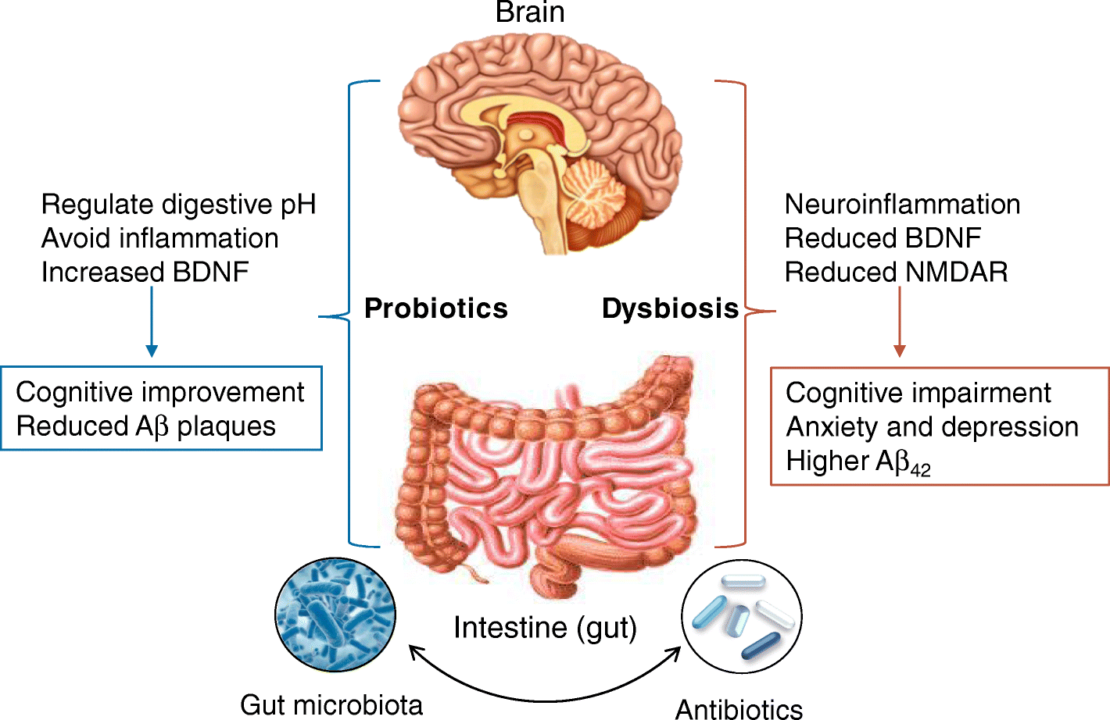
The Gut-Brain Axis
Probiotics are able to stabilise digestive pH, reduce inflammation, and increase neuroprotective molecules, such as brain-derived neurotrophic factor (BDNF).
Gut dysbiosis can induce neuroinflammation and reduce the expression of BDNF and the NMDA receptor, leading to cognitive impairment, mood disorders, and higher levels of toxic Aβ₄₂.
Angelucci F, Cechova K, Amlerova J, Hort J. Antibiotics, gut microbiota, and Alzheimer's disease. J Neuroinflammation. 2019;16(1):108. Published 2019 May 22. doi:10.1186/s12974-019-1494-4

Slide 66
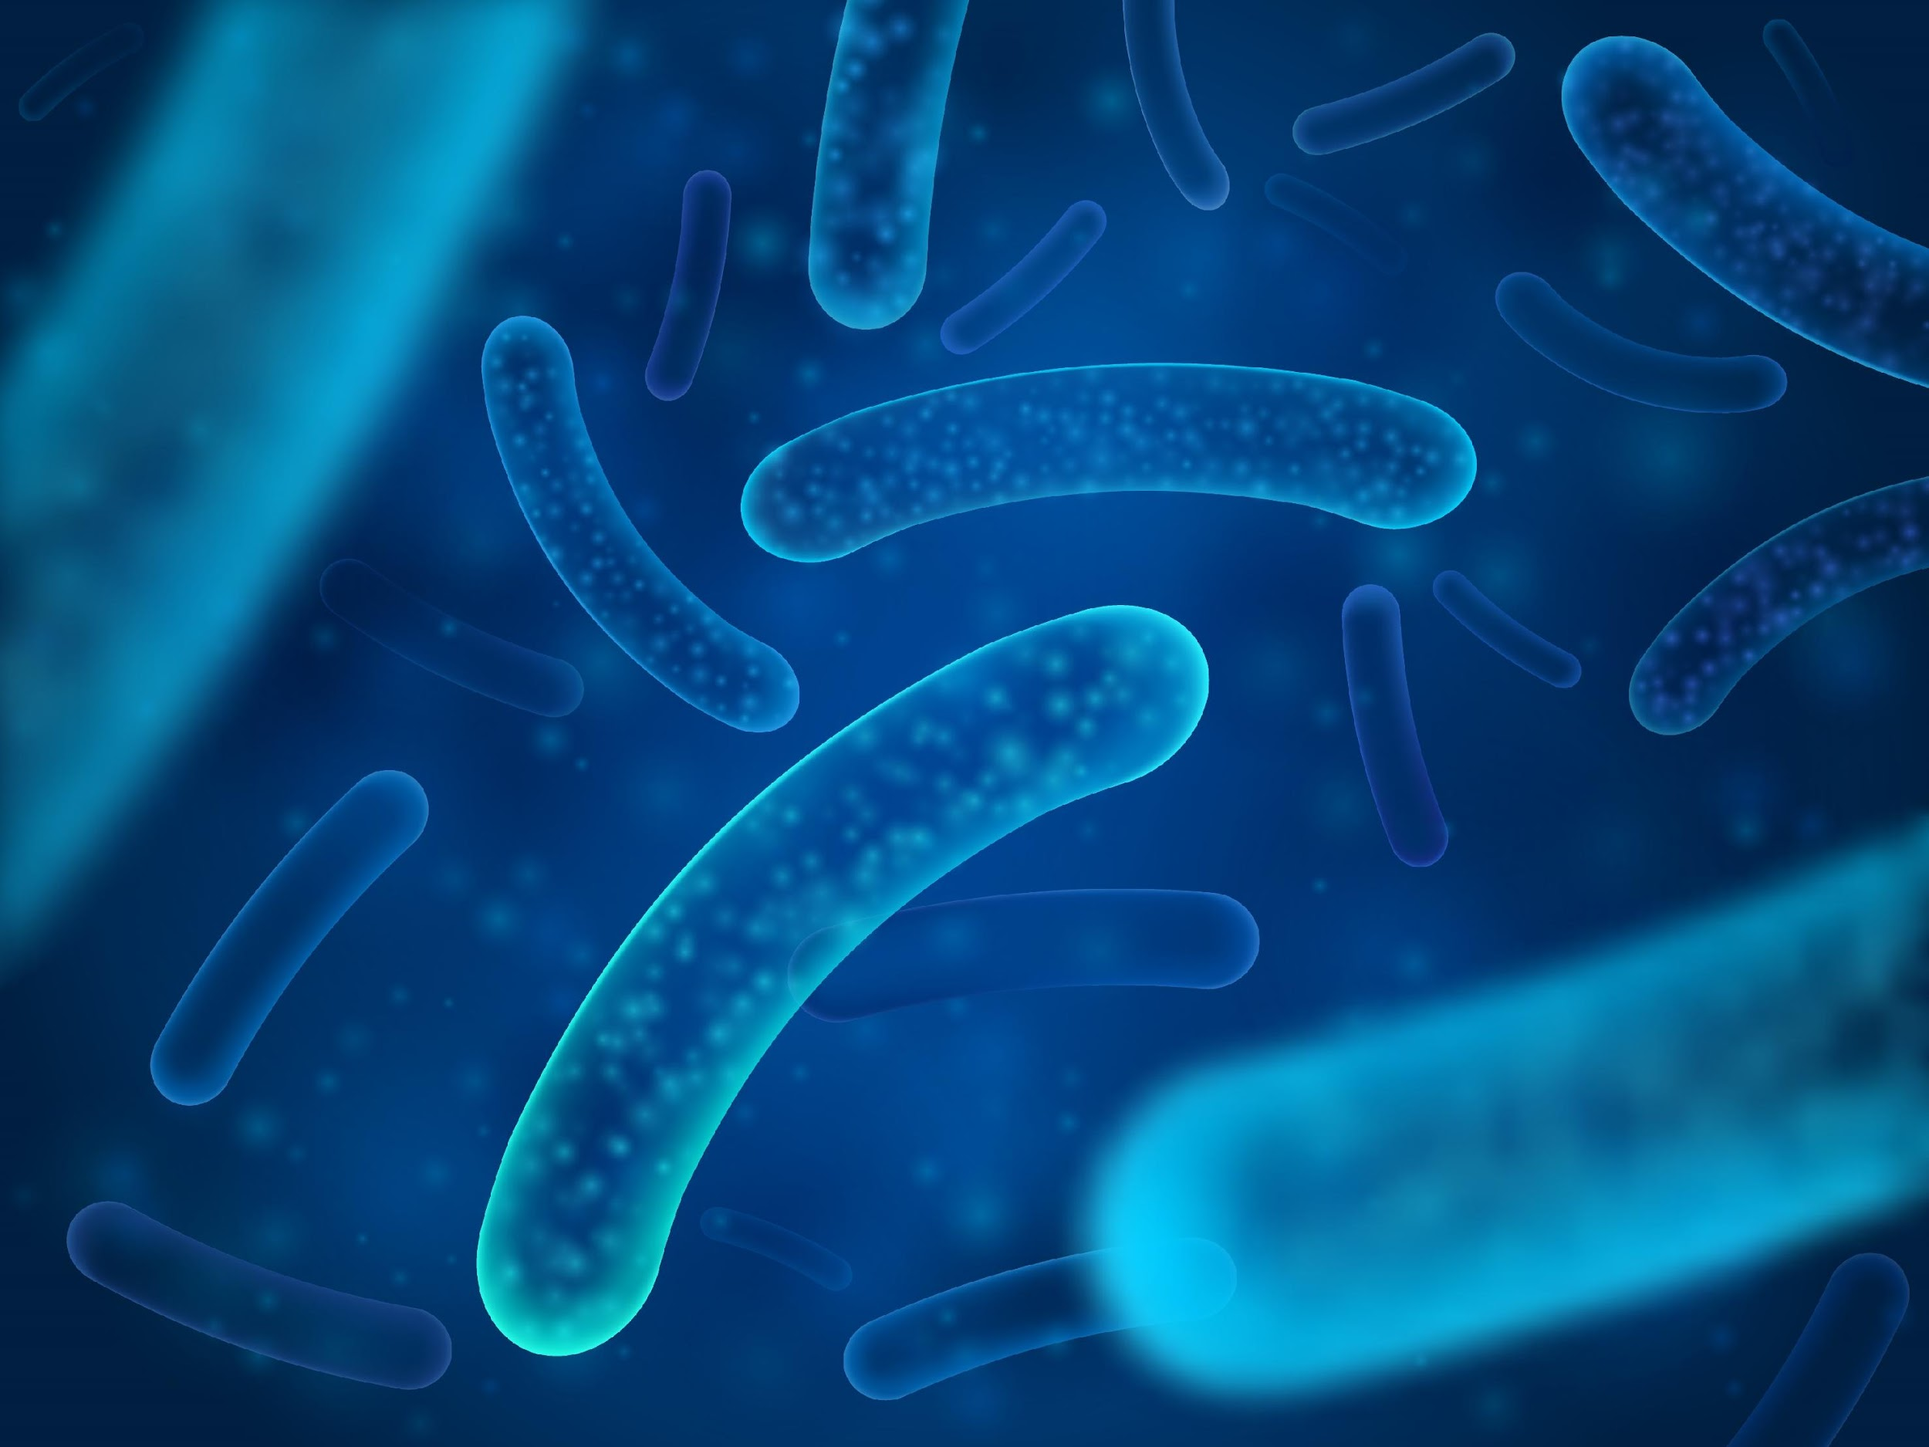
Probiotics
Bifidobacterium bifidum and Bifidobacterium longum probiotics have system-wide effects on the gut-brain axis in, healthy community-dwelling older adults, by promoting cognitive and mental health and changing the gut microbial composition.
Lactobacillus plantarum reduced some stress and anxiety symptoms via anti-inflammatory properties, followed by enhanced memory and cognitive abilities.
Kim CS, Cha L, Sim M, et al. Probiotic Supplementation Improves Cognitive Function and Mood with Changes in Gut Microbiota in Community-Dwelling Older Adults: A Randomized, Double-Blind, Placebo-Controlled, Multicenter Trial. J Gerontol A Biol Sci Med Sci. 2021;76(1):32-40. doi:10.1093/gerona/glaa090, Lew LC, Hor YY, Yusoff NAA, et al. Probiotic Lactobacillus plantarum P8 alleviated stress and anxiety while enhancing memory and cognition in stressed adults: A randomised, double-blind, placebo-controlled study. Clin Nutr. 2019;38(5):2053-2064. doi:10.1016/j.clnu.2018.09.010

Slide 67
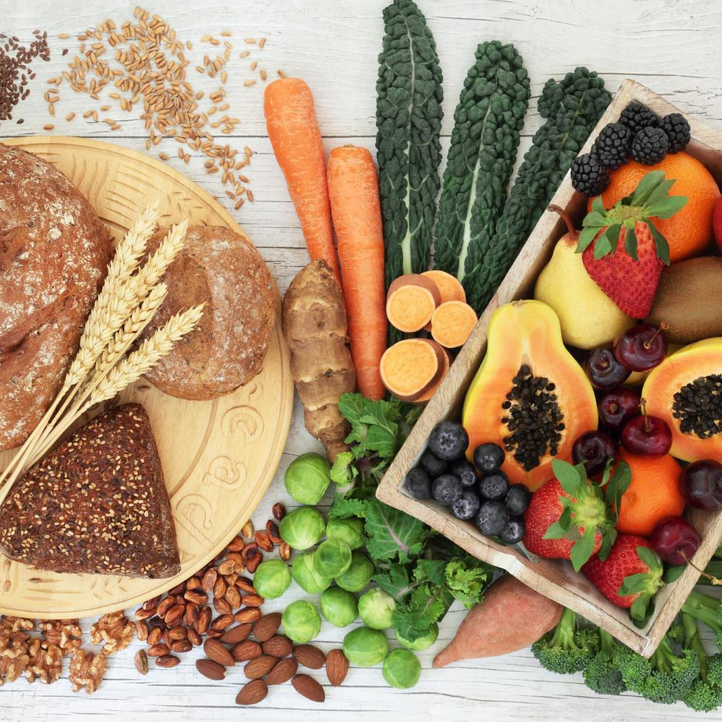
Fibre
Dietary fibre intake is positively associated with cognitive function in the elderly.
Fruit and vegetable sources of fibre are particularly beneficial.
Of course, it could also be that adults with greater cognitive function consume more fibre!
Sun, W., Li, S., Chen, C., Lu, Z., & Zhang, D. (2022). Dietary fiber intake is positively related with cognitive function in US older adults. Journal of Functional Foods, 90, 104986.

Slide 68
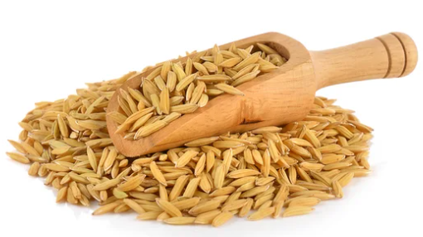
γ-Oryzanol
Rice bran is an abundant source of
γ-oryzanol which induces positive molecular changes in the brain.
γ-oryzanol is able to help prevent cognitive impairment related to neuroinflammation in a mouse model of neuroinflammation and cognitive alterations…
…thus showing promise for preserving memory and cognitive function.
Mastinu A, Bonini SA, Rungratanawanich W, et al. Gamma-oryzanol Prevents LPS-induced Brain Inflammation and Cognitive Impairment in Adult Mice. Nutrients. 2019;11(4):728. Published 2019 Mar 29. doi:10.3390/nu11040728

Slide 69
Acetylcholine
A neurotransmitter vital for cognition and control of inflammation.

Slide 70
Acetylcholine and Alzheimer’s Disease
The mainstream medical model to support Alzheimer’s disease and dementia focuses on maintaining levels of the neurotransmitter acetylcholine.
A widely used drug for Alzheimer’s raises levels of acetylcholine, by inhibiting its degrading enzyme called acetylcholinesterase.
In addition to supporting memory and cognition, via direct supply of acetylcholine, the drug is able to reduce brain inflammation via acetylcholine interaction with microglia in APP/PS1 mice – and, as a benefit, also increases BDNF.
Guo, H.B., Cheng, Y.F., Wu, J.G., Wang, C.M., Wang, H.T., Zhang, C., Qiu, Z.K. and Xu, J.P., 2015. Donepezil improves learning and memory deficits in APP/PS1 mice by inhibition of microglial activation. Neuroscience, 290, pp.530-542.

Slide 71
Choline Sources
Choline acetylcholine
Meat
Eggs
Phosphatidylcholine
Lecithin
Soybeans
Many people are deficient in choline. Vegans in particular should ensure that they include adequate plant sources of choline in their diet.
Mygind, V.L., Evans, S.E., Peddie, M.C., Miller, J.C. and Houghton, L.A., 2013. Estimation of usual intake and food sources of choline and betaine in New Zealand reproductive age women. Asia Pacific Journal of Clinical Nutrition, 22(2), pp.319-324., Derbyshire, E., 2019. Could we be overlooking a potential choline crisis in the United Kingdom?. BMJ Nutrition, Prevention & Health.

Slide 72
Natural Acetylcholinesterase (AChE) Inhibitors
AChE - The enzyme which degrades acetylcholine
Green and white tea
Coffee
Quercetin
Resveratrol
Curcumin
Rosemary
Chlorogenic acid – artichoke and coffee
Cardamom.
Okello, E.J., Leylabi, R. and McDougall, G.J., 2012. Inhibition of acetylcholinesterase by green and white tea and their simulated intestinal metabolites. Food & function, 3(6), pp.651-661, Pohanka, M. and Dobes, P., 2013. Caffeine inhibits acetylcholinesterase, but not butyrylcholinesterase. International journal of molecular sciences, 14(5), pp.9873-9882., Jabir, N.R., Khan, F.R. and Tabrez, S., 2018. Cholinesterase targeting by polyphenols: A therapeutic approach for the treatment of Alzheimer’s disease. CNS neuroscience & therapeutics, 24(9), pp.753-762., Hamidpour, R., Hamidpour, S. and Elias, G., 2017. Rosmarinus officinalis (Rosemary): a novel therapeutic agent for antioxidant, antimicrobial, anticancer, antidiabetic, antidepressant, neuroprotective, anti-inflammatory, and anti-obesity treatment. Biomed J Sci Tech Res, 1(4), pp.1-6., Heitman, E. and Ingram, D.K., 2017. Cognitive and neuroprotective effects of chlorogenic acid. Nutritional neuroscience, 20(1), pp.32-39., Setty, P.V., Sailesh, K.S., Neethu, N. and Mukkadan, J.K., 2013. A study on effect of oral administration of cardamom on memory boosting and regaining in wistar albino rats. Asian Journal of Health Sciences, 1(1).

Slide 73
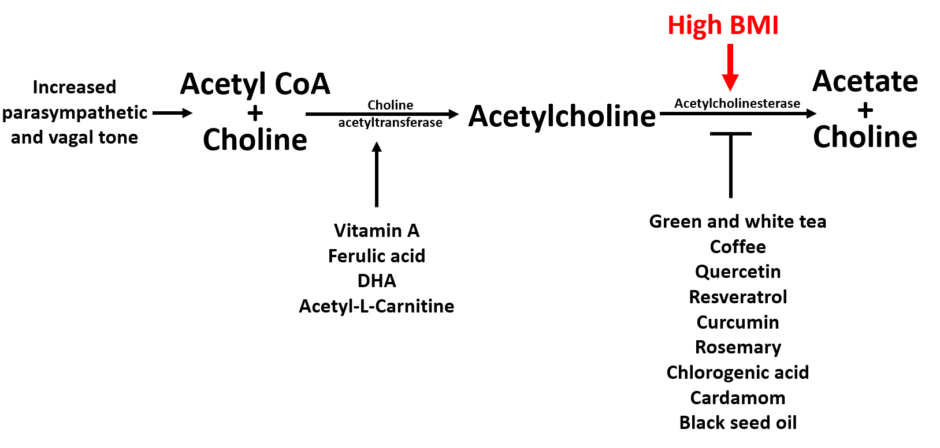
Supporting Acetylcholine at Multiple Levels

Slide 74
Diet and
Cognitive Health

Slide 75

The MIND Diet
The MIND diet is a hybrid of the Mediterranean and
DASH (Dietary Approaches to Stop Hypertension)
diets. Designed to help protect against Alzheimer’s disease,
and improve the health of patients with Alzheimer’s disease.
The MIND diet has 15 dietary components, including
10 ‘brain-healthy food groups’ - green leafy vegetables,
other vegetables, nuts, berries, beans, whole grains, fish,
poultry and olive oil … and excluding five unhealthy
groups that comprise red meats, margarine,
cheese, pastries and sweets, and fried or fast food.
Morris, M. C. et al. (2015) ‘MIND diet slows cognitive decline with aging’, Alzheimer’s and dementia : the journal of the Alzheimer’s Association. NIH Public Access, 11(9), p. 1015. doi: 10.1016/J.JALZ.2015.04.011

Slide 76

A Mild Ketogenic Diet
Dr Dale Bredesen advises a mild ketogenic diet - Ketoflex 12 / 3:
‘12’ means leaving 12 hours between
the last meal of the day and the first
meal the day after
‘3’ means leaving 3 hours between the
last meal of the day and bedtime
The 12 / 3 action will put the body into
a mild state of ketosis which is healing
for the brain and mitochondria
Simple carbohydrate intake will rapidly halt ketosis.
Bredesen, D. (2017) The End of Alzheimer’s. London: Vermillion.

Slide 77

The Mediterranean Diet
The Mediterranean diet has been associated with decreased mortality and favourable cardiovascular and cognitive profiles.
Many studies have found an association between adherence to a Mediterranean diet and lower cognitive impairment.
Moustafa B, Trifan G, Isasi CR, et al. Association of Mediterranean Diet With Cognitive Decline Among Diverse Hispanic or Latino Adults From the Hispanic Community Health Study/Study of Latinos. JAMA Netw Open. 2022;5(7):e2221982. Published 2022 Jul 1. doi:10.1001/jamanetworkopen.2022.21982

Slide 78
Tests

Slide 79




Slide 80

Mitochondrial Function Profile from AONM

Slide 81
APOE encodes human apolipoprotein E (ApoE), which is a lipid carrier vital for cholesterol homeostasis
APOE4 carriers exhibit altered brain insulin signalling and glucose metabolism
Apolipoprotein E4 impairs neuronal insulin signalling by trapping the insulin receptor
Approximately 25% of the general population carries at least one e4 allele of the apolipoprotein E (APOE4)
One APOE4 allele 2x risk - Two APOE4 allele 6x risk.
The Human e4
allele of APOE
is the Strongest
Genetic Risk Factor for Alzheimer’s Disease
Zhao, N., Liu, C.C., Van Ingelgom, A.J., Martens, Y.A., Linares, C., Knight, J.A., Painter, M.M., Sullivan, P.M. and Bu, G., 2017. Apolipoprotein E4 impairs neuronal insulin signaling by trapping insulin receptor in the endosomes. Neuron, 96(1), pp.115-129.
Gharbi-Meliani, A., Dugravot, A., Sabia, S., Regy, M., Fayosse, A., Schnitzler, A., Kivimäki, M., Singh-Manoux, A. and Dumurgier, J., 2021. The association of APOE ε4 with cognitive function over the adult life course and incidence of dementia: 20 years follow-up of the Whitehall II study. Alzheimer's research & therapy, 13(1), pp.1-11.

Slide 82
What We’ve Done Today
The importance of mitochondria and energy for cognitive health
The neurotrophins support brain ‘nourishment’
Healthy insulin signaling is important for brain function
Ceramide is a toxic lipid to the brain
Inflammation undermines cognitive health
The gut-brain axis.

Slide 83
What We’ve Done Today
The heart-brain axis
Cardiovascular health and brain health go hand in hand
Acetylcholine is an important neurotransmitter for cognition
A good diet and lifestyle is incredibly neuroprotective.

Slide 84
Cognitive Health
What a Healthy Brain Requires, What Goes Wrong, and Strategies to Maintain Function
What felt most relevant for you?
Do you have any thoughts, questions or practical ideas to share?
Feel free to type your key take-home ideas into the chat box or unmute yourself to ask your question…
Thank you!
This presentation is intended for educational purposes only. This presentation may not be modified or redistributed in whole or in part.

